Slide 1


Preparing for the Job Market
Presented by
Jill Dahlman, PhD, California Northstate University
Andrea Hernandez Holm, PhD, University of Arizona

Slide 2
Are you a job seeker or support specialist?
If you’re on the job market…
Do your research throughout the process.
Be reflective about your experiences.
Get feedback.
It’s never to early to begin gathering your materials, reviewing applications, discussing the process, attending workshops.
If you’re helping writers prepare…
Encourage them to reflect, write, and think critically about their goals and needs in the job search.
Help them learn to read job descriptions strategically.
Encourage them to expand their knowledge about the process.
Remember that trends change regularly, even in academia.
Remember that you don’t have all the answers– no one does.

Slide 3

Write before Writing
Reflect on your where you’re at.
What do you want/hope for in a job?
What are your short term goals? Long term goals?
What are you excited about? Interested in?
What are you proud of in your work?
Reflect on jobs you may apply for.
How do you qualify for this job?
Is this job (and institution, city, community) a good fit for your personal and academic short goals?
Why do you want to be there?
Where do you want to live?
Image: Person sitting with laptop computer. She is looking up, pointing toward sky as if thinking.

Slide 4
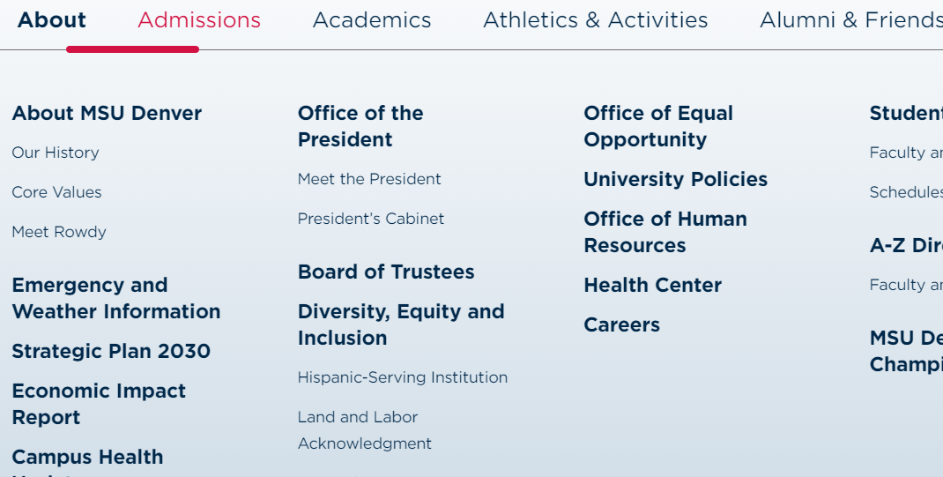
Research Everything
Understand the campus you are applying to
Review the mission, values, etc. about the university, college, and department.
Know your location
Is this a state you are familiar with or can see yourself fitting in?
Urban vs Rural – where are you comfortable?
Can you afford to live here? Check Sperlings Best Place Cost of Living
Know yourself
Are the place and culture good fits for you?
Image: Menu of content from MSU Denver home page. The About menu includes topics Our History, Core Valueshttps://www.msudenver.edu/cadre/

Slide 5
Learn the Language of the Job Market
Read job descriptions regularly and strategically to help you draft your application materials and to prepare for interview.
What is the content focus of the position?
What key words/concepts are present?
When is the end date? Do you have enough time to apply?
Is the job teaching or research heavy?
Are there publication or funding expectations?
What is the course load?
Does the job involve advising students?
What are the mentoring responsibilities?
What are the service expectations?
What is the allotted time for research? What resources and support are provided?
Let’s look at an announcement:
Assistant Professor of English Instruction, Metropolitan State University

Slide 6
Understand the Required Materials
Have drafts of frequently requested documents
Content needs to be different between documents
Put the paragraphs in the order of the minimum qualifications, if possible
Tailor your documents for each position
Understand Minimum Qualifications vs Desired Qualifications
Frequently Requested
Cover Letter
Curriculum Vita (CV)
Statements
Diversity
Teaching
Research
Position
Purpose
Writing Sample
Syllabus Sample
Portfolio

Slide 7
Things to Remember
Write for an academic audience.
Tone, structure, organization, style
Draft, review, revise, and polish all documents
Create an organization system early.
Master copies of important documents
Log of jobs and status of your application
Your notes about jobs, interviews, and goals
The purpose is not to “sell” yourself to the reader, but to tell your story and give the reader the opportunity to invite you to add their organization to it.
Be genuine
Be honest
Be confident

Slide 8
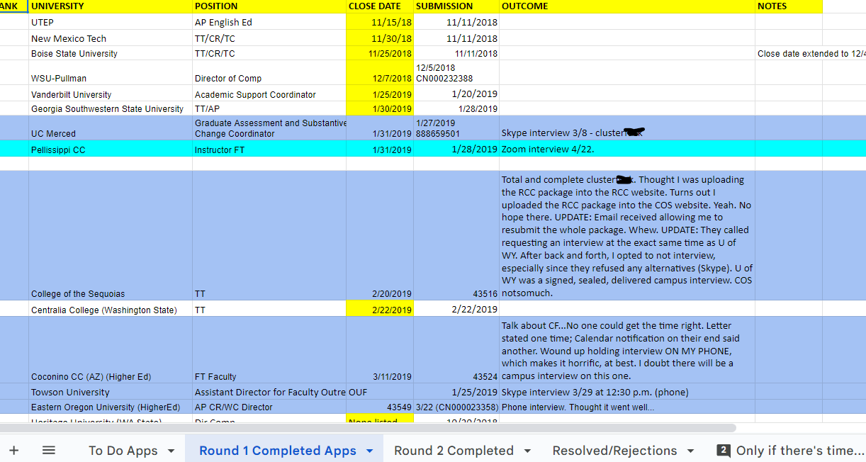
Jill’s Management System
https://docs.google.com/spreadsheets/d/1X29rzjbJhxsZwwQ-mOsxqLtmE2eC7plLofWXxRwFw9g/edit?pli=1#gid=0

Slide 9
Preparing for the interview is part of the writing process
What you write represents you, your needs, and your goals
Researching the job, department, institution, city, etc. includes reflection and critical thinking
So does researching the process. What do you need to know?
From phone/Zoom interview to campus visit
What happens on campus?
What are common interview questions?
What happens if you get an offer?

Slide 10

Questions?
Contact Us
Jill Dahlman, PhD
Jill.Dahlman@cnsu.edu
Andrea Hernandez Holm, PhD
ahholm@Arizona.edu
Image: Gray stones balanced precariously in an arch. The center stone is a brown color. The ocean is in the background.

