Slide 1


Welcome to “Genres of the Job Market” ft. Jill Dahlman and Andrea Hernandez Holm
Introduce yourself in the chat.
Please mute yourself and turn off your camera.
If you have any technical difficulties, please message OWCA Events in chat or email us at events@onlinewritingcenters.org

Slide 2

Thank you!
To the presenters:
Jill Dahlman and
Andrea Hernandez Holm
To the interpreters:

Slide 3




Participation Guidelines
Note that we are recording
Chat us if you cannot see the sign language interpreter
Keep audio off until Q&A
Post comments and questions in the chat at any time

Slide 4
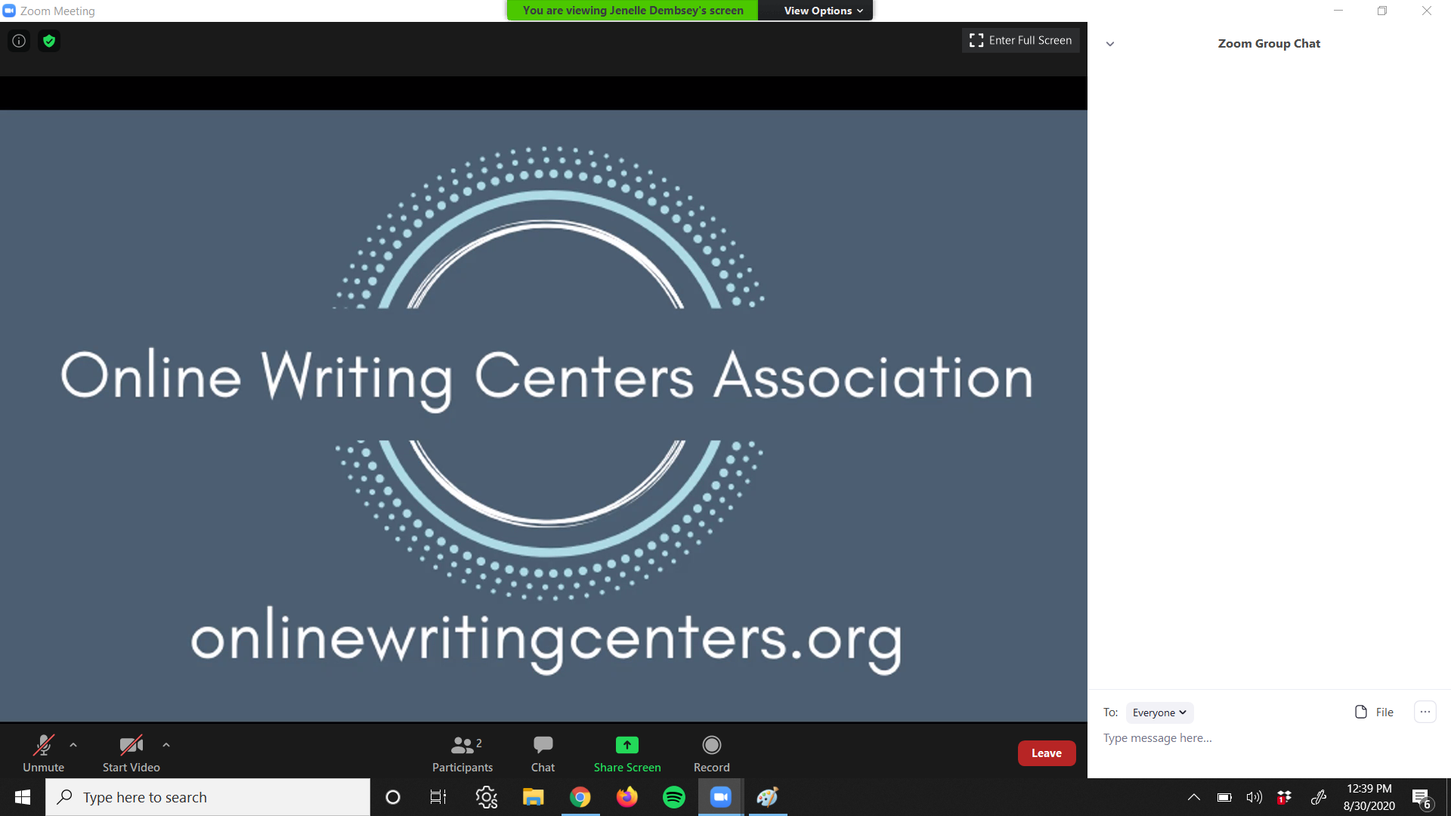
How to find the chat panel in Zoom

Slide 5
Upcoming Informational Session
“So You Want to Present at a Conference?”
Do you have ideas that can start a conversation? Have you done research that you want to share? Is there a workshop you feel is invaluable for others to participate in? Using the CFP for the OWCA’s 2024 Virtual Conference, this event will review what a CFP asks and what a strong proposal contains. There will be time for a Q&A as well as individual feedback on your proposal draft.
Sep 22nd @ 2PM Eastern

