Slide 1

Perspectives on Asynchronous Tutoring: The Case of the Writing & Communication Center (WCC) eTutoring Service for Correctional Education
Dr. Maura Grady, Director of Composition
Mohsine Bensaid, WCC Director

Slide 2

Who are we/our students?
Ashland University has the longest continuously operating higher education in prion program in the US (since 1964)
approx. 3,000 students taking online classes through either Corrections Blackboard or Lantern (Canvas-based) on special tablets (kiosks) or laptops (LAN)
Students have no access to web-based internet
Associate’s and Bachelor’s degrees available in several majors with General Education requirements.
We serve 13 states and the District of Columbia; 4 time zones

Slide 3
Why Writing & Communication eTutoring for students in online classes in prisons?
Solid model: Math eTutoring had a positive response and served as a guideline, esp. for content-based programs.
Parity of services: Students in main campus and traditional online classes have access to the Writing and Communication Center (WCC)
Building a skill foundation: The courses in English and communication build foundational skills and knowledge that prepare students for other classes and contexts
Another resource for learning: The students have access to their professors through their courses but often have additional questions

Slide 4
How does WCC eTutoring work?
After a successful pilot of 4 English classes, the service has expanded to assist students with other types of assignments (not just written assignments in English classes)
The WCC eTutoring “course” is organized by module and students can submit questions or writing sample of up to one paragraph via the assignment embedded in each module
The eTutor responds to the student via the assignment, showing up as assignment feedback
eTutors respond within 24-48 hours of submission time during the week, with a guideline to be “on duty” four days per week
Support is asynchronous, with all communication conducted through the assignment
Students in English, Communication, Religion, History, & IDS courses are automatically enrolled in the WCC eTutoring course.

Slide 5
What is the role of the eTutor?
The eTutors are qualified instructors with graduate degrees
The eTutor is there to answer questions and give feedback
The eTutor completes a Client Report Form for every student interaction
The eTutor is not a replacement for the student’s instructor in the main course
The eTutors are not editors nor proofreaders. They clarify, support, and guide
They are not expected to be content experts in all disciplines.

Slide 6
What type of questions/requests can students submit?
Help understanding the prompt
Help understanding writing and communication concepts
Help with punctuation or grammar rules
Help with outlining and organization
General questions: These are specific questions about a variety of topics that come up in writing and speaking

Slide 7
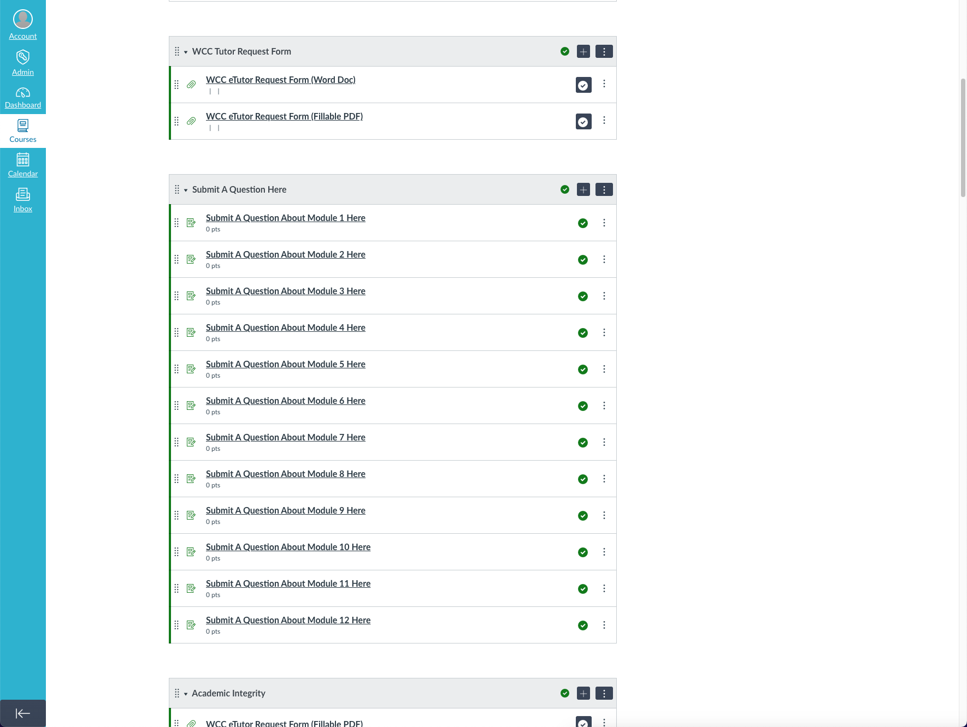
Student Request Form in Lantern

Slide 8
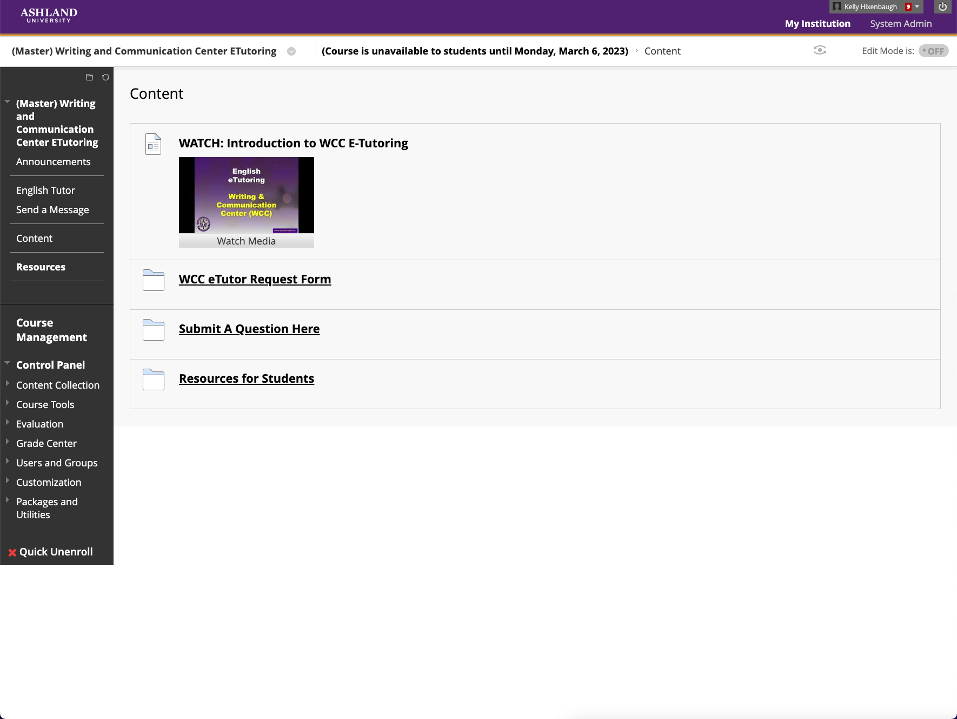
Student Request Form in Blackboard

Slide 9
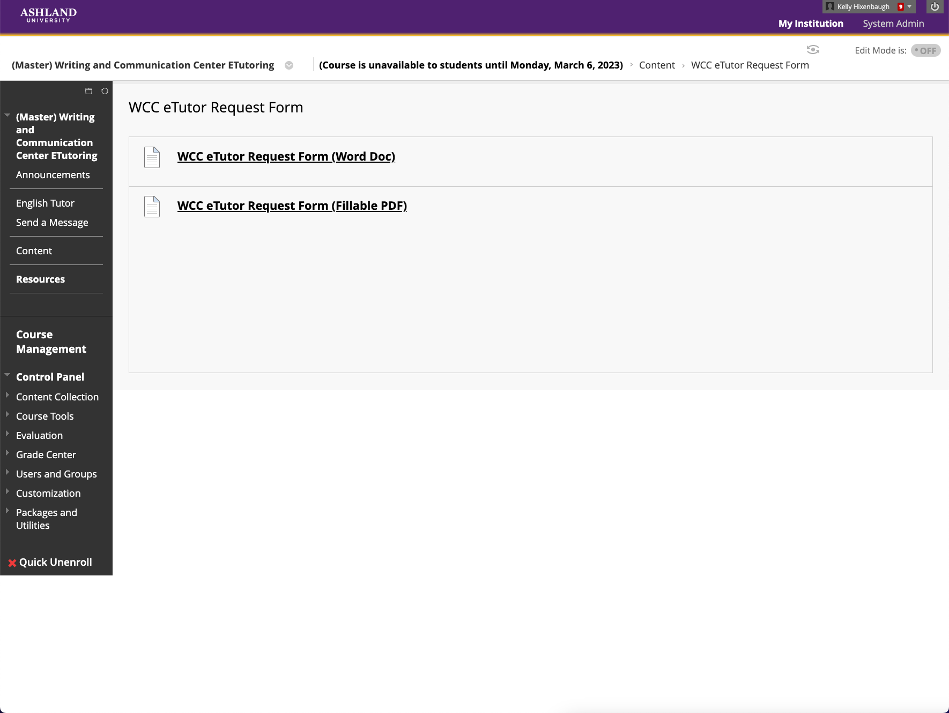
Student Request Form in Blackboard

Slide 10
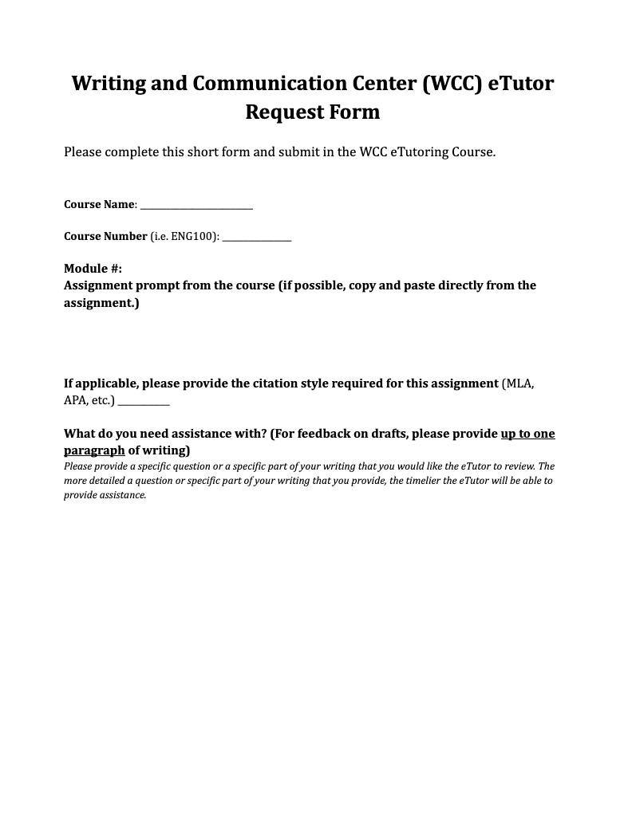
Student Request Form

Slide 11
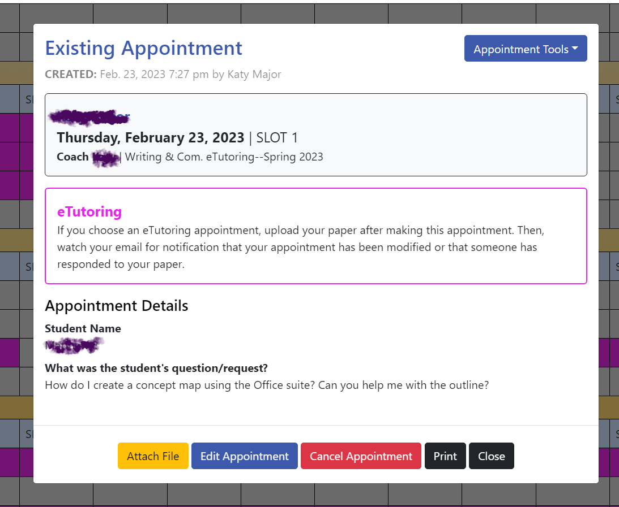
WCOnline Student Request

Slide 12
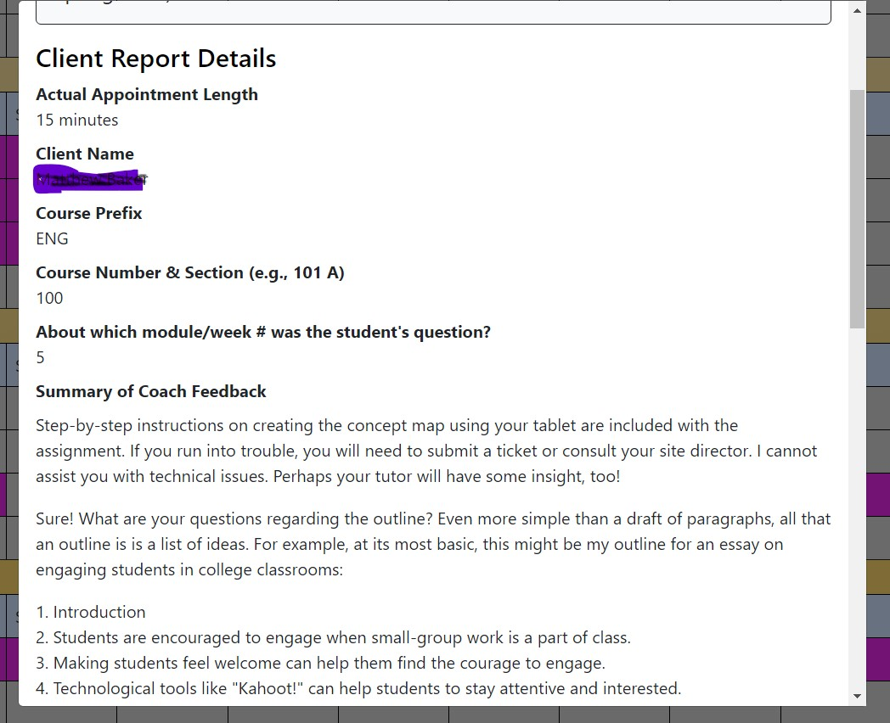
WCOnline Client Report Form

Slide 13
Student Feedback
⧫“I really appreciated having this resource available. We don't have many resources, so being able to ask questions with a prompt reply is invaluable to us as inmates.”
⧫“I was very impressed with the system. The E tutor was quick in her reply to any request. She was kind and encouraging as well. For an English student, encouragement is needed during the writing process. Great resource! She also helped me gain a better understanding of thesis statements as well.”

Slide 14
Student Feedback (Cont’d)
⧫“I did not have to use the E-tutoring service this semester. I felt I had a good understanding of the course, but I felt good knowing there was help available if I needed it.”
⧫“I did not utilize the E-tutor for English 101, hopefully it will be available in English 102.”

Slide 15

Q & A

Slide 16
Our Questions
Have you had any experience providing asynchronous support to students with limited access to technology? What measures have you taken to overcome this challenge (or similar challenges)?
Have you employed other forms of asynchronous feedback (e.g. audio or video feedback) to accommodate diverse needs?
Do you know of any opportunities for funding asynchronous tutoring services?

Slide 17

mgrady3@ashland.edu
mbensaid@ashland.edu
wcc@ashland.edu

