Slide 1
The Barriers of Multimodal Tutoring: Preparing Tutors for Diverse Approaches to Feedback
Presented by:
Greta Silva-Milian, Tara Thompson, and Colton Wansitler

Slide 2
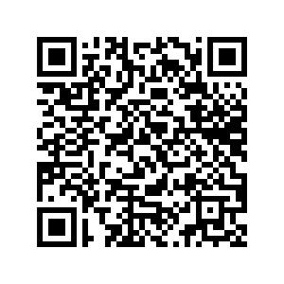
Scan this QR code to access the prepared script

Slide 3
College of Lake County’s Land Acknowledgement
We respectfully acknowledge that the College of Lake County is on the ancestral homelands of the Kickapoo, Peoria, Potawatomi, and other Native Peoples. We recognize the longstanding significance of these lands for Indigenous Peoples past, present, and future. Historical awareness of Indigenous exclusion and erasure is critically important to preventing further atrocities. The College of Lake County pledges to acknowledge the grave injustices of the past and pledges to create awareness and advance education that invites truth.

Slide 4
Introductions
Colton Wansitler (he/him/his) - Writing Center Coordinator
Tara Thompson (she/her/hers) - Lead Tutor, Writing
Greta Silva-Milian (she/her/hers) - Lead Tutor, Lakeshore

Slide 5
History
Tutor Preparations
Writing Center at CLC
Tutoring Center Reorganization
ENG 260 - Introduction to Writing Center Theory and Practice
Tutor Orientations
Mentorship
Professional Development
Tutoring Center
Writing Center

Slide 6
Questions
What modes of feedback does your institution offer to students (video conferences, asynchronous conferences, etc.)?
How does your institution prepare tutors to provide multimodal feedback?
In what ways is your institution struggling to prepare tutors for multimodal feedback?
What can your institution do to better prepare tutors for multimodal feedback?

