Slide 1


Developing Curated, Accessible, Course-Specific Resources in the Writing Center
Presentation by Professional Tutors
Barbara Seasholtz, MA-TESL and Ruth Grove, MEd
York College of Pennsylvania
2023
Writing and Communications Studio
Notes:
Hi. My name is Ruth Grove, one of the collaborators on this project.
And I’m Barbara Seasholtz .Both Ruth and I work as professional tutors in the York College of Pennsylvania Writing and Communications Studio.
Our presentation, “Developing Curated, Accessible Course-Specific Resources in the Writing Center” aims to encourage writing center administrators to consider how they might create a multimodal, curated resource that is course-specific based on institution needs and fully accessible to student writers as well as tutoring staff.
Identifying your rationale for the resource is one of the initial steps. Ruth will outline the rationale of our course-specific resource.

Slide 2

Quotation from Samuel Johnson
Knowledge is of two kinds. We know a subject ourselves, or we know where we can find information upon it.
Samuel Johnson
Notes:
Facilitating learning is a core objective of every writing center. Gaining knowledge is the ultimate student goal, and knowing where and how to find answers to build knowledge was an underlying inspiration for our resource. We set out to meet the evolving needs of our students by creating an accessible, multimodal resource.
Our resource has synergistic benefits: it facilitates clarity of course-related concepts, expectations, and outcomes for tutors during tutoring sessions and for students working on their own.
During this presentation, we’ll outline our process for developing this type of resource for students, tutors, and faculty.
Barbara will begin by discussing the important first component: institutional relationships.

Slide 3

Pre-project considerations
BACKGROUND
CONSIDERATIONS
Learning Management System (LMS): IT Dept.
Relationships/Needs Assessment: Faculty, Tutors
Pre-Prep: Familiarization with course content
Notes:
Making sure we had the capability in terms of technology and the buy-in from faculty was our critical first pre-design step.
Based on feedback from tutors, we reached out to select faculty of a specific course required for all students at our institution to obtain their feedback about student performance. We also requested the course curriculum and teaching guide for faculty.
Technology was another pre-design consideration. We reached out to the IT department to enquire about creating a home for our resource in the learning management system.
We then familiarized ourselves with course assignments, concepts and outcomes and gleaned areas in which we thought students would benefit from support.
Further, we developed a timeline to carry out the project during half a summer semester, which is typically a slower time for tutoring visits.

Slide 4

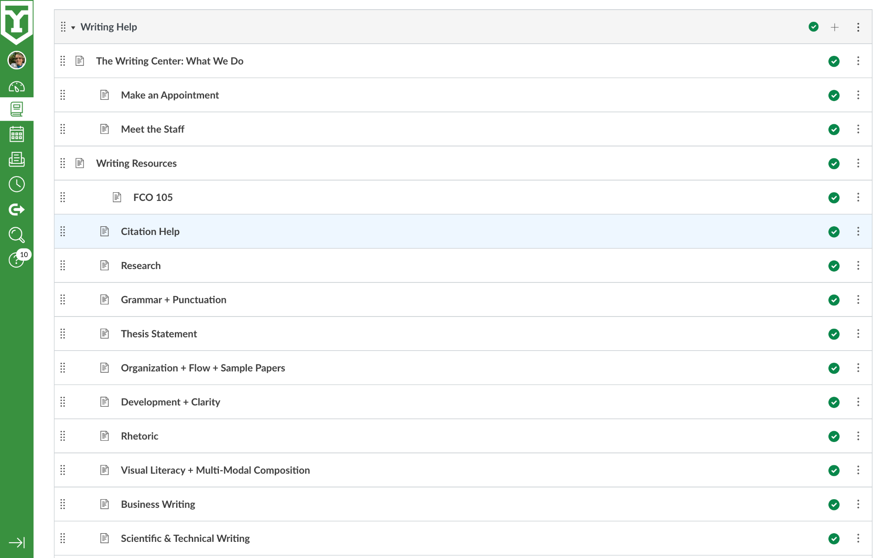
Our Writing Center Canvas Page
Notes:
York College of Pennsylvania uses Canvas as its Learning Management System. Prior to our work on this project, we had created a general writer’s resource page in Canvas available to all students across the college on a 24/7 basis. Given the success of that page, our director’s vision was to develop course-specific resources that were also accessible at all times through the LMS.
This slide displays the interface of the general resource available to all students. The class we developed the course-specific page for is FCO 105, which is easily visible in the general resource list and quickly accessed from the general page options.
Barbara will explain why we chose the word ‘curated’ to describe this presentation.

Slide 5
Curated
CURATED
Determine type of resource needed to align with content goals
Ensure sources were academic, not commercial websites
Ascertain sources were level-appropriate resources for both students and peer tutors
Focus on academic search engines as well as organizational and reference websites
Determine if new resources needed
Assign resource development to available personnel
Notes:
One concept we focused on as part of the design of the resource was “Curation.” While this word has become a buzzword to describe everything from clothing collections to household goods, it perfectly describes the process we employed.
Creating a curated resource was important to us because our content goals included ensuring the resources had a clear connection to the coursework and avoiding the inclusion of too many resources or resource overload.
Further, students who search on the Internet for writing help often encounter essay writing services, subscription solicitations, and information that may not be pertinent to their course. We wanted to help students avoid this frustrating search for information.
Our experience in tutoring for the FCO105 class has given us insight into the roadblocks students most often face, so we searched carefully for resources that squarely met each course objective.
Where we could not find resources that lined up with course objectives, we created them or asked student tutors for samples of their work since they had already completed the course.

Slide 6
Inclusive
INCLUSIVE
TYPES
Multimodal resources
Level-appropriate resources for both students and peer tutors
YCP student samples/models
Invitation links to tutoring
Links to other college resources like library, APA/MLA, etc.
Notes:
Not only did we need to curate the resource to be narrow enough for our focus, but we also needed to make the resource inclusive enough to encompass a variety of sources.
Materials needed to be multimodal to touch on the variety of ways students connect to content.
We also wanted to include student samples as models. Since peer tutors had already taken this class, their own work could serve as a resource.
Another goal of this resource was to help students easily access links to campus resources such as the tutoring center and the library.
Additionally, we wanted our peer tutors to have a reference so they could answer course content questions.
Layout and formatting of the information are important elements that Barbara will provide details on next.

Slide 7
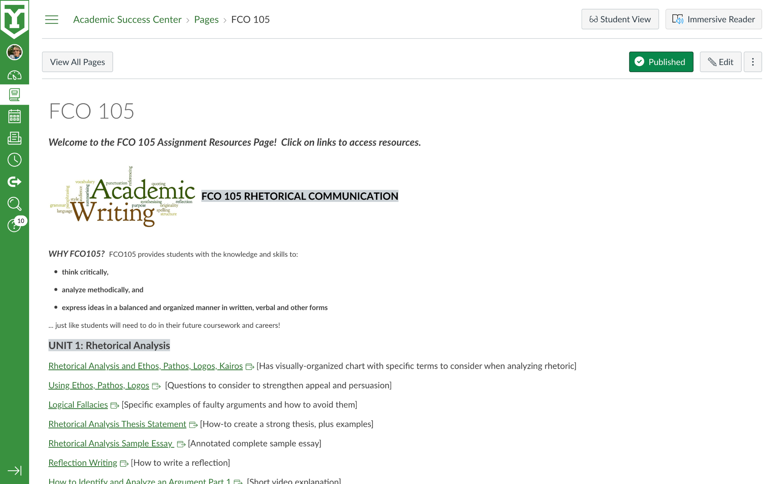
Our FCO 105 page
Notes:
Once a student or tutor accesses the FCO 105 page, they first arrive at learning objectives for the class.
The page is organized by unit as covered in the course and the units are made salient through bold lettering, a larger font size and wording that matches what faculty are using in class.
The order of the links follows the concepts presented within a unit, as laid out in the instructors’ guide for the class.
Each link has a brief description in brackets. We also use visual cues like bullets to help move students intentionally through the information.
Our goals were to make navigation simple and clearly show connections to coursework. We wanted students to look at the page and easily identify resources matching course assignments and concepts because we employed their course vocabulary.
Finally, we added an invitation for students to make an appointment with a tutor and included a live link to our tutoring schedule to encourage tutoring use.

Slide 8
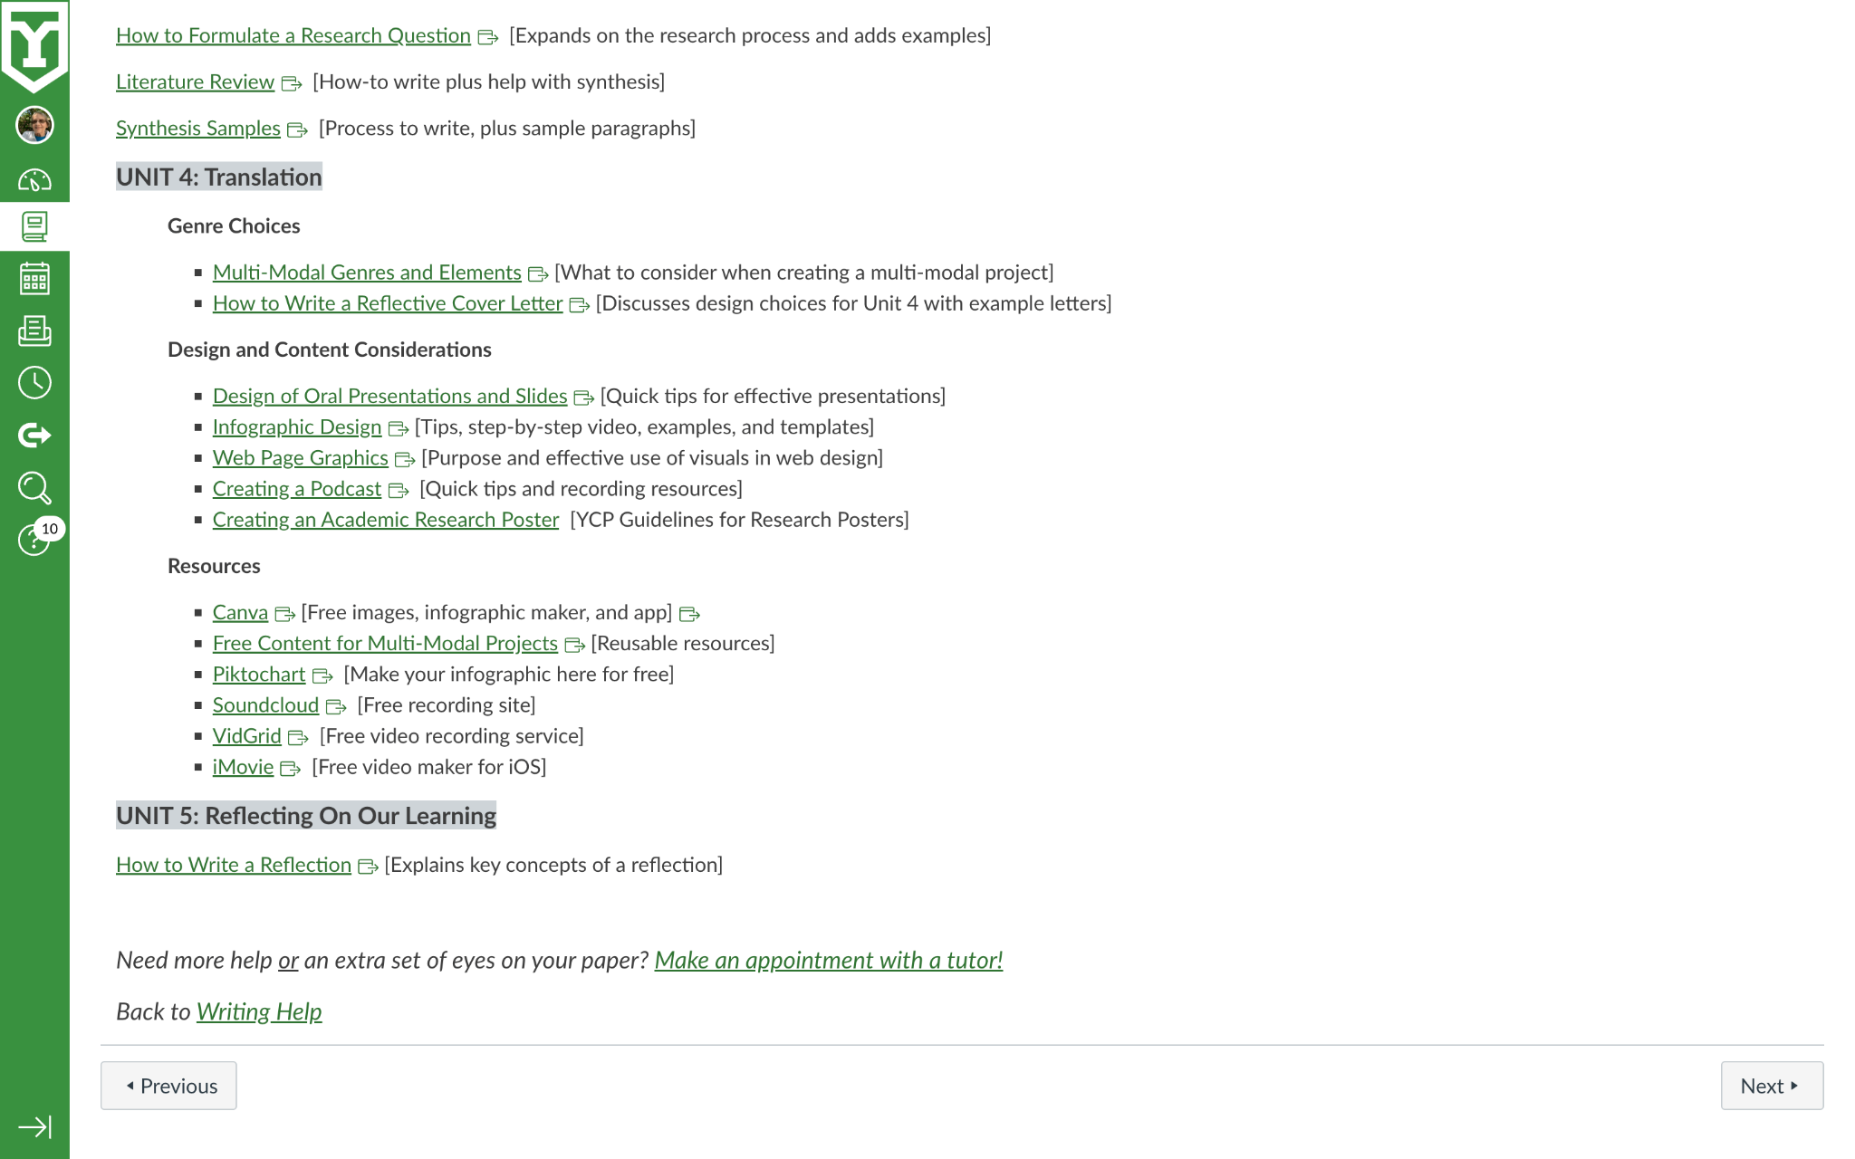
The variety of our sources
Notes:
Once a student or tutor accesses the FCO 105 page, they first arrive at learning objectives for the class.
The page is organized by unit as covered in the course and the units are made salient through bold lettering, a larger font size and wording that matches what faculty are using in class.
The order of the links follows the concepts presented within a unit, as laid out in the instructors’ guide for the class.
Each link has a brief description in brackets. We also use visual cues like bullets to help move students intentionally through the information.
Our goals were to make navigation simple and clearly show connections to coursework. We wanted students to look at the page and easily identify resources matching course assignments and concepts because we employed their course vocabulary.
Finally, we added an invitation for students to make an appointment with a tutor and included a live link to our tutoring schedule to encourage tutoring use.

Slide 9
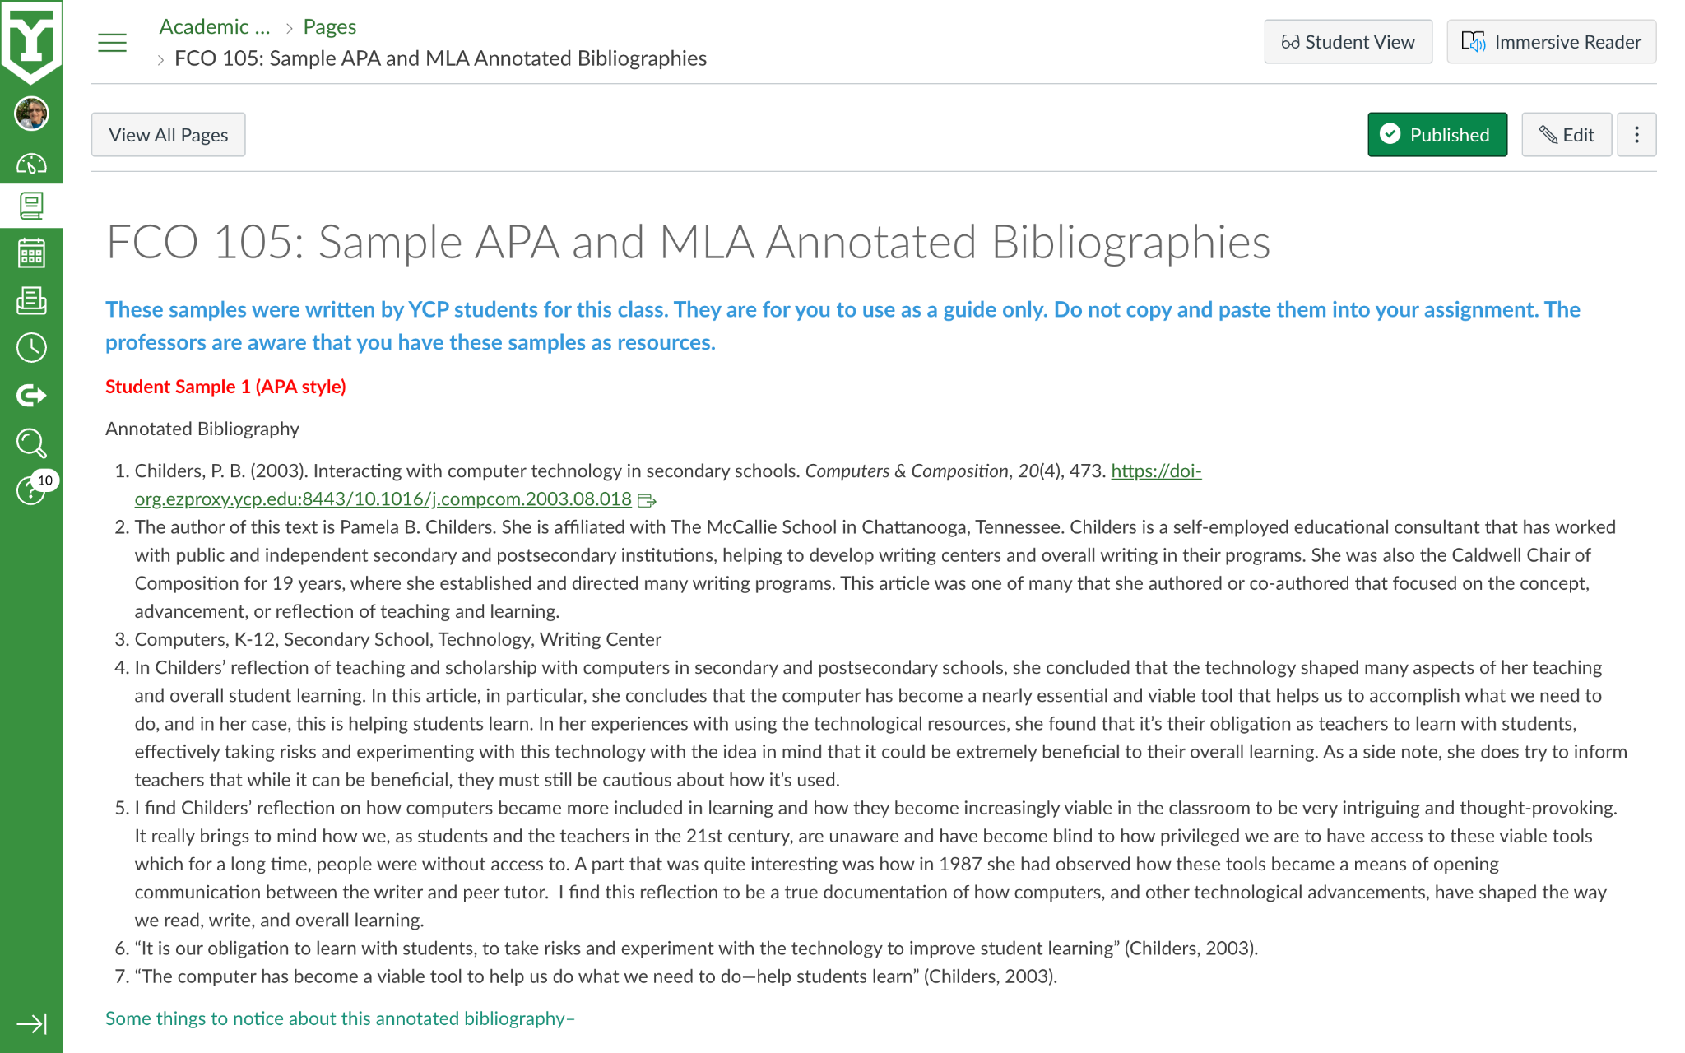
Student samples of the annotated bibliographies

Slide 10
Accessible
ACCESSIBLE
PROCESS
Determine where resource would live
CONSIDERATIONS
Closed-captioning
Level-appropriate language

Slide 11
Impact
IMPACT
Data
Anecdotal evidence

Slide 12
References
REFERENCES
Thanks for coming!
Crank, V. (2012). From high school to college: Developing writing skills in the disciplines. The WAC Journal, 23(1), 49-63.
Dembsey, J. M. (2020). Ableism in the Writing Center. Praxis: A Writing Center Journal, 18(1),
Paiz, J. M. (2018). Expanding the Writing Center: A Theoretical and Practical Toolkit for Starting an Online Writing Lab. TESL-EJ, 21(4), n4.
Emails: bseasholtz@ycp.edu, rgrove@ycp.edu

