Slide 1
Ready, Set, Go?
An Administrative Approach to Supporting Multimodal Tutoring Online
Julie Johnson Archer, Bethany Bibb, & Allie Johnston

Slide 2
Introductions
Facilitators
Workshop goals & plan
Working definition of multimodal

Slide 3
Center Readiness
Bethany Bibb

Slide 4
Guiding Questions
What type of online writing center are you running or working to build, e.g., fully online, hybrid, etc.?
What do you and your center need to know, have, or do to support multimodal online tutoring?
Notes:
Pandemic pivot = “pedagogical triage”

Slide 5
Pandemic Priorities & Realizations
Priorities
Expediency and efficiency
Focus on modality and technology:
Fast
Free (or low cost)
(Fairly) easy to use
Realization
Lack of or limited access: “limited access to strong Internet connection, whether because of lower income, disenfranchisement, or rural geography” (Nejezchleb, 2020)
Notes:
Pandemic pivot = “pedagogical triage”

Slide 6
Post-Pandemic Priorities
Emphasis on students and pedagogy
(Re)assessment of modality and technology:
Access and reliability (Stewart, 2021; Martinez & Olsen, 2015)
Accessibility and usability (Cecil-Lemkin & Johnson, 2021; Martinez & Olsen, 2015)
Notes:
Pandemic pivot = “pedagogical triage”

Slide 7
Students & Pedagogy over Technology
“The key point here is not that any of these tools are inherently problematic, but that instructors should think first about pedagogical considerations, learning goals, and student realities rather than starting with available technologies” (Sheppard, 2021, pp. 66-67)

Slide 8
Assessing & Reassessing Center Readiness
Start with – and at – the center.
Assess/reassess four main considerations:
Students
Locations and environments
Modalities
Technologies and equipment

Slide 9
Activity 1: Assessing Center’s Readiness for Multimodal Tutoring
On the OWCA conference program website, locate and download our Workshop Activities Handout file.
Choose two main considerations to assess/reassess and answer the questions for them.
You’ll have 10 minutes for this activity before we move on, and you’ll have an opportunity to share your responses during the discussion time at the end of our workshop.

Slide 10
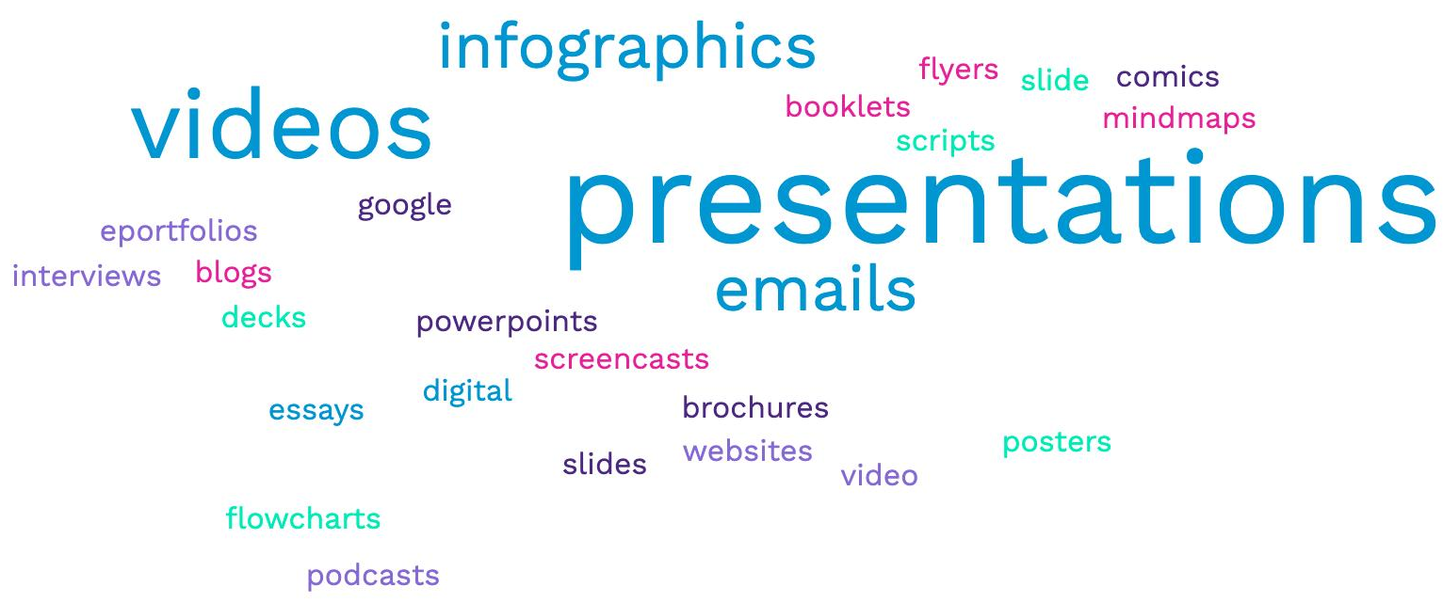
Tutor Readiness: Technology Skills
Image credit: Julie Johnson Archer

Slide 11
Writing Center Training
"There is no substitute for writing center training for multimodal composition. While other forms of training are beneficial, including workshops and English classes, they are not as effective . . . Writing centers should consider how they can incorporate multimodal training into orientations, continued training, writing center classes, and more" (Cheatle, 2020, p. 26).

Slide 12
Tech savvy or not…
What technical training do tutors need to be ready for multimodal tutoring online?
Suggestions:
Develop a survey to assess tutors’ technical confidence and skills. Joseph Cheatle’s (2020) survey is a good place to start!
Ask tutors to train the staff based on their knowledge (Del Russo & Shapiro, 2019).

Slide 13
Tech Considerations
Technologies
Microsoft Word
PowerPoint
Google Slides
Google Docs
Zoom
Adobe Acrobat
What others come to mind?
Contexts
Asynchronous vs synchronous context
Hybrid context
Tutor time and labor
Accessibility
Closed Captioning
Inserting comments

Slide 14
Activity 2: Assessing Tutors’ Technical Readiness for Multimodal Tutoring
Activity 2 on the Workshop Activities Handout
What technologies/software are needed for the multimodal compositions students work on in your institution?
What do you know already about your tutors’ technological preparedness, and what pieces of data are missing?
What technological training do you already offer, and what might be needed for tutors to be ready for appointments?

Slide 15
Tutor Readiness: Rhetorical Framework
Allie Johnston

Slide 16
Preparing Tutors with a Multimodal Mindset
Why is this important?
Aligns with larger goals of writing centers in justice work and flexibility to support students of all learning styles
“Providing additional training to writing tutors to prepare them to work with students on multimodal projects allows them to begin the work of restoring justice because the ‘job of the tutor is to help human beings…’” (Fitzgerald & Ianetta, 2016, p. 167).

Slide 17
Rhetorical Considerations
"The most significant area of training is in understanding the implications of technology on different rhetorical considerations. While respondents may feel comfortable commenting on things like visuals and presentation technology, they are much less confident in thinking about the intersections of technology with gender, race, sexual orientation, class, and national identity"
(Cheatle, 2020, p. 26).

Slide 18
Challenges Benefits
Tutors have varying levels of experience with multimodal assignments.
Multimodal assignments may range from visuals to audio and more.
Tutors have the opportunity to share their viewpoint as an audience member consuming the multimodal work.
Tutors have the opportunity to exercise what they do best: genre awareness.

Slide 19
Practical Considerations
As a center, have digitally available resources for equipping tutors:
Text and font
Color theory
Consistency of modes/blending modes
Use of white space/pause
Partnership of alphabetic text and images
(Hotson 2022); (Sabatino & Fallon 2019).

Slide 20
Activity 3: Assessing Tutors’ Rhetorical Readiness for Multimodal Assignments
Turn to the shared document we’ve been building on throughout this workshop.
Reflect on your writing center’s context and current support towards students with multimodal assignments.
Would your tutors feel comfortable in assisting students with multimodal assignments, especially in an online format (synchronous and asynchronous settings)?
If not, what are the major concerns of your tutors/what aspects of multimodal assignments in tutoring sessions make them uncomfortable?
How can you build your tutors’ confidence in participating as an audience member for a multimodal assignment?
What steps can your center take to provide tutors with resources to support them in giving effective feedback for multimodal assignments?

Slide 21
Group Discussion
21

Slide 22
Q&A
22

Slide 23
References
Cecil-Lemkin, E., & Marvel Johnson, L. (2021). Expanding disability access: Developing your multimodal toolkit for writing center sessions [Conference presentation]. Online Writing Centers Association (OWCA). https://www.onlinewritingcenters.org/scholarship/cecil-lemkin-etal-2021/
Cheatle, J. (2020). Multimodal composition in writing centers: The practical, the problems, and the potential. SDC: A Journal of Multiliteracy and Innovation, 24(1). https://southeasternwritingcenter.wildapricot.org/resources/SD_Archive/articles/24_1/SDC_24_1_Spring_2020-Cheatle.pdf
Del Russo, C., & Shapiro, R. (2019). Multimodal tutor education for a community in transition. Writing Lab Newsletter, 44(1–2), 19–26.
Hotson, B. (2022). “I don’t know, let’s play”: Multimodal design support in the writing centre. Canadian Writing Centres Association. https://cwcaaccr.com/2022/02/03/multimodal-design-support-in-the-writing-centre/?amp=1
Martinez, D., & Olsen, L. (2015). Online writing labs. In B. L. Hewett & K. E. DePew (Eds.), Foundational Practices of Online Writing Instruction (pp. 183-210). The WAC Clearinghouse. https://wac.colostate.edu/docs/books/owi/chapter5.pdf

Slide 24
References, cont’d.
Nejezchleb, A. (2020). Answer if you have callers: Phone tutoring in the writing center. WLN: A Journal of Writing Center Scholarship, 45(3-4), 9-16. https://www.wlnjournal.org/archives/v45/45.3-4.pdf
Sabatino, L. D., & Fallon, B. (Eds.). (2019). Multimodal composing: Strategies for 21st century writing consultations. UP of Colorado.
Sheppard, J. (2021). Pandemic pedagogy: What we learned from the sudden transition to online teaching and how it can help us prepare to teach writing in an uncertain future. Composition Studies, 49(1). https://files.eric.ed.gov/fulltext/EJ1307828.pdf
Stewart, M. (2021). Student-teacher conferencing in zoom: Asymmetrical collaboration in a digital space/(non)place. Kairos, 25(2). https://kairos.technorhetoric.net/25.2/praxis/stewart/index.html

Slide 25
Contact Us
Julie Johnson Archer – julie.johnson@acu.edu
Bethany Bibb – bethanybibb@suu.edu
Allie Johnston – johnstona@apsu.edu

