Slide 1
Empowering Learners through Feedback in Online Environments
Nadia Moraglio, MA
Writing Specialist
Writing Skills Improvement Program (WSIP)
University of Arizona
Notes:
Hello, everybody. My name is Nadia Moraglio, and I am a Writing Specialist at the Writing Skills Improvement Program at the University of Arizona. My presentation is about Empowering Learners through Feedback in Online Environments.

Slide 2
Today’s Presentation
Tutoring Roles
Student Needs
Student Voices
Student Agency
Non-Evaluative Feedback
Notes:
I will discuss my tutoring roles, our students’ needs and their voices, and also how non-evaluative feedback helps foster students’ agency.

Slide 3
My Role as Tutor
Listen to and understand students’ voices and needs
Act as students’ audience for their writing
Provide formative (non-evaluative) feedback to help address their needs and move forward in the writing process
Build “rapport, respect, relationship” through conversations in different modalities (in person, online, synchronous, asynchronous)
Guide students to find their voice as writers
Empower students as writers and academics
Notes:
My role as a tutor is to:
Listen to and understand student voices and needs.
Act as students’ audience for their writing, and especially,
Provide formative and non-evaluative feedback to help address their needs and move forward in the writing process.
I aim to build, rapport, respect, and relationship through conversations in different modalities, whether those are in-person, online, synchronous, or asynchronous.
I guide students to find their voices as writers, so that I can finally empower them as writers, and also as academics.

Slide 4
Student’s Needs
Many writers struggle with voicing their ideas because of varied reasons.
Some include:
Biases
Discrimination
Negative feedback
Writers’ block
Notes:
Our students' needs are varied. Many students struggle with voicing their ideas because of varied reasons. Some may include biases and discriminations that stem from their first or second language, where they come from, their educational backgrounds, among many others., Negative feedback is detrimental for our students, as they focus on what they do not know, instead of what they already do, and they do it well, and that will lead to writer's block so that students do not know how to move forward in the writing process.

Slide 5
Establishing a Conversation
Asking questions (needs, writing goals, concerns)
What is it that you want to convey in your writing? What prevents you from saying that?
What areas (structure, development, flow, etc.) would you like to address?
What is one area you would like to focus on?
What concerns you?
Notes:
Asking questions is essential to establish a conversation with our students, to find out their needs, their writing goals, and concerns.
Some questions I would ask them are:
What is that you want to convey in your writing? What prevents you from saying that?
What areas like structure, development, or flow would you like to address?
What is one area you would like to focus on?
And, finally, what concerns you?
By establishing a conversation, I put the basis to finally talk about their writing, and what can help them the best to move forward.

Slide 6
Tutors as Audience
Focusing on what we read, hear, and feel instead of what’s incorrect:
I notice the tendency to switch tenses. The paragraph starts in the present tense, but all the examples are in the future.
I feel you introduce the topic, but the examples support another area.
I hear the repetition of similar words.
I see well-developed paragraphs in this section, but the next one seems limited.
Your text shows/indicates connections with prior research.
Notes:
I act as an audience for our writers, and I focus on what I read, hear, and feel, instead of what's incorrect. Some sentences I might say depending on the writing I read are:
I notice a tendency to switch tenses. The paragraph starts in the present tense, but all the examples are in the future.
I feel you introduced a topic, but the examples support another idea.
I hear their repetition of similar words.
I see well-developed paragraphs in this section, but the next one seems limited.
Your text shows or indicates a connection with prior research by saying such placement.
I point out what's there, and not what might imply a judgment so the students can check in to see if what the audience read is exactly what they wanted to say or not.

Slide 7
Non-Evaluative Feedback
Non-evaluative feedback is a type of formative feedback that focuses on:
Improving and moving forward without the pressure of a grade.
Informing the students what their writing is conveying.
Raising awareness of patterns noticed in their writing (Elbow & Belanoff, 1989)
Increasing student responsibility (self-assessment and self-correction) (Earl, 2003)
Providing information about progress, and/or about how to proceed. (Hattie & Timperley, 2007)
Notes:
and that is at the basis of non-evaluative feedback. It is a type of feedback that is formative in nature and focuses on:
Improving and moving forward without the pressure of a grade
Informing the students what their writing is conveying
Raising awareness of patterns noticed in their writing
Increasing students' responsibility, like self-assessment and self-correction, and
Providing information about progress, and or about how to proceed.

Slide 8
Feedback and Students’ Agency
To increase students’ agency, feedback should:
Empower learners to express their voice, identity, and the information they want to share.
Facilitate students to discover their writing voice, and not rephrase their sentences or edit for errors.
Allow learners to make sense of the information received.
Create opportunities for writers to make changes rather than telling them how to write their thoughts.
Notes:
Feedback increases students' agency, and as such feedback should:
Empower learners to express their voice, identity, and the information they want to share
Facilitate students to discover their writing voice and not just rephrase their sentences or edit for errors
Allow learners to make sense of the information received, and
Create opportunities for writers to make changes rather than telling them how to write their thoughts

Slide 9
Empower Students with Positive Comments
Your topic sentence is clear because it is specific.
Your explanation is relevant and supports your argument.
The vocabulary selection emphasizes the description.
You support the argument with a variety of sources.
Notes:
First of all, it's important to start empowering students with positive comments. For example, we could say:
Your topic sentence is clear because it's specific.
Your explanation is relevant and supports your argument.
The vocabulary selection emphasizes the description, and
You support the argument with a variety of sources.
When we emphasize what it's there, what’s already positive, then we can start tapping into anything that could change.

Slide 10
Turn Negative Comments into Engaging Questions
I don’t understand what you are saying. → I am not sure I follow your argument. Can you explain your claims in a different way?
You are off-topic. → What is the purpose of your assignment? Who is your audience? What are you trying to convey?
There is no logic. → What is the main point? What are you trying to prove? What is your evidence? Try to brainstorm or make a chart.
Notes:
But at the same time, we do not want to make negative comments; we can turn those into engaging questions.
For example,
“I do not understand what you're saying,” could be as I'm not sure I'm not following your argument. Can you explain your claims in a different way?
“You're off-topic.” What is the purpose of your assignment? Who is your audience? What are you trying to convey? Or,
“There is no logic.” What is the main point? What are you trying to prove? What is your evidence? Try to brainstorm or make a chart.
Such questions help students to think about what they want to say so that they can express that through their writing.

Slide 11
Feedback in Online Modalities
Synchronous meetings (Zoom, Google Meet) in conjunction with Google Docs or screen share.
Benefits:
Synch. meetings: Video/audio recordings, transcripts shared later with students (review meeting, ideas, feedback)
Google Docs: collaboration through in-text feedback (suggesting mode, bubble comments)
Screen share: Students make their own changes based on the discussion.
Notes:
Such feedback can be given in a variety of different modalities, and when we work online in synchronous meetings, we use Zoom or Google Meet in conjunction with Google Docs or screen share.
Synchronous meetings are great because we can make recordings and the transcript, and we can share those later with the students so that they can review the meeting, ideas, and feedback.
Such transcripts could be great for students who suffer from Writer’s Block because it could be the start of their brainstorming.
Google Docs is excellent for collaboration through the use of in-text feedback, When that is done in suggesting mode and bubble comments, students can see their text not being altered, but they can see the comments that refer to what they wrote.
And when we do screen shares, students make their own changes based on the discussion. So that's great because we're completely hands-off with their writing.

Slide 12
Editing vs Commenting
Editing: can be synchronous or asynchronous
Students passively accept comments
No revisions are needed as the tutor initiates revisions
Original sentence: Stephen Hayes developed a theory to study what is known in Behavioral Psychology as "verbal behavior." The theory developed by Hayes was named "Theory of Relational Frames".
Notes:
It's important to notice the difference between editing and commenting. Editing can be synchronous and asynchronous. Students passively accept comments, and there are no revisions needed as the tutor initiates the revision.
I will read one sentence as an example:
Stephen Haynes developed a theory to study what is known in behavioral psychology as verbal behavior. The theory developed by Haynes was named the Theory of Relational Frames.
My comments in Google Docs are in suggesting mode, but I’m already providing the students with the answer. I’m telling them to cross out the second sentence and to move the name of the theory in the first sentence. Students only need to accept their comments, so there is no action required on their end in terms of thinking about what sentences they want to write.

Slide 13
Comments as Tools for Student’s Agency
Notes:
A similar way to address the same sentence could be to make a comment that helps them to think and actually write.
So, I could say: to avoid repeating theory, try to connect the 2 sentences. Use the name of the theory right when you introduce it.
In this way, the students have their own agency to write their own sentences based on the comment.

Slide 14
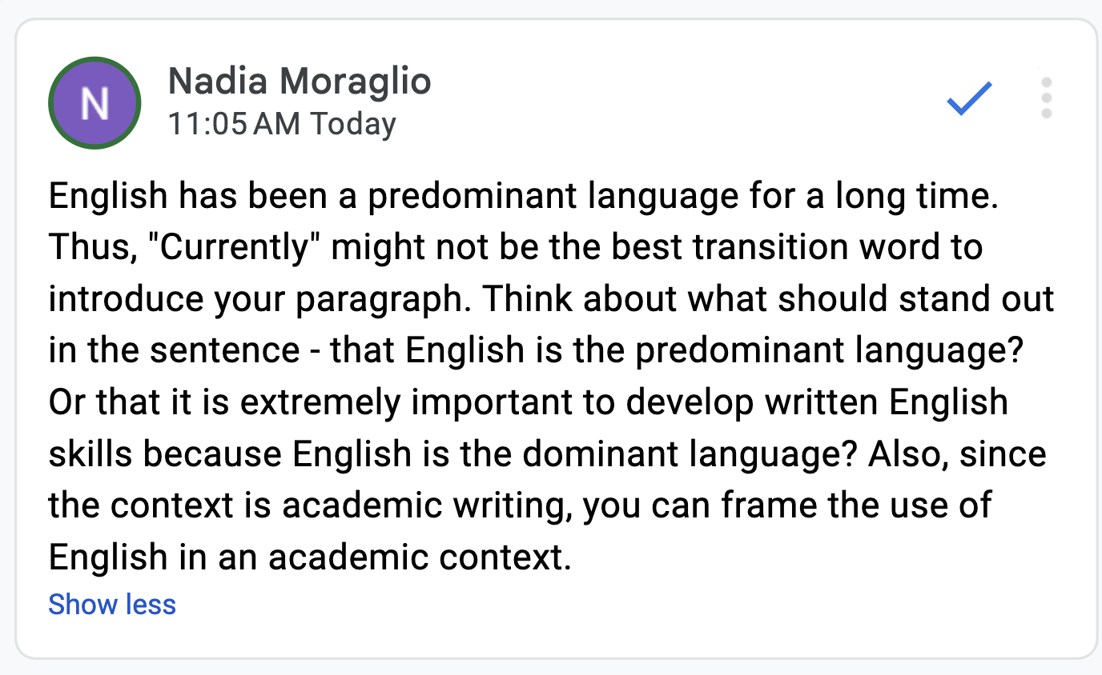
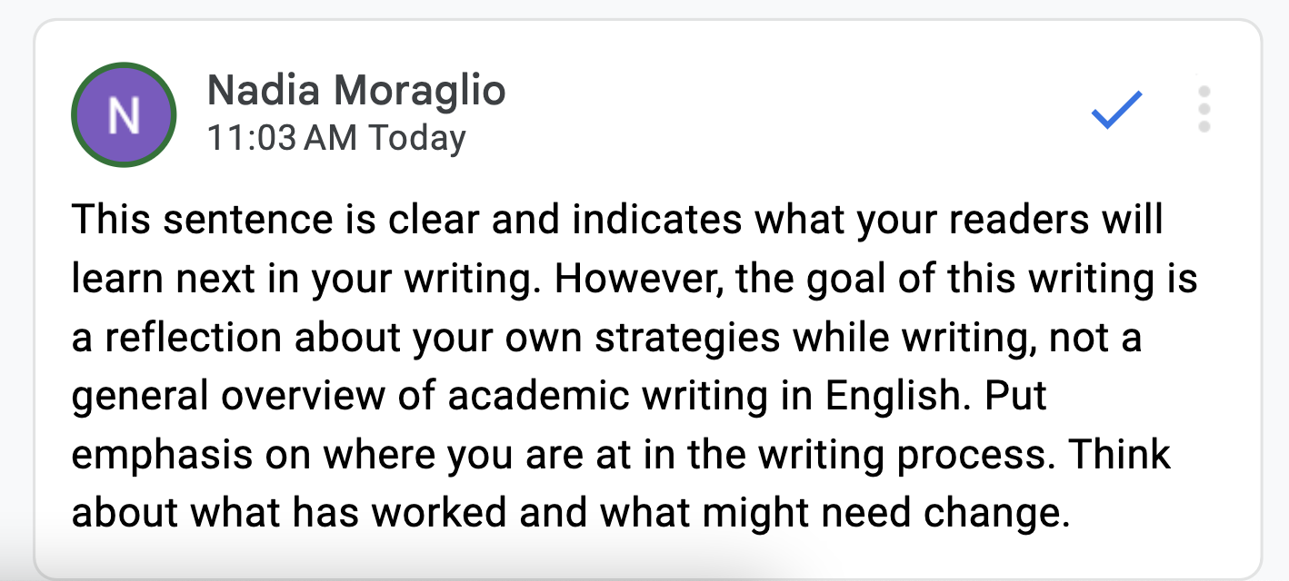
Provide Non-Evaluative Comments to Foster Growth
Notes:
Provide non-equality feedback comments to foster growth.
This is another example, and I will read the sample sentence first.
“Currently, English is a universal language, and it is extremely important to develop written skills as well as oral skills, which are often difficult for people who are not familiar with the language they are learning. However, there are strategies that help improve written skills in this language. This writing is about the importance of academic writing in English.”
My first comment is on “currently”: English has been a predominant language for a long time. Thus, "Currently" might not be the best transition word to introduce your paragraph. Think about what should stand out in the sentence - that English is the predominant language? Or that it is extremely important to develop written English skills because English is the dominant language? Also, since the context is academic writing, you can frame the use of English in an academic context.
My second comment is related to grammar, whom: “Whom” is correct, but its use is declining. "Who" tends to take over "whom" when grammar allows it.
And my final comment is on the last sentence: This sentence is clear and indicates what your readers will learn next in your writing. However, the goal of this writing is a reflection about your own strategies while writing, not a general overview of academic writing in English. Put emphasis on where you are at in the writing process. Think about what has worked and what might need change.
In this way, students have some basis to get started to think about how they want to change their paragraph.

Slide 15
Final Remarks
Effective feedback goes beyond its delivery; it includes:
Knowing your students (background, needs, concerns, goals)
Understanding their voices
Offering different types of feedback depending on need (local: sentences, grammar patterns; global: structure, organization)
Providing information that students can put into practice on their own
Using the modality that best fits your student’s needs
Notes:
So finally, effective feedback goes beyond its delivery, it includes:
Knowing your students’ background needs concerns or goals
Understanding their voices
Offering different types of feedback depending on need (for example, local sentences, grammar patterns, or global structure or organization).
Providing information that students can put into practice on their own.
Using the modality that best fits your student’s needs.

Slide 16
Thank you!
Online and in-person services:
Tutoring :
Individual by appointment, small group, and drop-in
Weekly Workshops
Online Writing Room
Editing
Job Market Prep
Writing Programs:
Graduate Writing Institute, Writing Boost!, Young Writers Institute
Nadia Moraglio
moraglin@arizona.edu
Writing Skills Improvement Program
University of Arizona
Notes:
So thank you for attending my presentation. This is my information and what our program offers.

Slide 17
References
Earl, L. (2003). Assessment as learning: Using classroom assessment to maximize student learning. Thousand Oaks, CA: Corwin Press.
Elbow, P., & Belanoff, P. (1989). Sharing and responding. Random House, NY.
Hirsh, J. (2018, January 21). Moving from Feedback to Feedforward [Blog post). Retrieved from: https://www.cultofpedagogy.com/pod/episode-87/
Hattie, J., & Timperley, H. (2007). The Power of Feedback. Review of Educational Research, 77(1), 81-112.
Liu, J. & Sadler, R.J. (2000). The effects of peer review vs teacher comments in both electronic and traditional modes on ESL writers’ revisions. Paper presented at the 34th Annual TESOL Convention, 14-18, Vancouver, British Colombia, Canada. Reprinted in Liu & Hansen, 2005.
Notes:
And we have the reference page. Thank you!

