Slide 1
An Interconnected Framework for Assessment of Digital Multimodal Composition
Ewa McGrail, Kristen Hawley Turner, Amy Piotrowski,
Kathryn Caprino, Lauren Zucker, and Mary Ellen Greenwood
Online Writing Centers Association Conference Spring 2023

Slide 2
Today’s Goals
To review research on digital composition, multimodal composition, and writing assessment
To share framework for assessing digital multimodal assessments
To preview student assignments in the context of shared framework
To articulate future directions

Slide 3
Literacies
As stated in the Beliefs for Integrating Technology into the English Language Arts Classroom (Bartels et al., 2018), “Literacy means literacies” (p. 307) in today’s world.

Slide 4
Digital Compositions
Are multimodal (New London Group, 2000).
Are products of authentic and purposeful composition (Duke et al., 2006; Lindblom, 2015; Wiggins, 2009).
Embody interaction and/or collaboration with real audiences through the use of myriad communication means (McGrail & Behizadeh, 2017).
Welcome creativity and challenge traditional views of originality (Law, 2020; McGrail & McGrail, 2010).

Slide 5
Digital Multimodal Composition
Assessing new types of literacies can be challenging.
Instructors - at PK-12 and higher education - do not have knowledge they need to assess multimodal compositions (Tan et al., 2020).

Slide 6
Assessing Multimodal Composition
The Beliefs for Integrating Technology into the English Language Arts Classroom (Bartels et al., 2018) mentioned the following words and phrases:
Audience
Multimodality
Repurposing

Slide 7
Multimodal Writing Assessment
Teachers’ comments often looked the same on students’ traditional and multimodal compositions (Wierszewski, 2013).
Our work builds on underdeveloped literature and provides guidance on assessment of digital multimodal writing.

Slide 8
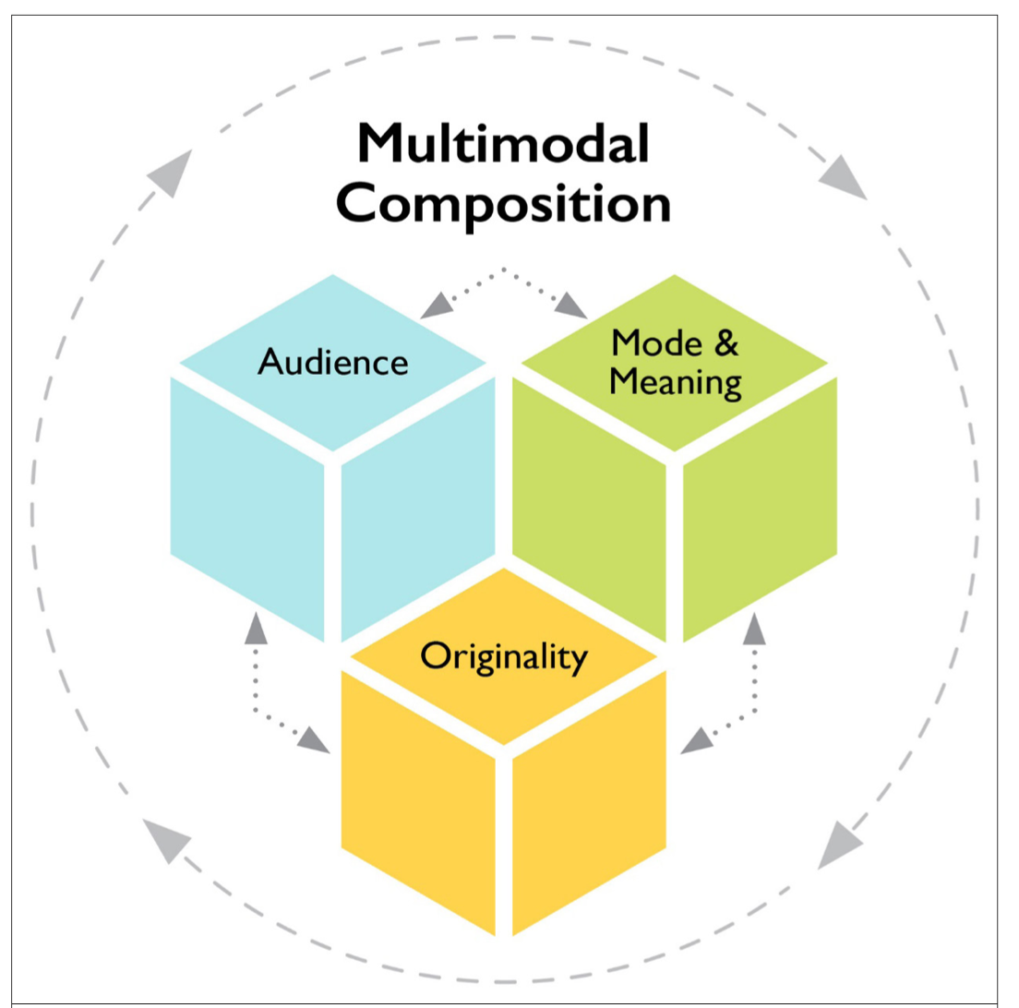
The Framework
conceptualizes digital
multimodal composing
through
three interconnected
and layered domains

Slide 9
Audience
Audience has
broadened (boyd, 2014)
Intended audience
may not be the audience responding (Lunsford & Ede 2009)

Slide 10
Audience
Questions for Writers / Assessors
What conceptions of audience(s) do writers have?
How do writers utilize audience interactivity to achieve their writing goals?
How do writers negotiate power dynamics and potential conflicts in imagined and actual audiences?

Slide 11
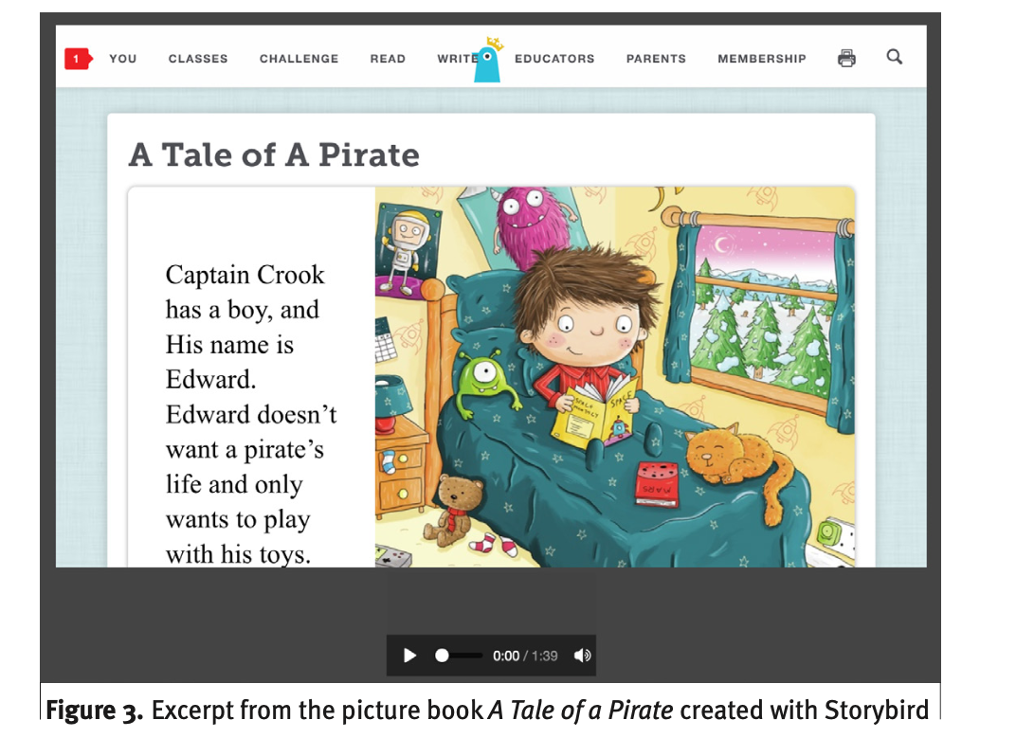
Audience Focus Text: Original Storybook
What conceptions of audience(s) do writers have?
How do writers utilize audience interactivity to achieve their writing goals?
How do writers negotiate power dynamics and potential conflicts in imagined and actual audiences?
Liu & Dou, 2015

Slide 12
Mode & Meaning
We relied on the work of Kress (2005) and Anderson and Kachorsky (2019) to explain mode:
“Mode refers to the means and tools of composing – and these tools exist in social and cultural contexts” (McGrail et al., 2021, p. 287).

Slide 13
Mode & Meaning
Questions for Writers / Assessors
How do writers make choices about the modes they compose in and the media they use to disseminate their multimodal compositions?
How do writers combine modes in ways that communicate their meaning to an audience? Are the combinations of modes persuasive in communicating the intended meaning?
How do writers choose the media to get their message to their audience?

Slide 14
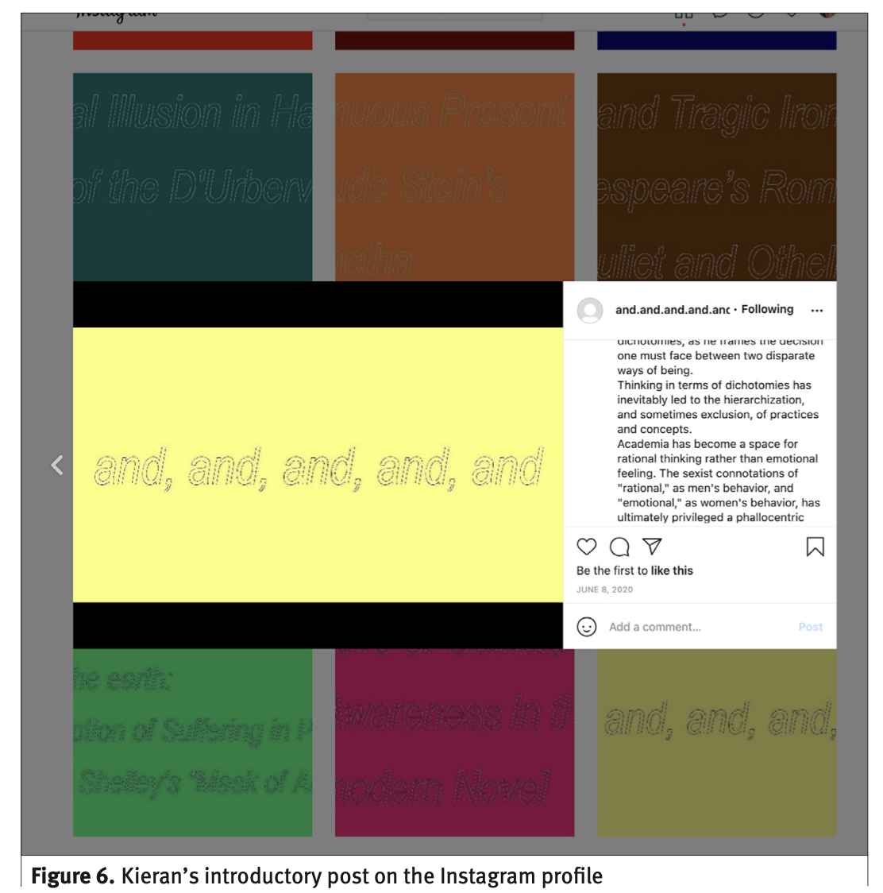
Mode & Meaning Focus Text: Instagram Profile
How do writers make choices about the modes they compose in and the media they use to disseminate their multimodal compositions?
How do writers combine modes in ways that communicate their meaning to an audience? Are the combinations of modes persuasive in communicating the intended meaning?
How do writers choose the media to get their message to their audience?

Slide 15
Originality
We relied on the work of Jocius (2020) and Smith (2017) as we considered remixing.
We know that elements of what has been composed previously can be seen in multimodal texts.
We consider the ways in which the composer repurposed an original text in a unique, creative manner-the text’s transformativeness (Hobbs, 2019)

Slide 16
Originality
Questions for Writers / Assessors
In what ways does the composition embody originality as it relates to multimodal composition?
From what derivative source or sources did the writer gain inspiration? What derivative source or sources did the writer use in the multimodal text?
How did the writer alter any texts used in a transformative way?

Slide 17
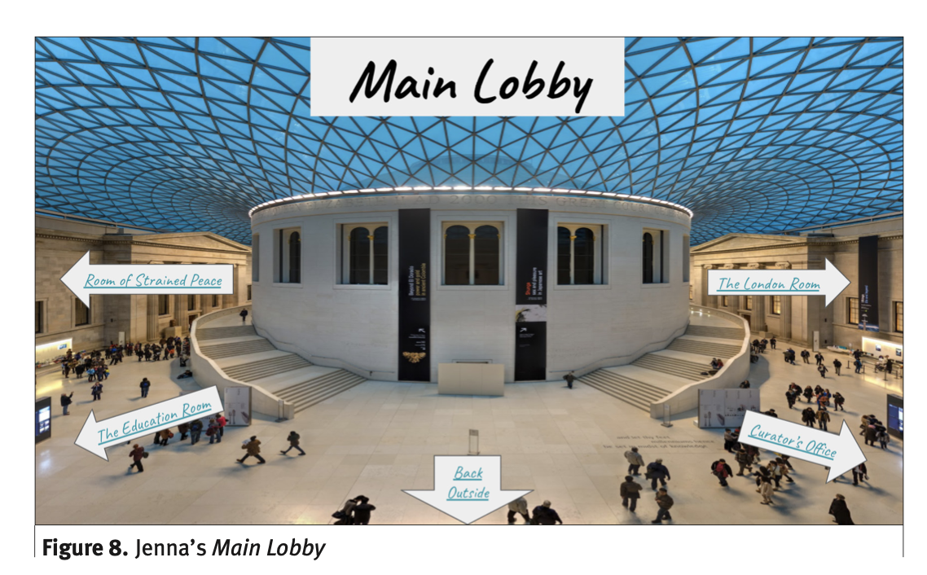
Originality Focus Text: Digital Museum
In what ways does the composition embody originality as it relates to multimodal composition?
From what derivative source or sources did the writer gain inspiration? What derivative source or sources did the writer use in the multimodal text?
How did the writer alter any texts used in a transformative way?
(H., 2019a)

Slide 18
Overlap Between Domains
Audience / Mode & Meaning
How might different audiences choose to navigate this multimodal text?
Mode & Meaning / Originality
How do writers take a message from one mode to another mode?
Originality / Audience
What audience understandings does the writer assume?

Slide 19
Future Directions / Implications
Use questions throughout the composing process
Note that certain domains and connected questions may be more appropriate for particular assignments than others
Invite students to have a role in the assessment process
Be open to revisiting the framework

Slide 20
References
Anderson, K. T., & Kachorsky, D. (2019). Assessing students’ multimodal compositions: An analysis of the literature. English Teaching: Practice and Critique, 18(3), 312–334.
Bartels, J., Beach, R., Connors, S., Damico, N., Doerr-Stevens, C., Hicks, T., Labonte, K., Loomis, S., Lynch. T. L., McGrail, E., Moran, C., Pasternak, D., Piotrowski, A., Rice, M., Rish, R., Rodesiler, L., Rybakova, K., Sullivan, S., Sulzer, M., & Zucker, L. (2018). Beliefs for integrating technology into the English language arts classroom. National Council of Teachers of English Position Statement. http:// www2.ncte.org/statement/beliefs-technology-preparation-english-teachers/
boyd, d. (2014). It’s complicated: The social lives of networked teens. Yale University Press.
Duke, N. K., Purcell-Gates, V., Hall, L. A., & Tower, C. (2006). Authentic literacy activities for developing comprehension and writing. The Reading Teacher, 60(4), 344–355.
H., J. (2019a). The Museum of ED 352’s Trip Abroad. https://docs.google.com/ presentation/d/1BF0tEYKz85k7LFVh3OLvucas7ZAUis7F8pW75min3c/ edit#slide=id.p
Hobbs, R. (2019). Ethical practices: Meditation. In K. H. Turner (Ed.), The ethics of digital literacy: Developing knowledge and skills across grade levels (pp. 155–158). Rowman and Littlefield.
Jocius, R. (2020). The CLICK model: Scaffolding multimodal composing for academic purposes. Language Arts, 97(3), 146–158.
Kress, G. (2005). Gains and losses: New forms of texts, knowledge, and learning. Computers and Composition, 22(1), 5–22.

Slide 21
References
Law, L. (2020). Creativity and multimodality: Analytical framework for creativity in multimodal texts (AFCMT). Linguistics and Human Sciences, 14(1), 60–93.
Lindblom, K. (2015). School writing vs. authentic writing. Writers who care. https://writerswhocare.wordpress.com/2015/07/27/school-writing-vs-authen tic-writing/
Liu, Z., & Dou, K. (2015). Home. Treasure of Reading. https://sites.google.com/site/ treasureofreading/home
Lunsford, A., & Ede, L. (2009). Among the audience: On audience in an age of new literacies. In M. E. Weisler, B. Fehler, & A. M. González (Eds.), Engaging audience: Writing in an age of new literacies (pp. 42–72). NCTE.
McGrail, E., & Behizadeh, N. (2017). K–12 multimodal assessment and interactive audiences: An exploratory analysis of existing frameworks. Assessing Writing, 31, 24–38.
McGrail, E., & McGrail, J. P. (2010). Copying right and copying wrong with Web2.0 tools in the classroom. Contemporary Issues in Technology & Teacher Education, 10(3), 257–274. http://www.citejournal.org/vol10/iss3/languagearts/article1. cfm
McGrail, E., Turner, K. H., Piotrowski, A., Caprino, K., Zucker, L., & Greenwood, M. (2021). An Interconnected Framework for Assessment of Multimodal Composition. English Education.

Slide 22
References
New London Group. (2000). A pedagogy of multiliteracies: Designing social futures. In B. Cope & M. Kalantzis (Eds.), Multiliteracies: Literacy learning and the design of social futures (pp. 9–37). Routledge.
Smith, B.E. (2017). Composing across modes: A comparative analysis of adolescents’ multimodal composing processes. Learning, Media and Technology, 42(3), 259–278.
Tan, L., Zammit, K., D’warte, J., & Gearside, A. (2020). Assessing multimodal literacies in practice: A critical review of its implementations in educational settings. Language and Education, 34(2), 97–114.
Wierszewski, E. (2013). Something old, something new: Evaluative criteria in teacher responses to student multimodal texts. In H. A. McKee & D. N. DeVoss (Eds.), Digital writing assessment and evaluation (Chapter 5). Computers and Composition Digital Press/Utah State University Press.
Wiggins, G. (2009). Real-world writing: Making purpose and audience matter. English Journal, 98(5), 29–37.

Slide 23
Please Be in Touch!
Ewa McGrail emcgrail@gsu.edu
Kristen Hawley Turner kturner3@drew.edu
Amy Piotrowski amy.piotrowski@usu.edu
Kathryn Caprino caprinok@etown.edu
Lauren Zucker lauren6@gmail.com
Mary Ellen Greenwood maryellen.greenwood@usu.edu
Kathryn Caprino caprinok@etown.edu

