Slide 1
University Writing
Auburn
Office of the Provost

Slide 2
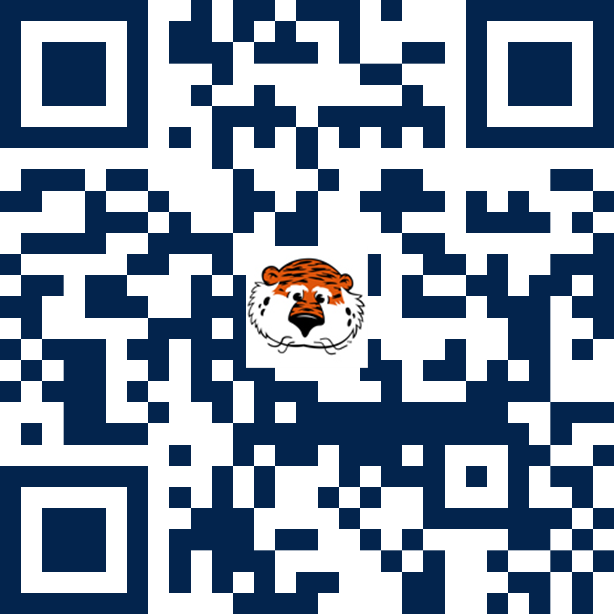
Multimodality and welcoming diverse writers online: Developing a consulting philosophy
Created and facilitated by Katharine H. Brown, Jonah Breed, Clare Hancock, & Huan Liu
April 13, 2023
Materials available at aub.ie/owca
Notes:
Creator credits should remain intact to recognize the intellectual work of other staff members. With handouts, this information should appear in the footer or in a separate section at the end. With presentations, this information should appear on the title slide or on the final slide of the presentation.
Created by indicates the original creator (person who initially put the materials together) and anyone who made substantial changes to the activities or content of the workshop. Reorganizing the order, lightly revising the text, or updating the format does not count.
Facilitated by indicates the person who actually delivered the workshop.
All finalized electronic materials for each workshop should be saved as PDFs to the “Workshop Materials for Participants” folder on Box. This ensures participants can access the materials during and after the workshop.
Each workshop will have a separate folder with all of the materials that participants will access during the workshop (such as slides, worksheets, and handouts). The folder and files need to be saved using names that will make sense to the participants. Folder and file names may or may not adhere to the internal file naming conventions, depending on the context.
After creating the link in Box, change the settings to allow participants to access the materials. In the Box folder, select the link icon on the right-hand side of the screen. Click the button under “Share Link” to create a sharable link. Change the permissions from “People in your company” to “People with the link.”
Prior to the workshop, create an aub.ie link with a name that matches the folder name. Link the Box folder to the aub.ie link. Add Ashley as an administrator to the aub.ie link by clicking “Add Administrator” and typing “crb0085.” Chris can help with this process if needed. Note that there should be one aub.ie link per folder, not one link for every document.
If there is already an aub.ie link associated with the folder, work with Chris or the previous facilitator to change the link from the old folder to the new folder.
Add the aub.ie link to the first slide of the presentation and to other materials as needed and appropriate.

Slide 3
Agenda
Each presenter will:
  Reflect on how writing consulting philosophy statements prepared us to tutor diverse learners online
  Discuss how we have centered diversity, equity, & inclusion in our work
Audience members will:
  Reflect on core values and plan a philosophy statement
  Engage in writing and discussion activities

Slide 4
Multimodality and DEI at University Writing
Katharine H. Brown

Slide 5
Philosophy Statement Excerpt
"As a white, queer writing program administrator, I maintain awareness of my identities to understand how they shape my work. Through a focus on diversity, equity, and inclusion, I work to create a welcoming working and learning environment for staff and students with diverse backgrounds and identities. By fostering community-building and critical conversations amongst our staff, I seek to develop spaces where our employees and students feel a sense of belonging and recognize that they are valued and appreciated."

Slide 6
Our Context
Auburn University (AU): public, land-grant, R-1 university (30,000+ students); Alabama; PWI; 40% legacy students
University Writing (UW): WAC/WID writing support unit
  Houses a number of programs, especially the ePortfolio Project and the Miller Writing Center (MWC)

Slide 7
ePortfolios & the MWC
ePortfolio Project
  AU's 2012-2022 QEP for accreditation with SACSCOC
  ePortfolios are integrated into academic programs across campus and supported by the MWC
MWC
  Offers synchronous (F2F & online) and asynchronous tutoring
  Peer consultants learn about multimodality and develop their own ePortfolios as part of professional development

Slide 8
Multimodality
Connects to diversity, equity, and inclusion (DEI) by shifting writers' concepts of identity and meaning-making (Kress, 2008; Nash, 2018)
  Identity: a reflective model can encourage students to explore how their identities shape their writing (Leigh, 2012; Schwartz, 2014)
  Meaning-making: writing is a social practice, and writers can write toward a new, more equitable future (Wargo, 2017; Wargo, 2018)

Slide 9
Multimodality and DEI
Backgrounds and identities are assets to writing, tutoring, and learning (Archer, 2017)
Connections between writing and negotiations of power can be explored (Boyd, 2017; Knobel & Lankshear, 2014)
Home literacies are welcomed (Nash, 2018)
Expanded concepts of academic writing can welcome linguistic diversity

Slide 10
Online, (A)synchronous Tutoring
Inherently multimodal
Poses challenges to consultants in:
  Developing the rapport that encourages clients to ask meaningful questions (Worm, 2020)
  Recognizing opportunities to utilize practices grounded in DEI
Philosophy statements invite reflection on these challenges

Slide 11
Philosophy Statements
A required part of consultants' ePortfolios
Asks consultants to reflect on their backgrounds and identities, identify their core values, and determine how to enact their values within consultations (F2F and online)
Encourages consultants to center DEI and engage in multimodal composition

Slide 12
UW's Vision Statement
Philosophy statements scaffolded toward collaborative development of a program mission statement:
  "University Writing's vision is to empower the Auburn community through diverse, equitable, and inclusive writing and instructional support" (University Writing, 2022)

Slide 13
Serving LGBTQ+ Writers in Changing Spaces
Jonah Breed

Slide 14
Philosophy Statement Excerpt
I am a white, cishet graduate student and educator.
“Teaching and consulting involve working with writers with a range of identities in spaces that will continue to change form. It is my goal to center both the safety and growth of my students, regardless of identity or space. Because I cannot and do not wish to fully control the conversations that happen in the spaces I educate in, I believe it is my responsibility to encourage agreements and expectations for conversations, whether they be online, in-person, or elsewhere.”

Slide 15
Brave/Safe Spaces
Brave spaces promote collaboratively setting expectations and rules for conversations instead of avoiding difficult topics altogether (Arao & Clemens, 2013).
Safe spaces aim to provide protection but can lead to people viewing safety as synonymous with comfort (Arao & Clemens, 2013).
Writing center spaces avoiding discussion of identity erases a part of students’ identities, which affects how consultants and clients engage with the writing (Pittendrigh & Camarillo, 2017).

Slide 16
Affinity Group
Last semester I participated in one of University Writing’s first affinity groups: LGBTQ+ Allies.
I joined the group to further develop my teaching philosophy and pedagogical skills in both writing center and ELA classroom spaces.
Both environments center writing and identity.

Slide 17
Online “Spaces”
Online appointments complicate what counts as a “space.”
Online appointments change how consultants and clients establish a connection (Worm, 2020).
A change in space doesn’t have to mean a change in content.
Text chat offers a unique-to-online method for establishing the expectations for conversation.
Notes:
Worm’s study shows mixed results, and chalks some of the changes up to anecdotal. So, I think just mentioning that it changes how the connection is made is what I want to go for here.

Slide 18
Welcoming LGBTQ+ Clients Online
“Hey ____, I hope you are doing well. I want to preface our appointment by acknowledging that writing is a very personal thing and connects directly to the writer’s identity. My goal today is to aid you along your writing journey, and I understand that some topics may be hard to discuss. While I encourage discussion to foster growth, I am only one part of our appointment today. So, if you have any expectations you would like to set for our conversation, please share them!”

Slide 19
Nontraditional Learner Support
Clare Hancock

Slide 20
Philosophy Statement Excerpt
"The experience of writing can be trying and discouraging, and the act of sharing that writing can reveal a sense of vulnerability. Thus, gaining the trust of my clients is incredibly important to me, and I take time to address progress, provide possible solutions, and celebrate successes to build that trust. As an employee, PhD student, and soon-to-be mother, I understand potentially competing identities, and I hope to build an environment of acceptance and validation from the very beginning."

Slide 21
Nontraditional Students
Definition can be based off age but mostly:
Enrollment patterns: Anything different than the "typical" immediate enrollment into college after high school
Financial/family: full time employment, multiple dependents, family obligations or constraints
HS graduation status: GED or completion certificate recipients
(National Center for Education Statistics)

Slide 22
Adult Learners in the MWC
Clients come in with years of prior or current workforce experience and family responsibilities
These experiences have helped me shape my philosophy and better understand how I can approach and better assist this identity

Slide 23
Online Intricacies
Online as a modality option offers opportunity and flexibility (Barron et al., 2023)
Online writing center tools offer quick and efficient ways for students to get the most out of their sessions
Some may not fully understand the extent of technological capabilities and opportunities that come with their education and need additional assistance (Gos, 2015; Wisniewski et al., 2020)

Slide 24
Welcoming Nontrad. Clients Online
During meeting:
Consider organizing discussion in a "goal-oriented" way
Offer opportunities for cognitive reframing (Ackerman, 2018)
Briefly cover the range of online tools that can be used; refer back to tools during the discussion
After meeting:
Include a bulleted list or organize follow-up form to encourage self-efficacy moving forward

Slide 25
Multimodal WC for Multilingual Writers
Huan Liu

Slide 26
Philosophy Statement Excerpt
"As an international graduate student and multilingual writer, I found that if there is a welcoming and safe environment, I would be more willing to share my ideas. I want to provide such a place for diverse students. So, whenever I have appointments, I adjust my mood to be positive because it is easy for people to feel frustrated, upset, and desperate. The writing center could be a place to ease their writing difficulties with both academic and psychological support."

Slide 27
Needs of Multilingual Writers (MLs)
Language level
  They care about ‘right’ and ‘wrong’ in language use: grammar (Nakamaru, 2010)
    Word choices and sentence patterns
  Writing skills
    Structure/organization and format
Communication
  Practice speaking skills in English
    Conversation is regarded as one of the best ways to learn another language (Rafoth, 2015)
  Learn communication skills through negotiated interaction
    Listen to understand intonational cues and recognize humor, sarcasm, and other expressions (Rafoth, 2015)
Notes:
MLs seek help with writing, but more than writing

Slide 28
Multimodal WC & Multilingual Writers
Advantages of multimodal online WC
  Provide a coordinated system and more choices (Barron et al., 2023)
    Offline: scheduled & drop-in appointments
    Online: synchronous & asynchronous
  Ease multilingual writers' nerves with “space and time”
    Comfortable space
    Time flexibility

Slide 29
Strategies for Creating a “Harbor”
Send a greeting text (welcome linguistic diversity)
  "Hi, dear _____. This is Huan. Welcome to the Miller Writing Center (MWC). Nice to meet you. The MWC values perspectives from individuals and the linguistic diversity of the world. How may I help you in this appointment?"
Provide one-minute video instructions on how to use the multimodal WC functions with different languages
Suggest communication tools
  Video/Voice talking/Text
Notes:
One-minute introduction on:
making appointments/online session icons/asynchronous appointments
Positive politeness: including showing optimism, expressing empathy and understanding, and using statements of praise and encouragement.

Slide 30
Support from WC
Peer Consultants
  Learn about multilingual learners through MWC pre-semester TESOL training curriculum
  Offer mini-lessons on world cultures and languages
Administrators
  Keep updating the multimodality of WC
  Guide PCs to have their consulting philosophy

Slide 31
Philosophy Statement Activity

Slide 32
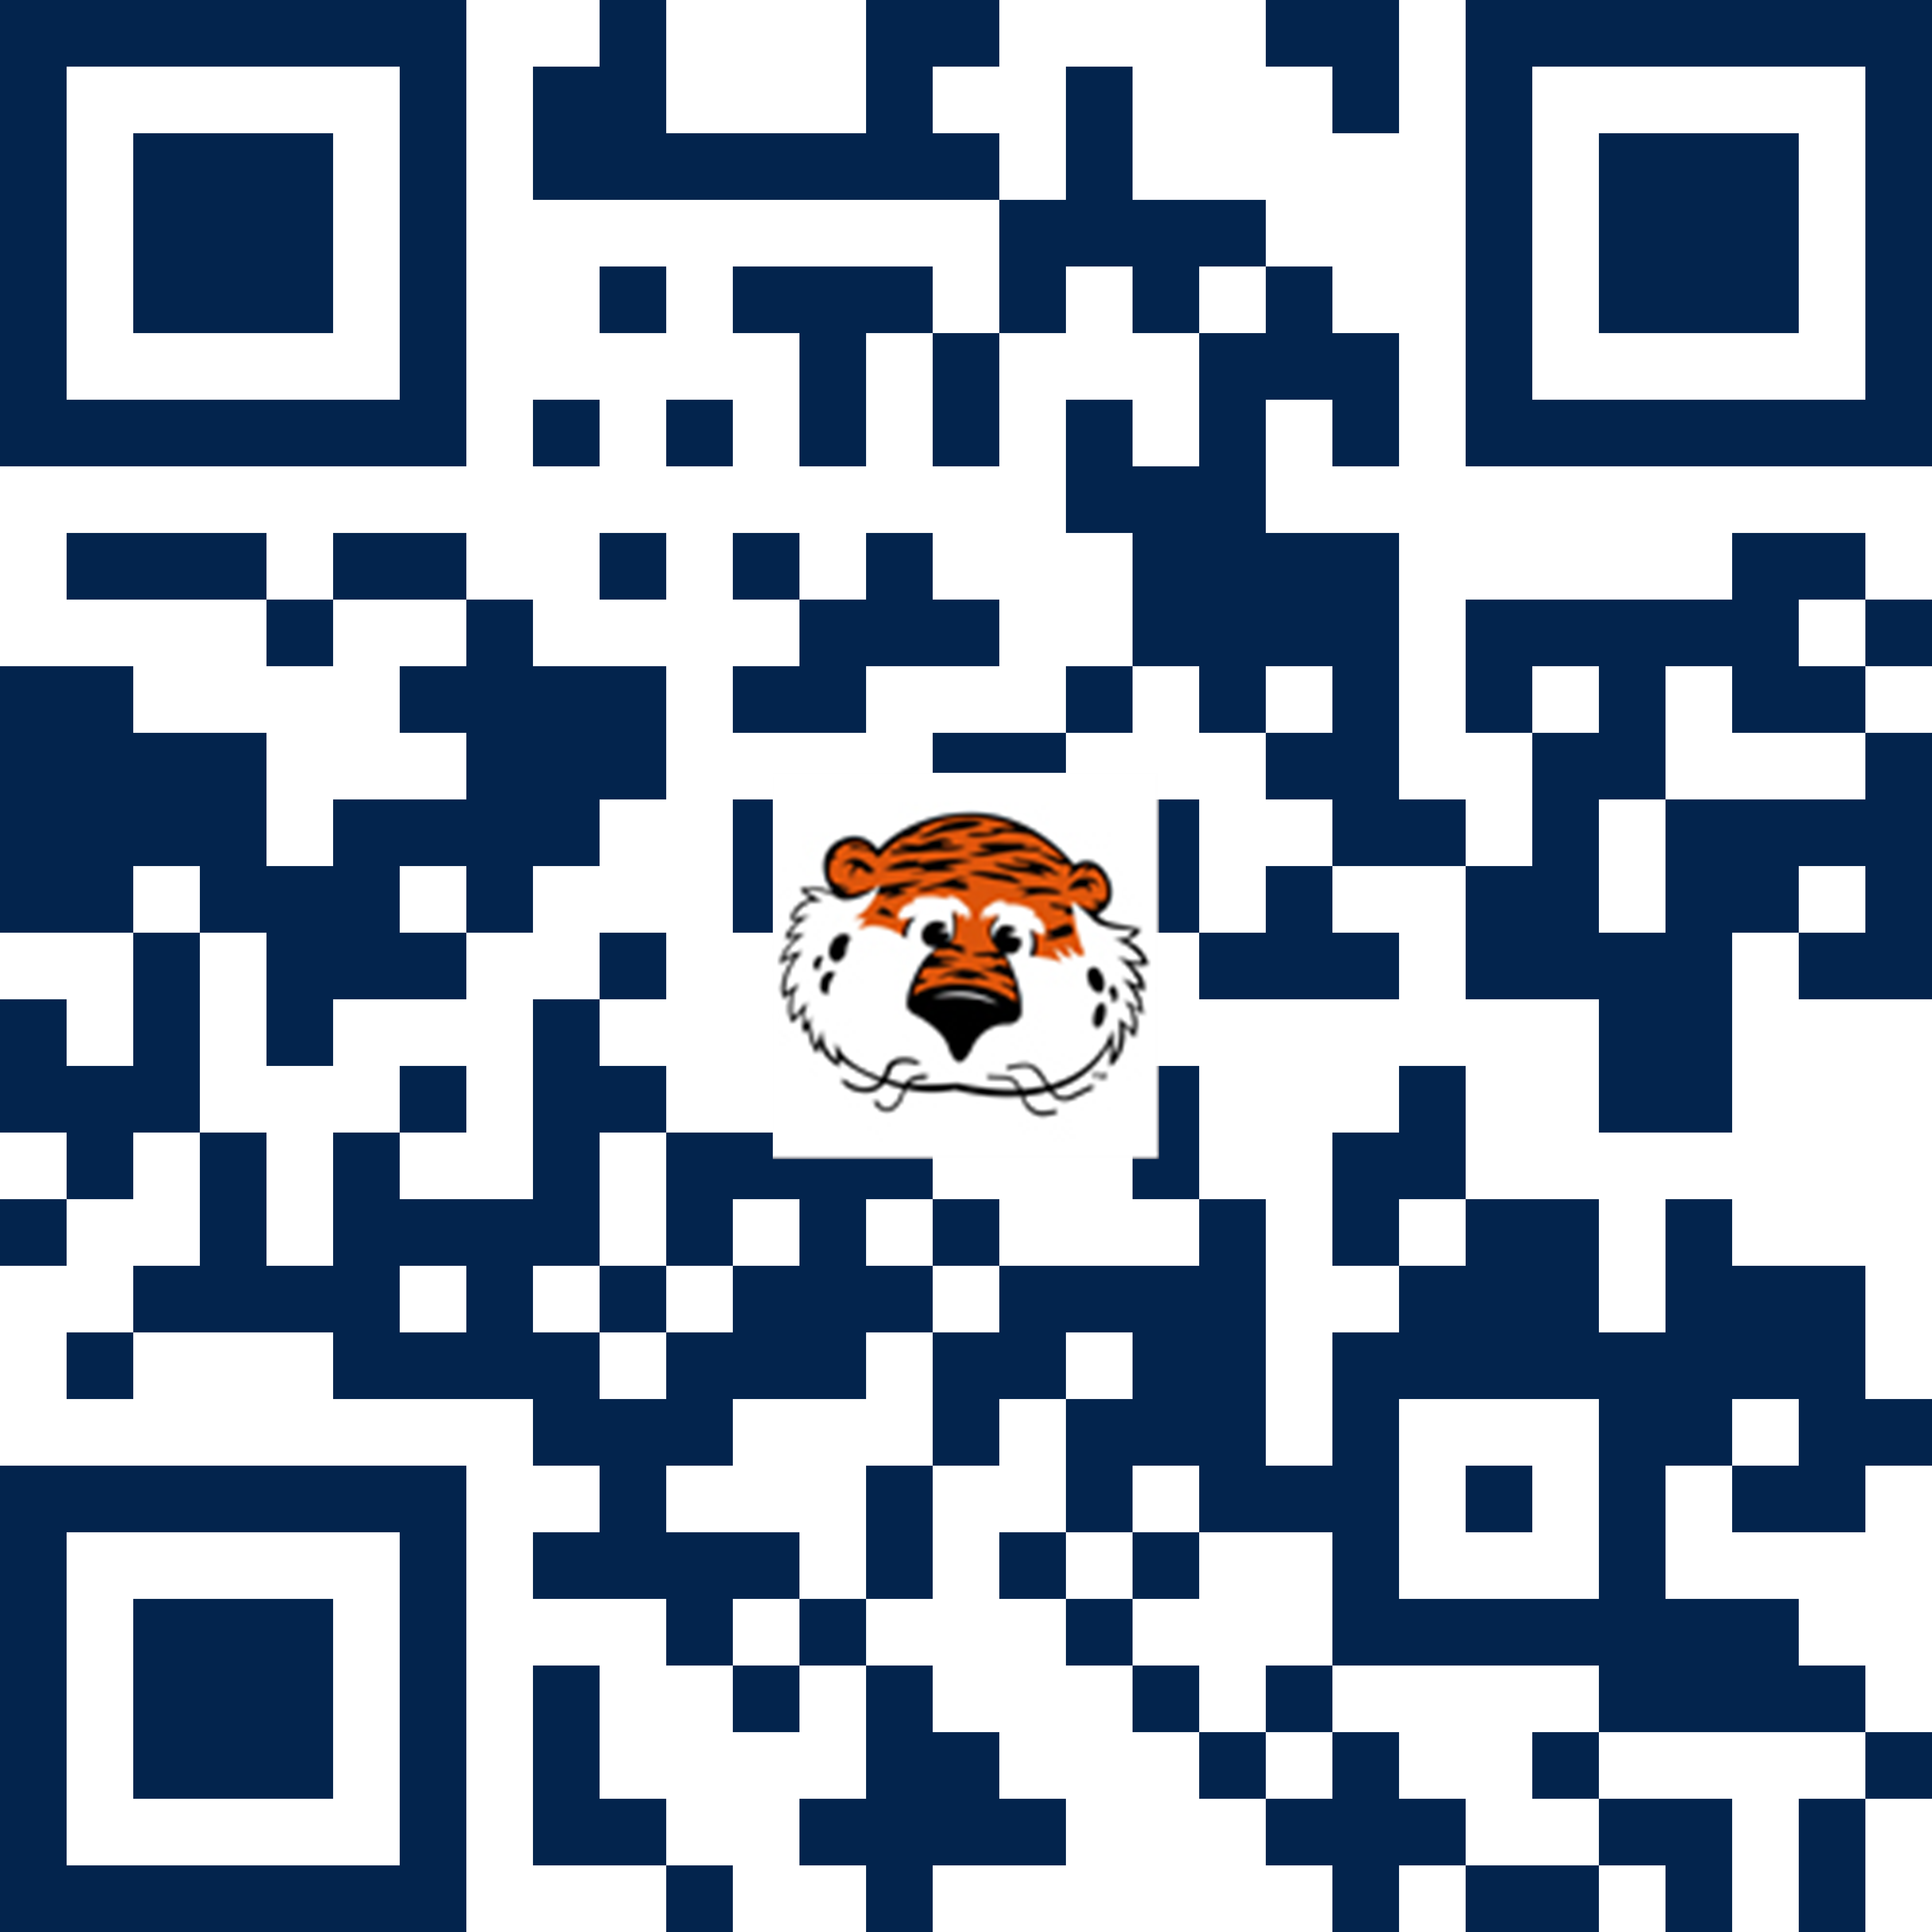
Reflect on Core Values
Katharine: justice, kindness, meaningful work
Jonah: empathy, growth, empowerment, humor
Clare: trust, validation, positivity
Huan: compassion, safety, support
Visit https://aub.ie/values or scan the QR code to enter your values

Slide 33
Reflective Writing
How do your identities shape the core values you identified?
What do you intend consulting to do for your clients? For yourself?
Adapted from Miron (2023)

Slide 34
Discussion
How do you enact your core values and intentions as a peer consultant or administrator?
How do you enact your core values in each modality?

Slide 35
Q & A

Slide 36
Questions for Discussion
Do you utilize philosophy statements in your context? How do these shape how you serve diverse writers?
How has the modality of your writing center changed? How is it changing?
How has your approach to consulting changed with asynchronous interactions in the writing center?

Slide 37
References
Ackerman, C. A. (2018). Cognitive Restructuring Techniques for Reframing Thoughts. Positive Psychology. https://positivepsychology.com/cbt-cognitive-restructuring-cognitive-distortions/
Alshreif, N. (2017). Multilingual writers in the writing center: Invitational rhetoric and politeness strategies to accommodate the needs of multilingual writers. The Peer Review, 1(1).
Arao, B., & Clemens, K. (2013). From Safe Spaces to Brave Spaces: a new way to frame dialogue around diversity and social justice. In Landreman, L. (Ed.), The Art of Effective Facilitation: Reflections from Social Justice Educators (pp. 135-150). Sterling, VA: Stylus Publishing.
Archer, A. (2017). Using multimodal pedagogies in writing centres to improve student writing. Stellenbosch Papers in Linguistics Plus, 53, 1-12.
Barron, K. L., Warrender-Hill, K., Wallis Buckner, S. & Ready, P. Z. (2023). Expanding writing center space-time: Tutoring modality, access, and equity. The Peer Review, 7(1).
Boyd, A. S. (2017). Social justice literacies in the English classroom: Teaching practice in action. Teachers College Press.
Gos, M. (2015). Nontraditional student access to OWI. In B. L. Hewett & K. E. DePew (Eds.), Foundational practices of online writing instruction (pp. 315-352). The WAC Clearinghouse.
Knobel, M. & Lankshear, C. (2014). Studying new literacies. Journal of Adolescent and Adult Literacy, 58(2), 97-101.
Kress, G. (2008). Multimodality: A social semiotic approach to contemporary communication. Routledge.
Leigh, S. R. (2012). The power of the sketch(book): Reflections from high school English students. Journal of Adolescent and Adult Literacy, 55(6), 539-549.
Miron, L. (2023). 2023 spring consultant professional development. University Writing.

Slide 38
References (Cont.)
Nakamaru, S. (2010). Lexical Issues in Writing Center Tutorials with International and US-educated Multilingual Writers. Journal of Second Language Writing, 19(2), 95-113.
Nash, B. (2018). Exploring multimodal writing in secondary English classrooms: A literature review. English Teaching: Practice & Critique, 17(4), 342-356.
National Center for Education Statistics. (n.d.) Nontraditional undergraduates/definitions and data. https://nces.ed.gov/pubs/web/97578e.asp
Pittendrigh, N., & Camarillo, E. (2017). Creating brave spaces in South Texas. The Peer Review 1(2). https://thepeerreview-iwca.org/issues/braver-spaces/creating-brave-spaces-in-south-texas/
Rafoth, B. (2015). Multilingual writers and writing centers. University Press of Colorado.
Schwartz, L. H. (2014). A funds of knowledge approach to the appropriation of new media in a high school writing classroom. Interactive Learning Environments, 23(5), 595-612.
Wargo, J. M. (2017). Designing more just social futures or remixing the radical present? Queer rhetorics, multimodal (counter)storytelling, and the politics of LGBTQ youth activism. English Teaching: Practice & Critique, 16(2), 145-60.
Wargo, J. M. (2018). #SoundingOutMySilence: Reading a LGBTQ youth’s sonic cartography as multimodal (counter)storytelling. Journal of Adolescent and Adult Literacy, 62(1), 13-23.
Wisniewski, C., Regidor, M. C., Chason, L., Groundwater, E., Kranek, A., Mayne, D., & Middleton, L. (2020). Questioning assumptions about online tutoring: A mixed-method study of face-to-face and synchronous online writing center tutorials. The Writing Center Journal, 38(1-2), 261-294.
Worm, A. (2020). Believing in the online writing center. Writing Center Journal, 38(1), 231-258.

Slide 39
Cite this resource:
Share and adapt this resource:
Brown, K. H., Breed, J., Hancock, C., & Liu, H. (2023, April 13). Multimodality and welcoming diverse writers online: Developing a consulting philosophy [Conference presentation]. University Writing, Auburn University.
This presentation has an Attribution-NonCommercial-ShareAlike Creative Commons license. Viewers may share and adapt these materials for non-commercial purposes provided they appropriately give credit, indicate if changes were made, and distribute their materials with the same license. Learn more about this license at
creativecommons.org/licenses/by-nc-sa/4.0/.

Slide 40
University Writing
universitywriting@auburn.edu
(334) 844-7475
auburn.edu/writing

