Slide 1
Design Decisions,
Curious Readership, and
Asynchronous Responses to Multimodal Compositions
Kate Balogh
Writing, Reading, Speech Assistance
College of DuPage, Glen Ellyn, Illinois

Slide 2
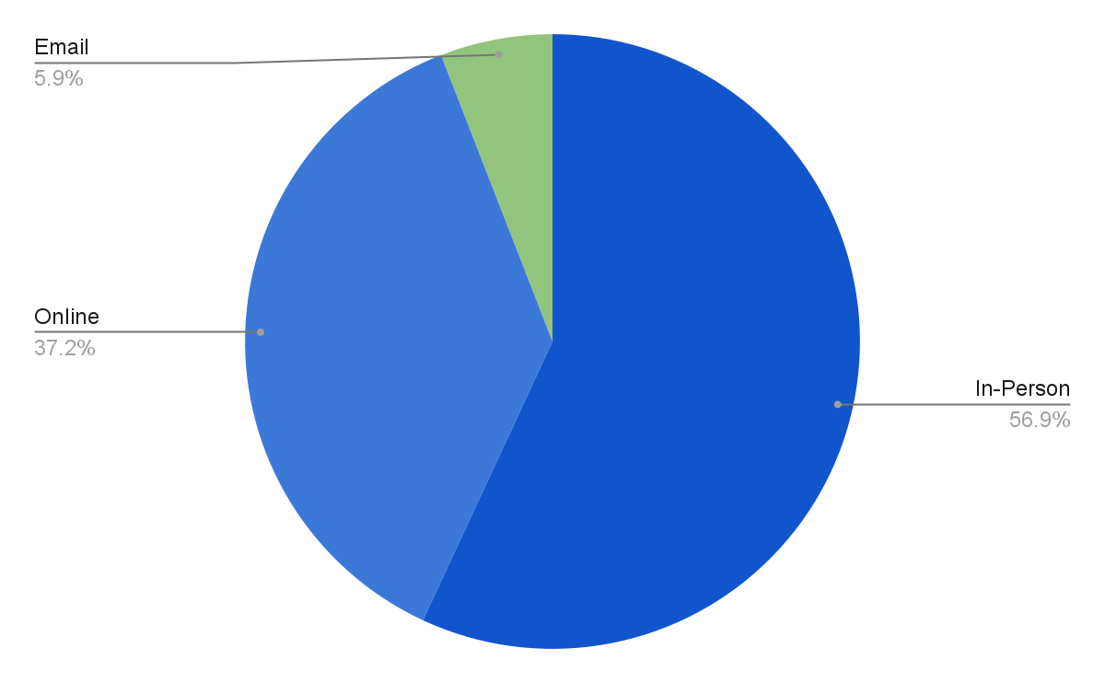
Institutional and Departmental Context

Slide 3
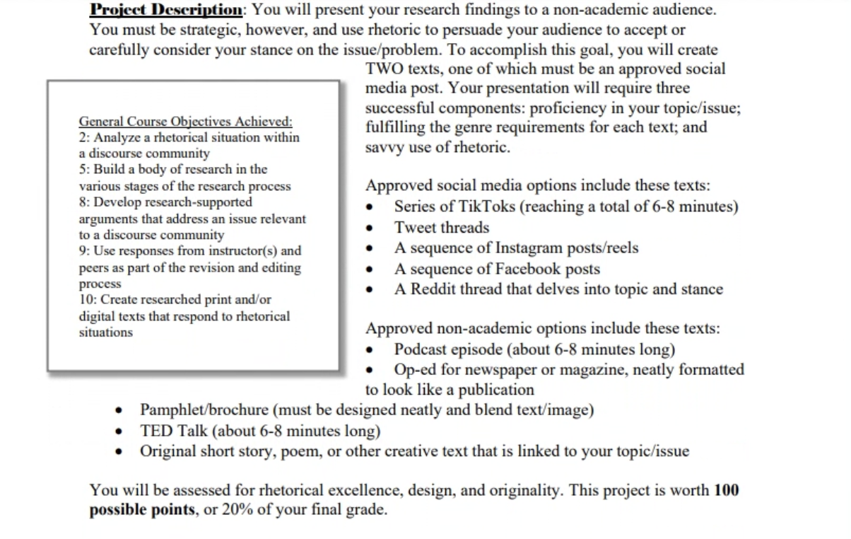
WRSA and Multimodal Compositions

Slide 4
Examples of designed documents
Designed Documents
Resumes
Infographics
PowerPoint decks
Brochures, flyers, and advertisements
Social media posts

Slide 5
Multimodal composition assessment framework 1
Do I know how to do this?

Slide 6

Multimodal composition assessment framework 1 continued
Strategies of Generous Reading

Slide 7
Multimodal composition assessment framework 2
“What is said and the techniques that are used are in conversation with each other.”
(Wahleithner, 2014, p.83)

Slide 8
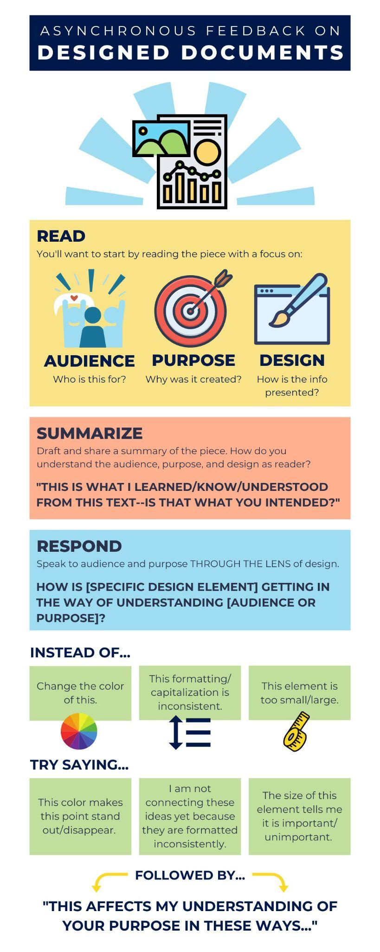
Quick reference Infographic—title section

Slide 9
Quick reference Infographic—read section

Slide 10
Quick reference Infographic—summarize section

Slide 11
Quick reference Infographic—respond section

Slide 12
Quick reference Infographic—sample responses section

Slide 13
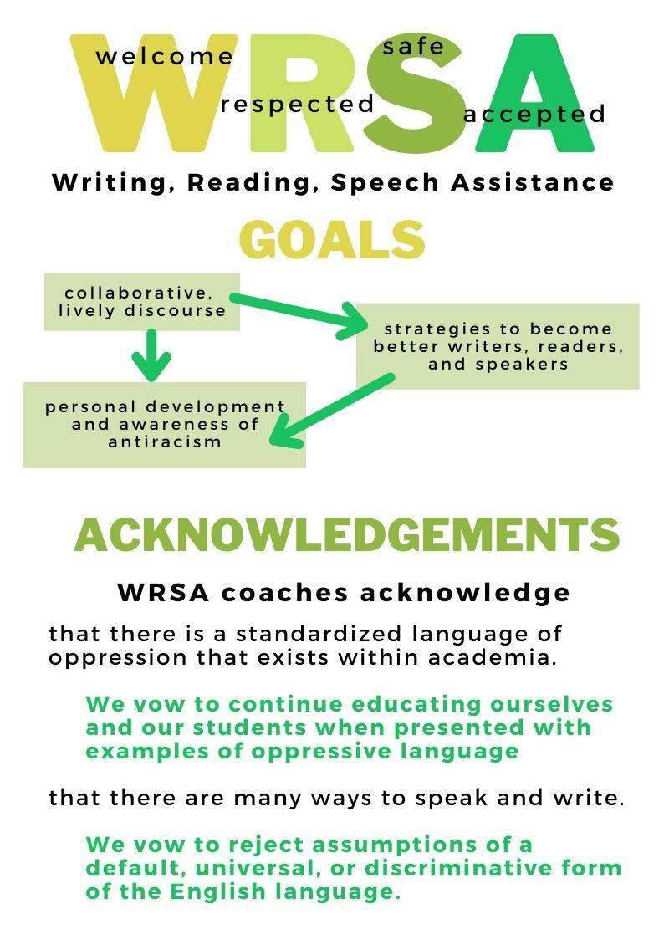
Modeling using sample infographic

Slide 14
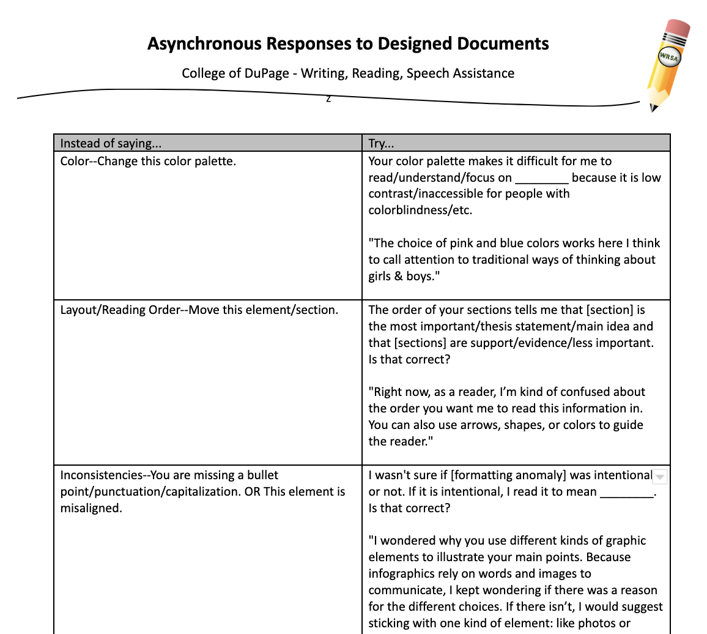
Response Matrix

Slide 15
Questions?

Slide 16
Instructions/prompt for small group work
Let’s practice.
Read the text.
Draft a (brief) summary for the writer.
Take note of three (3) initial reactions/responses.
Revise these reactions to be included in feedback.
What are three (3) questions you would ask in your feedback?

Slide 17
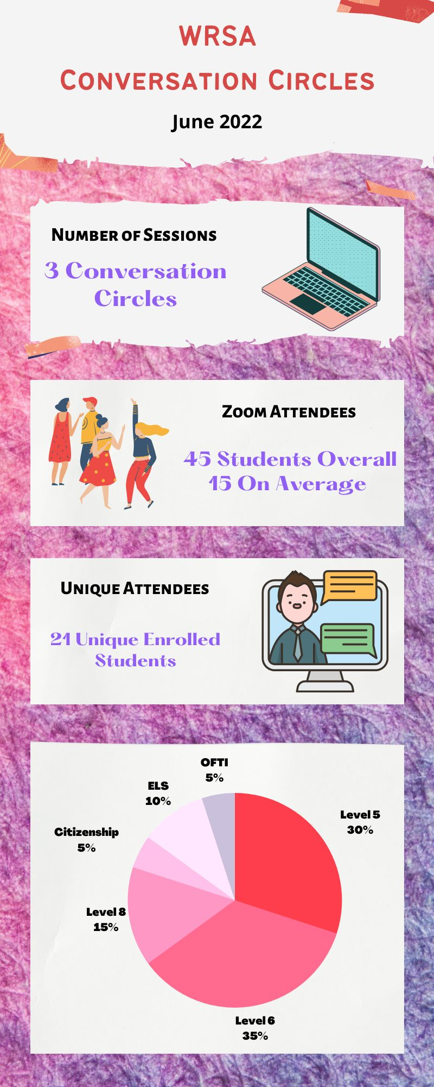
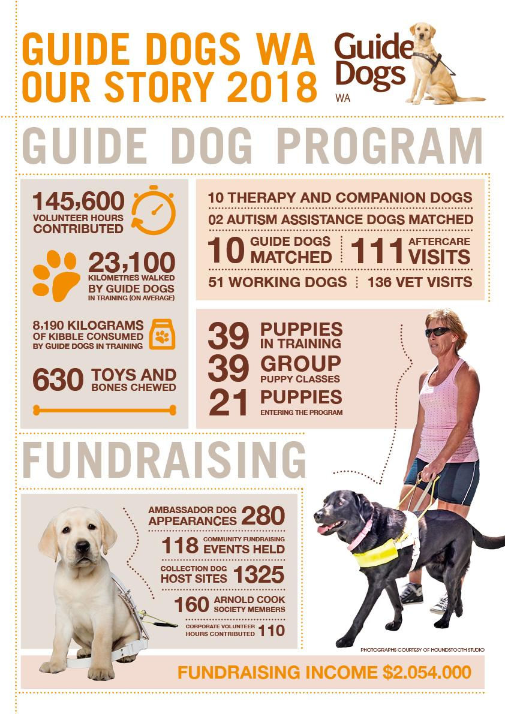
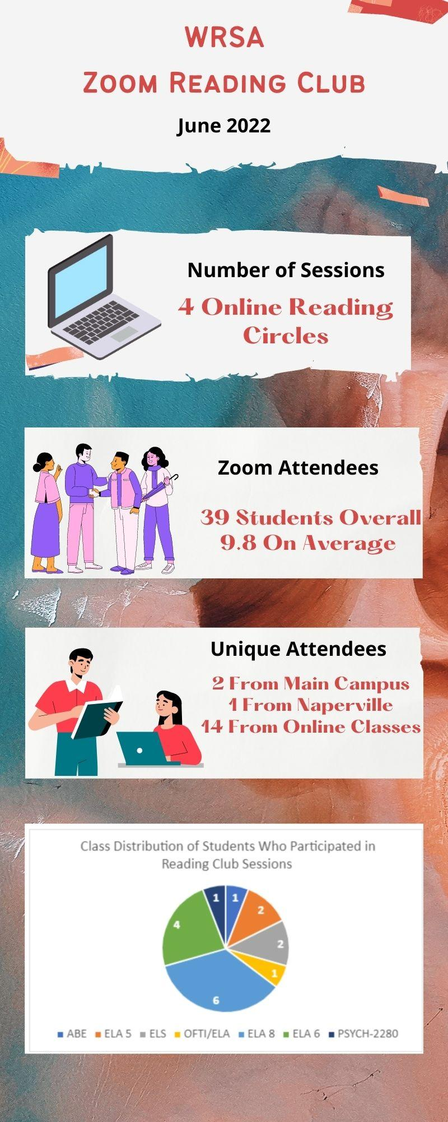
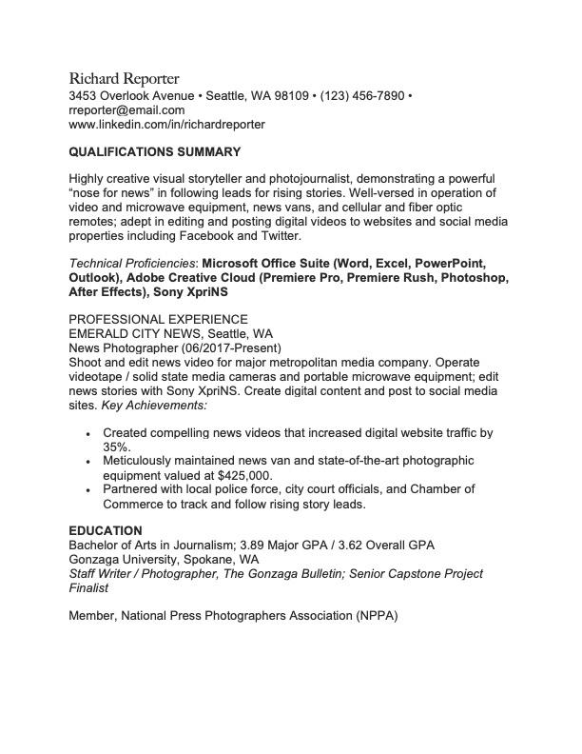
Whole-group discussion of small group work
Share your work.

Slide 18
Challenges, Opportunities, & Best Practices
Personal design preferences vs. design that serves the purpose
Draft and polished responses
Practice as writers
What wisdom and experiences can you share from your spaces?

Slide 19

Speaker contact Information
Thank you.
Contact me:
Kate Balogh
WRSA, College of DuPage
baloghk@cod.edu
katebalogh@gmail.com

