Slide 1


Catherine Courtney Agar Director of the Writing Center & Student Tutoring Keuka College

Slide 2
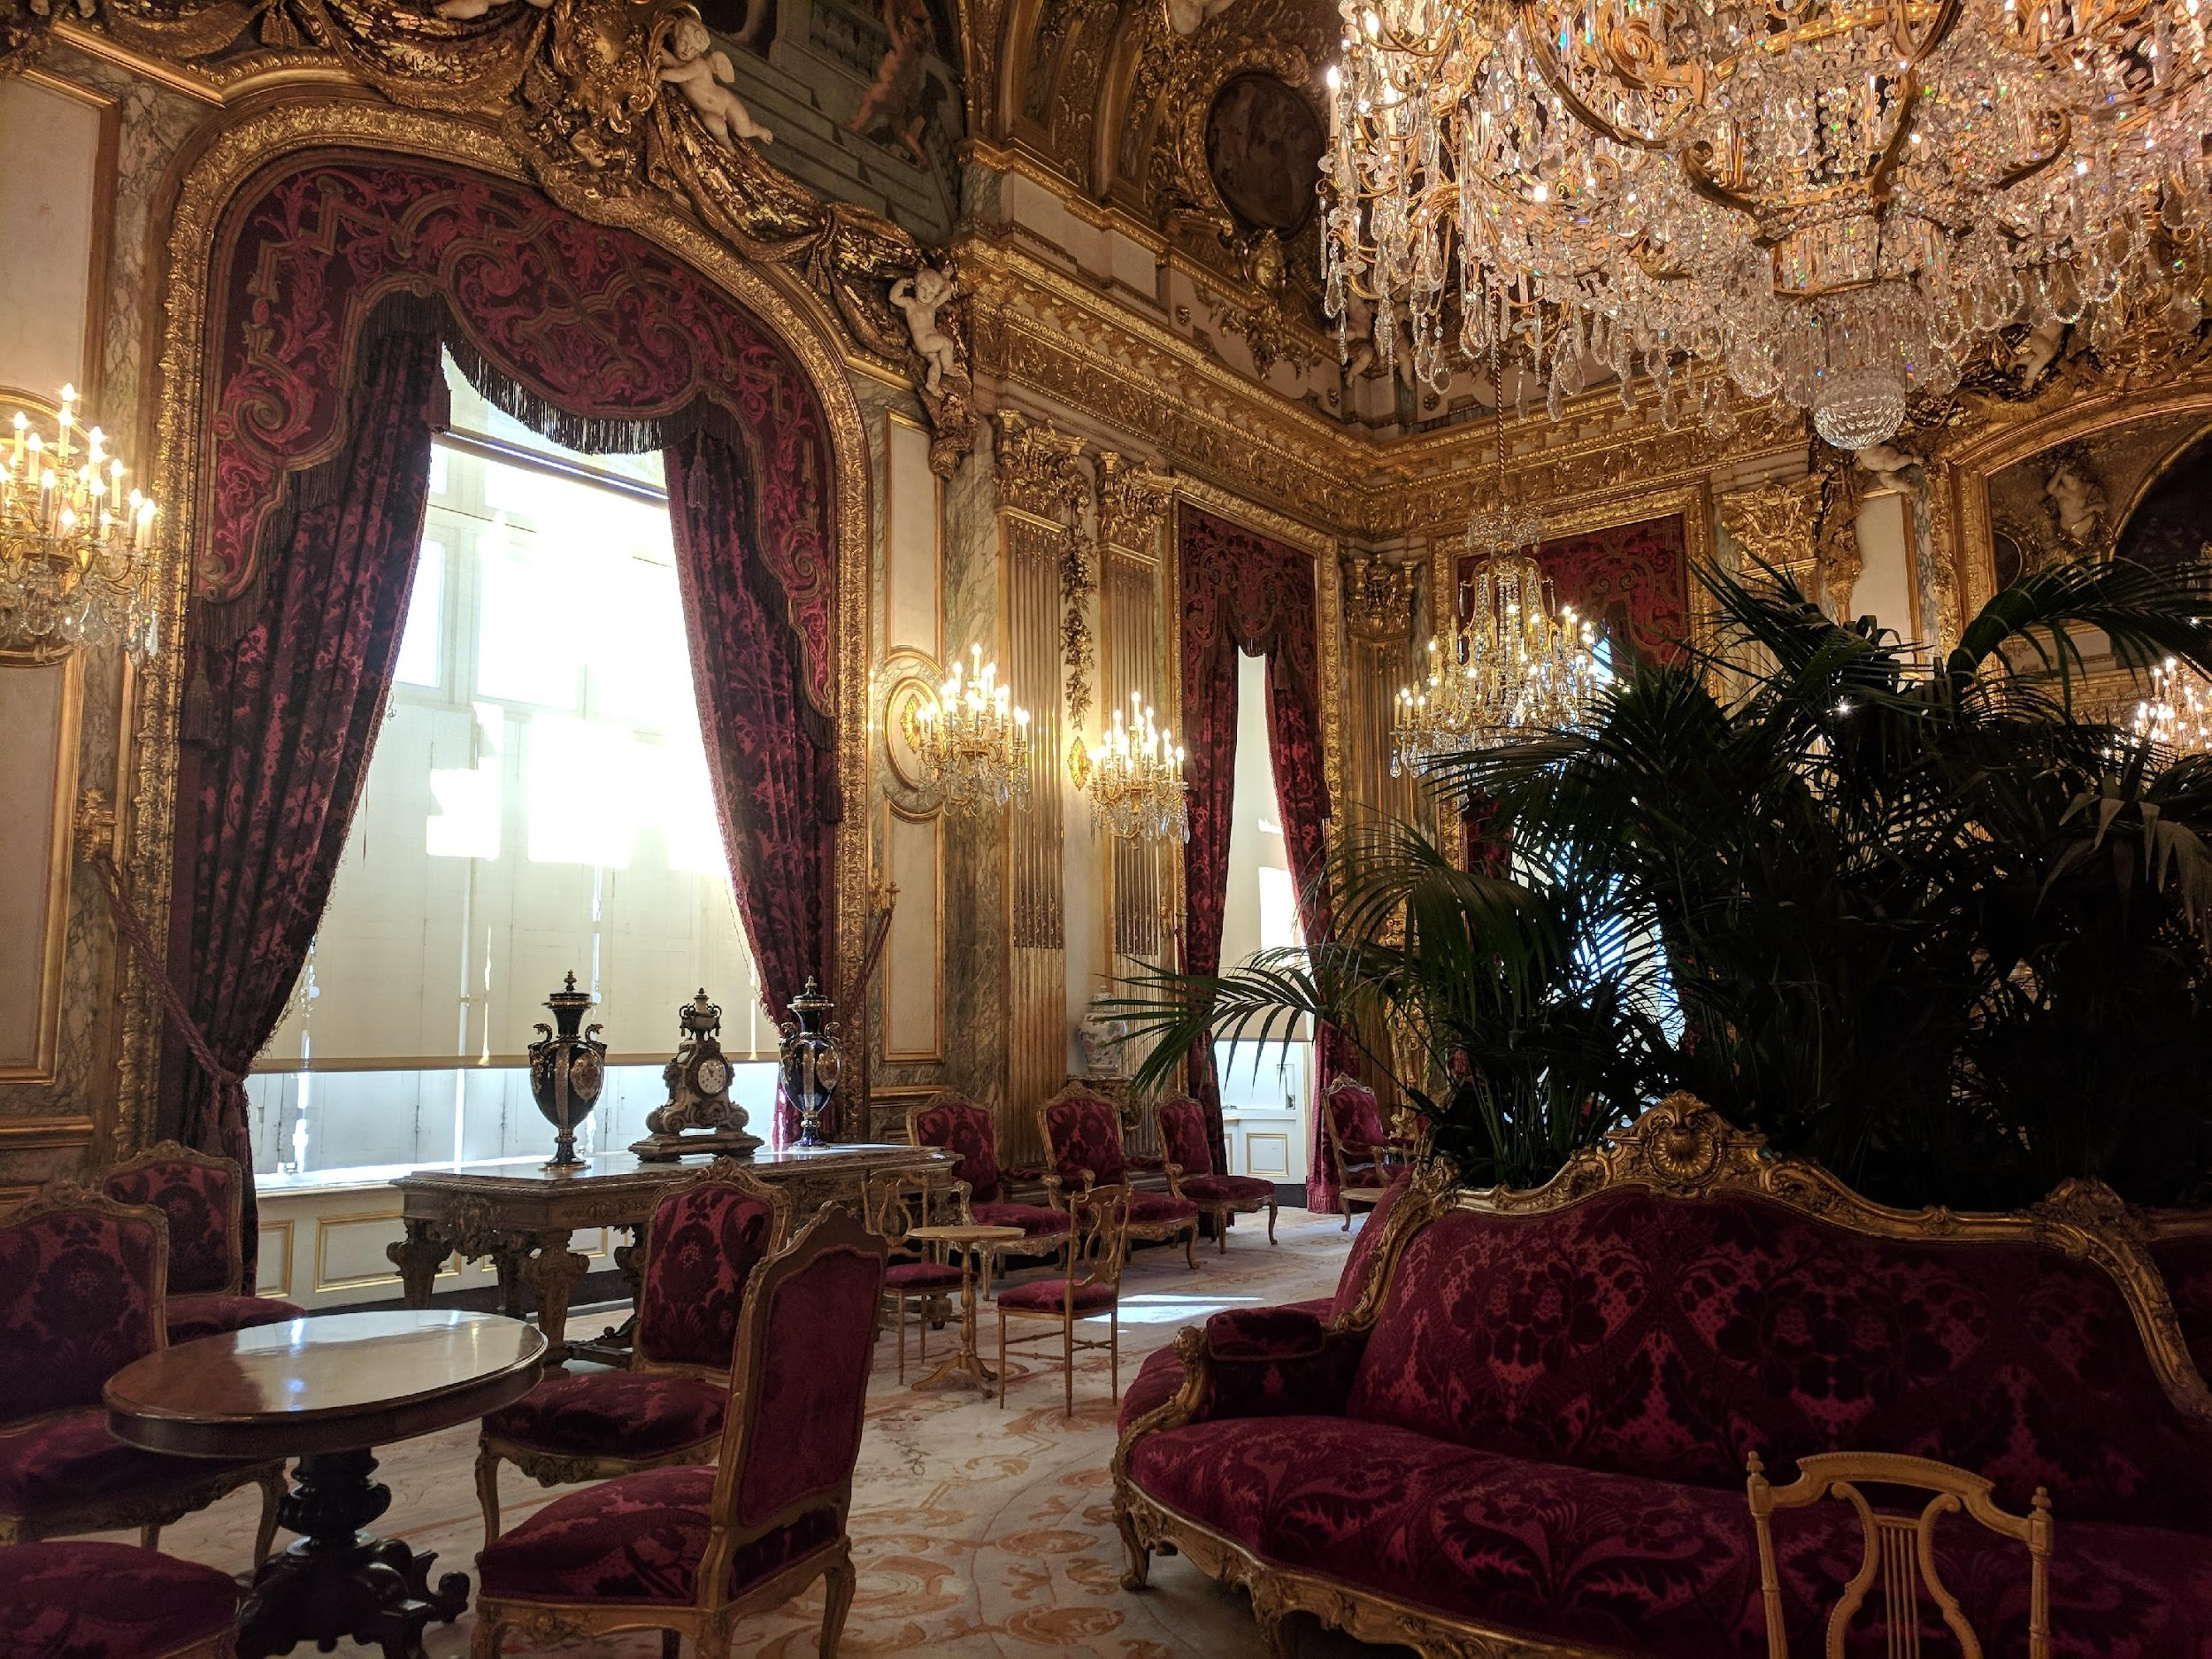
“The Burkean Parlor”

Slide 3

“The Family Room”

Slide 4
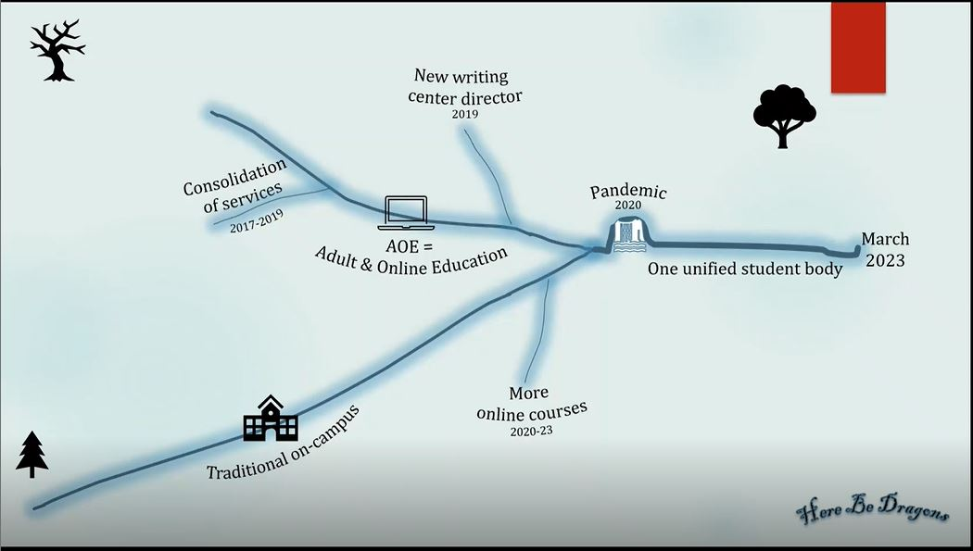
Timeline

Slide 5
Why a family room?
Students’ lived environments are multimodal
This is reality
People come and go
People interact in different ways, moment by moment
Students are not even aware of any transition between modalities

Slide 6

Affordances of multimodality
Accessibility
Neurodivergence
Retrievability
Brain science: spaced practice, retrieval practice, interleaving
Student choice/struggles

Slide 7


Why all 3 modalities work
All three modalities are educational.
All three modalities are educational.
All three modalities are educational.
Also: All three modalities are educational.
Written feedback places the responsibility for making changes on the student.
They must manipulate the text,
and that is how we learn.

Slide 8

Leveraging Difference
Students are all different, with different preferences
We cannot afford to take a seat in the “parlor” and insist they visit us there
Instead, we must enter the family room!
We must be INFORMAL – FLEXIBLE – MULTIMODAL

Slide 9




Contact information
Questions or discussion?
Please feel free to contact me!
Catherine Courtney Agar
Director of the Writing Center & Student Tutoring
Keuka College
cagar@keuka.edu

