Slide 1
Fostering a Research Culture in the Writing Center
Presented by Dr. Candis Bond
Director, Augusta University Center for Writing Excellence
cbond@augusta.edu
www.augusta.edu/cwe

Slide 2
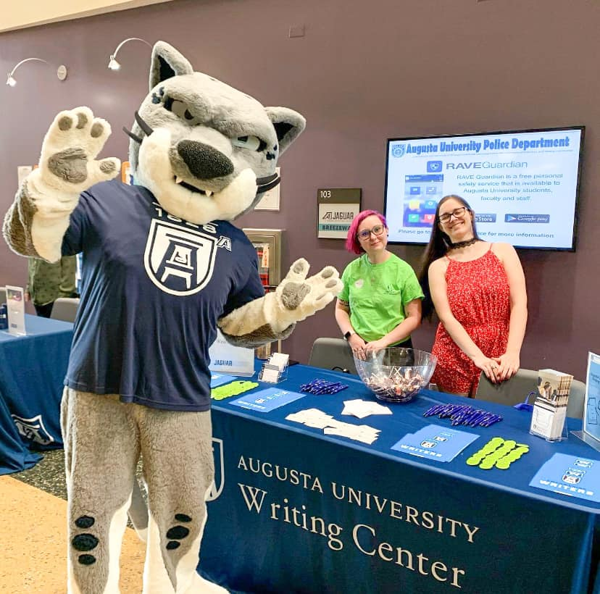
Roadmap
Who are we? An introduction to the AU CWE
Finding your “why?”
Aligning with your institution’s mission and goals
Creating a culture and providing opportunities
Maximizing visibility

Slide 3
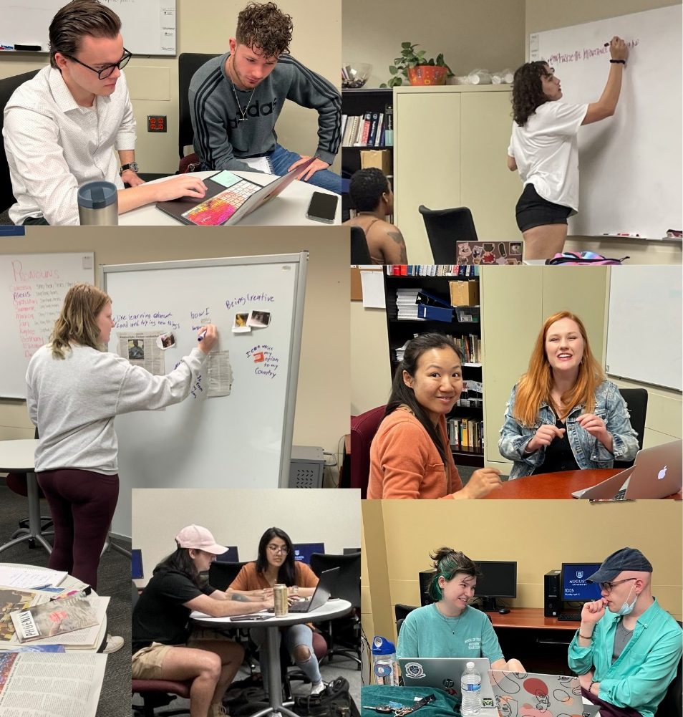
Who are we?
Mid-sized, comprehensive research university (~10,000 students)
“Georgia’s Health Sciences University”
Undergraduate, graduate, and professional staff (~20)
Notes:
We are highly trained undergraduate peer consultants, graduate assistant consultants, and professional consultants who are excited to collaborate with you on your writing! We love thinking about the craft of writing and love working with writers of all different ability levels and experience.

Slide 4
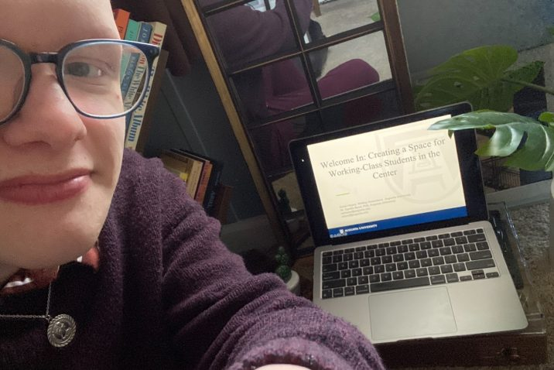
My whys: My first-generation experience
“Presenting at the SWCA conference was a very validating experience,” said Aaron Hayes. “As a working-class and first-gen student, having the opportunity to meet with other like-minded students and directors to discuss the overlooked issues that students like myself face was incredibly profound. As a first-time presenter, I was inspired by the conversation and hope to further my activism for first-gen and working-class students.”—Quotation from an article by Paige Fowler, published in Augusta University’s online newspaper, the JagWire
Aaron Hayes posed for a selfie before his virtual SWCA presentation
https://jagwire.augusta.edu/center-for-writing-excellence-staff-reflect-on-their-work-and-research-after-success-at-regional-conference/

Slide 5
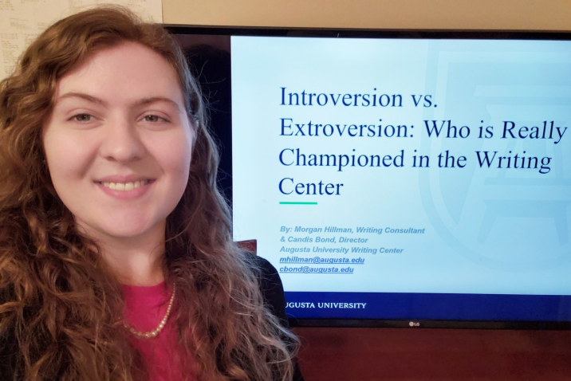
My whys: Linking theory and practice and becoming a respected site of expertise on campus
“Attending this conference has taught me that we, as writing consultants, have the authority to challenge the practices we utilize during consultations. Even though I’m an undergrad student, I feel that I have agency to question and improve pedagogy during my sessions,”—Undergraduate writing consultant Morgan Hillman, quoted in the Jagwire
Morgan Hillman presented virtually at SWCA
https://jagwire.augusta.edu/center-for-writing-excellence-staff-reflect-on-their-work-and-research-after-success-at-regional-conference/

Slide 6

Aligning with university mission and goals
R1-aspiring
Top 60 NIH school by 2030
16,000 students by 2030
https://www.augusta.edu/about/planning/strategic-plan/

Slide 7
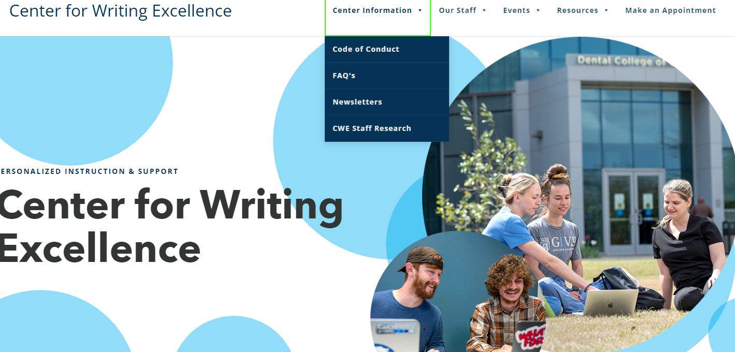
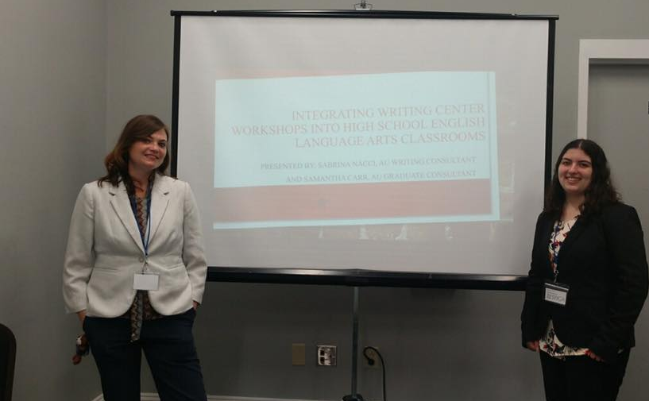
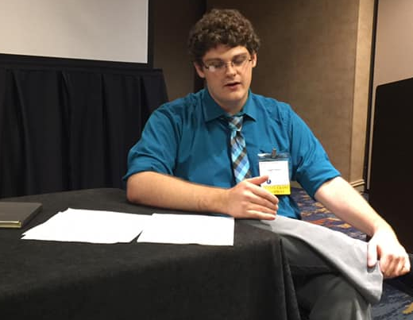
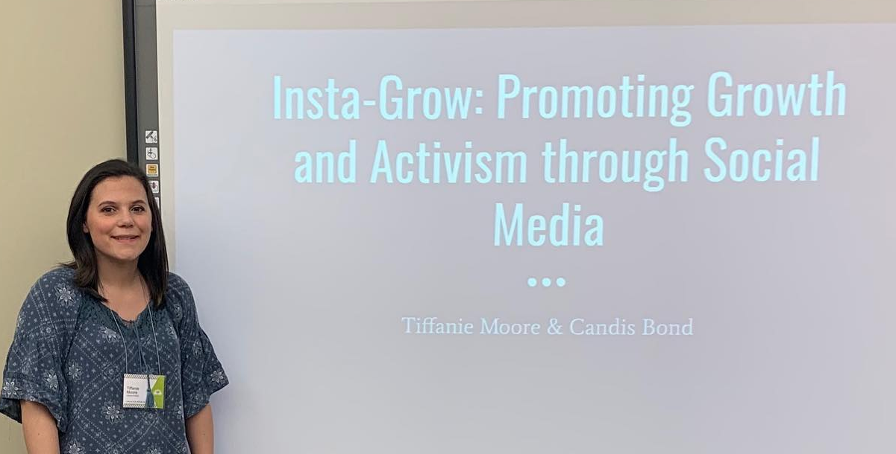
Creating a culture
Modeling
Research-heavy training course
Requiring submission to conferences for course credit
Providing direct instruction in writing conference proposals and preparing presentations
Providing realistic audiences for course and training activities that can lead to publication
Paying for research activity on the clock
Undergrads present at SWCA and IWCA

Slide 8

Maximizing visibility
Use university media outlets and social
Partner with other units for funding
Include staff research in infographics, presentations, and reports for leadership
Create and distribute a newsletter
Create space on your website or in your physical space to display research
https://www.augusta.edu/cwe/

