Slide 1


Welcome to “Fostering a Culture of Research in Your Writing Center” ft. Candis Bond, Scott Whiddon, & Carolyn Wisniewski
Introduce yourself in the chat. Let us know: Why are you interested in adding more research into your writing center? What challenges might you face in doing so?
Please mute yourself and turn off your camera
If you have any technical difficulties, please message Duane Theobold in chat or email us at events@onlinewritingcenters.org

Slide 2

Thank you!
To the presenters:
Dr. Bond, Dr. Whiddon, & Dr. Wisniewski
To the interpreters:

Slide 3




Participation Guidelines
Note that we are recording
Chat us if you cannot see the sign language interpreter
Keep audio off until Q&A
Post comments and questions in the chat at any time

Slide 4
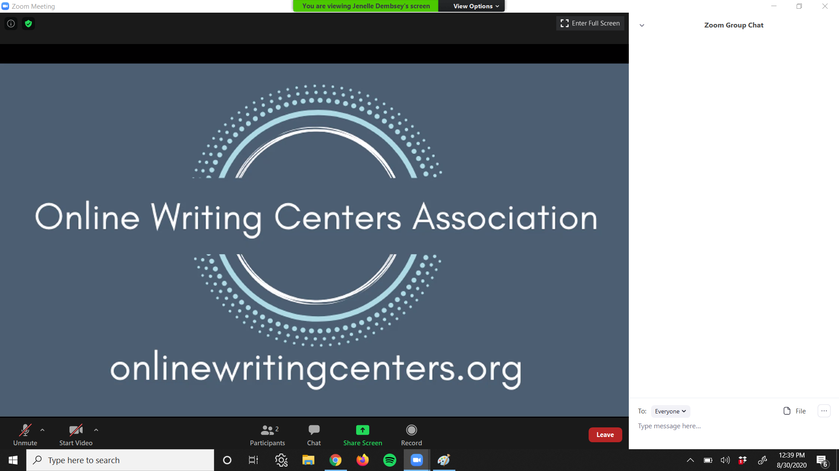
How to find the chat panel in Zoom

Slide 5
Questions & Discussion
The panelists have prepared a handout to help you start thinking about integrating research into your own writing center context.
We’ll share a link to this handout in the chat.
What questions do you have for the panelists?

Slide 6
Upcoming Reading Club
Discussing
Kenneth Bruffee’s “Collaborative Learning and the ‘Conversation of Mankind’” in College English.
Nov. 10th @ 5PM Eastern

Slide 7

Upcoming Election
Application Deadline: October 31st

