Slide 1
Demonstrating Interdependence:
Aligning Writing Coach Skills & Multimodal Practices
Dr. Mary McGinnis
@rhetoric_speak mmcginnis@ccga.edu
Dr. Jennifer Gray
@WriteIntoMyDay jgray@ccga.edu
#OWCA21

Slide 2

Why Multimodality?
Source: Wikimedia Commons

Slide 3
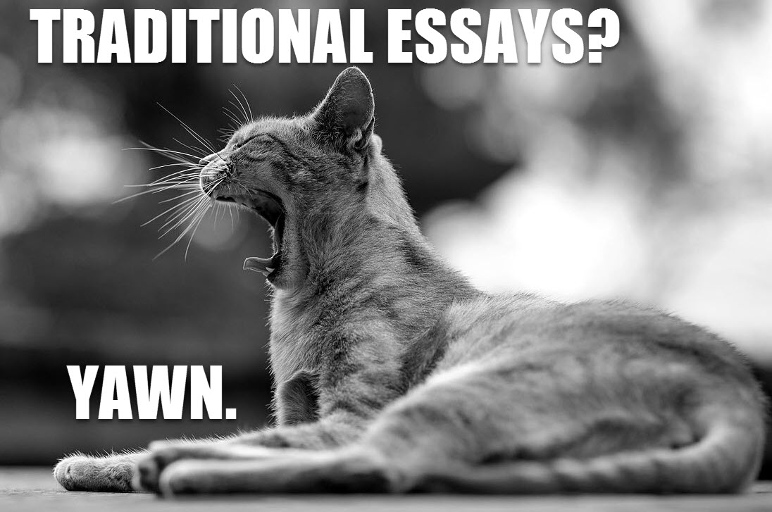
Multimodality engages students.

Slide 4
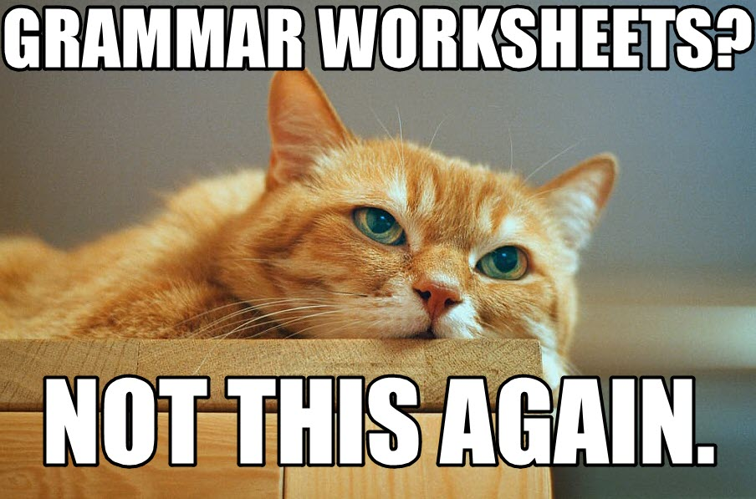
Multimodality redefines “Good Writing.”

Slide 5

Multimodality is Useful!
Source: memegenerator.net

Slide 6

Training Step 1:
The Infographic
Source: giphy

Slide 7
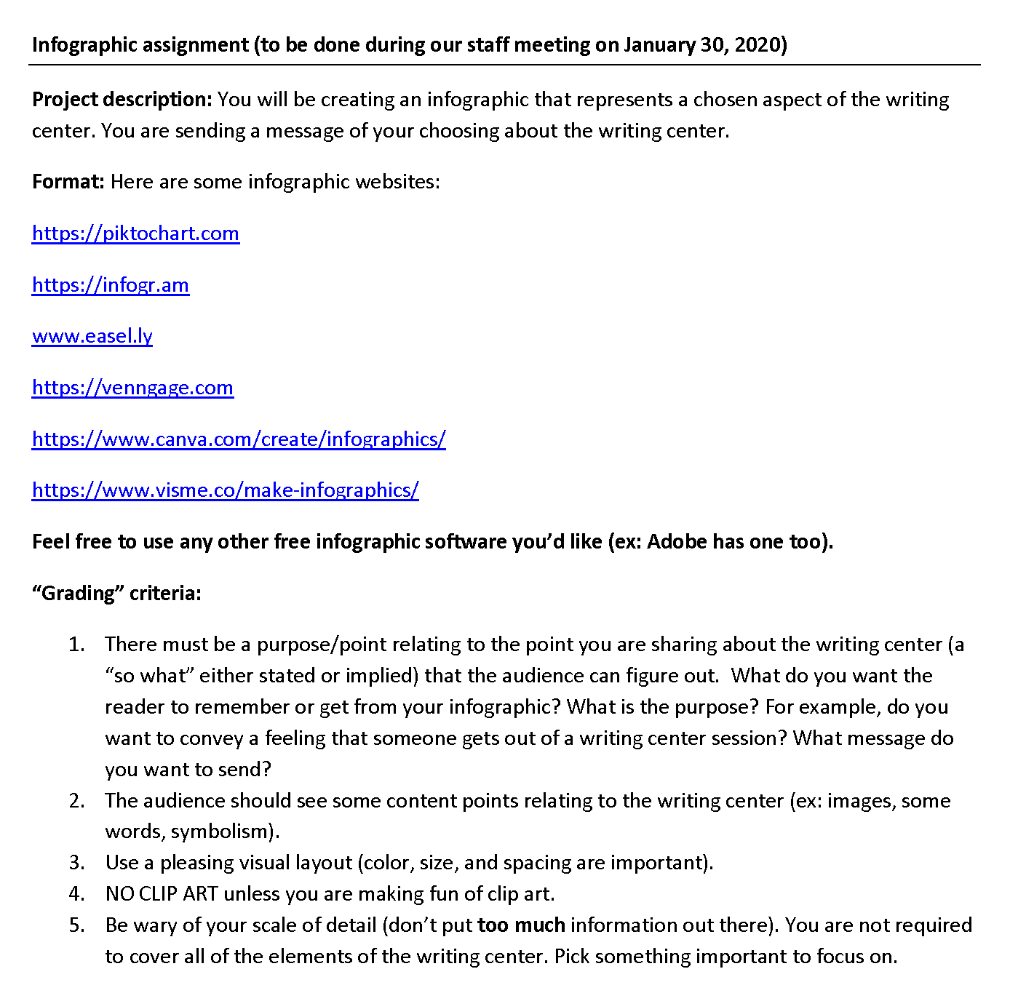
writing center staff training
Step 1: Assignment sheet
Get this handout: https://bit.ly/Gray-WC1

Slide 8
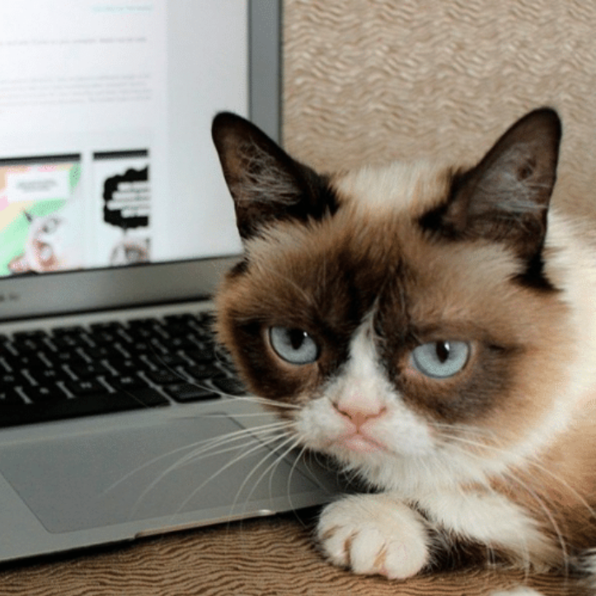
Training Step 2: Evaluating A Multimodal Artifact
Source: Me.me

Slide 9
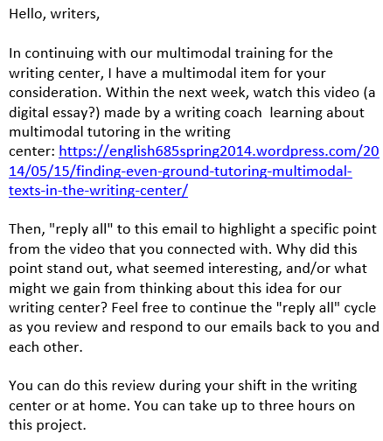
Writing Center Staff Training
Step 2: Emailed instructions Evaluating a Multimodal Document
Get this handout: https://bit.ly/Gray-WC2

Slide 10
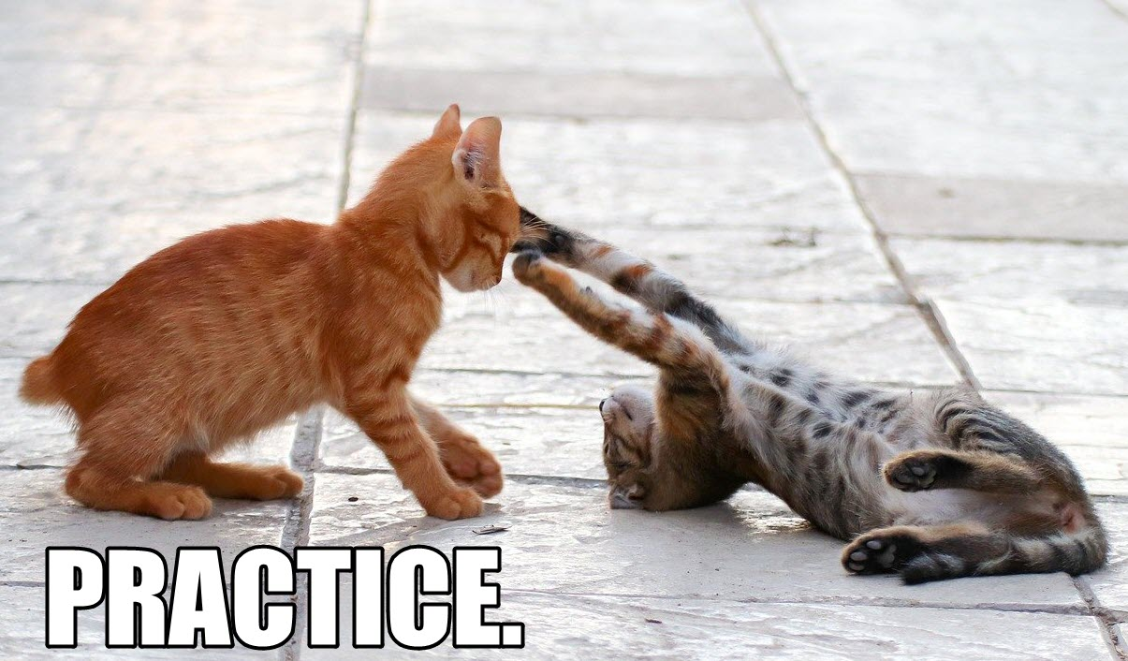
Training is a process.

Slide 11

Other considerations and conclusions

Slide 12
Read our Article!
“Multimodality and The Writing Center’s Role in Restoring Justice for ‘Bad Writers’” in The Peer Review 4.2.
http://thepeerreview-iwca.org/issues/issue-4-2/multimodality-and-the-writing-centers-role-in-restoring-justice-for-bad-writers/

Slide 13
References
Banks, A. (2015). Ain’t no walls behind the sky baby! Funk, flight, freedom. CCC, 67 (3), 267-279.
Coppola, S. (2019). Writing, redefined. Voices from the Middle 26(4), 17-20.
Darrington, B., & Dousay, T. (2015). Using multimodal writing to motivate struggling students to write. TechTrends, 59(6), 29-34. doi:10.1007/s11528-015-0901-7.
Dusenberry, L., Hutter, L., & Robinson, J. (2015). Filter. Remix. Make: Cultivating adaptability through multimodality. Journal of Technical Writing and Communication, 45(3), 299-322. doi:10.1177/0047281615578851
Eyman, D. (2019). Multimodal and multimedia projects in the writing center. A Blog of WLN: A Journal of Writing Center Scholarship.
Fitzgerald, L., & Ianetta, M. (2015). The Oxford guide for writing tutors: Practice and research. Oxford.
Gray, J. (2015). What do students think about the five-paragraph essay? Teachers, Profs, Parents: Writers who care. https://writerswhocare.wordpress.com/2015/05/26/what-do-students-think-about-the-five-paragraph-essay/

Slide 14
References, cont’d.
Schulze, H. (2014). Finding even ground: Tutoring multimodal texts in the writing center. Retrieved from https://english685spring2014.wordpress.com/2014/05/15/finding-even-ground-tutoring-multimodal-texts-in-the-writing-center/
Selfe, C. (2004) Toward new media texts: Taking up the challenges of visual literacy. In A.F. Wysocki, J. Johnson-Eilola, C. Selfe, & G. Sirc (eds.) Writing New Media: Theory and Applications for expanding the teaching of composition (pp. 67-110). Logan: Utah State Press.
Shipka, J. Toward a Composition Made Whole.
Stanford University Writing Center. (2019). Digital media consulting. Retrieved on from https://undergrad.stanford.edu/tutoring-support/hume-center/see-tutor/digital-media-tutoring

Slide 15
Image Citations
Slide 1: File:Lolwut cat.jpg
Slide 5: https://i.redd.it/5nkqinpmlh131.jpg
Slide 10: Mad The Internet GIF by moodman
Slide 12: Grumpy Cat Computer | Meme Generator
Other images remixed CC0 1.0 from Piqsels.com.

