Slide 1

Promoting ESL Students’ Writing Development in Online Synchronous Tutoring: a Dynamic Assessment Approach
Ruge Zhao
rqz5183@psu.edu
The Pennsylvania State University

Slide 2




Agenda
ESL writing tutoring: The context
A Vygotskian socio-cultural perspective: ESL writing tutoring as a dialogic mediation
Pedagogy: Dynamic assessment-informed tutoring practice
Discussion: benefits and drawbacks

Slide 3

ESL writing tutoring
I tutored first-year ESL students once a week via zoom for 13 weeks throughout a semester
Question: How to promote ESL writers' writing learning and development in online tutoring

Slide 4

ESL writing tutoring
One-to-one writing tutoring provides significant learning opportunities where ESL writers receive individualized assistance on their rhetorical and language concerns (Harris & Silva, 1993).
Cultural preference: “contrastive rhetoric”
Set the agenda: assessment: language proficiency or? writing skills
Grammar: explicit rules?

Slide 5

ESL writing tutoring
A need of theoretical conception that could explain and encompass the full range of successful practices if our goal in writing center work is to help students develop their skills on writing (Nordlof, 2014)

Slide 6
A Vygotskian socio-cultural perspective: ESL writing tutoring as a dialogic mediation
MEDIATION
THE ZONE OF PROXIMAL DEVELOPMENT
Humans‘ mental functioning is mediated by cultural artifacts such as language, literacy, numeracy,etc.
Other-regulation: describes mediation by people and can include explicit or implicit feedback on grammatical form, corrective comments on writing assignments, or guidance from an expert or teacher.
“the distance between the actual developmental level as determined by independent problem solving and the level of potential development as determined through problem solving under adult guidance or in collaboration with more capable peers” (Vygotsky, 1978, p. 86).
Notes:
Here I need to introduce V and SCT a little bit.
And then introduce “mediation” a little bit.
Conclusion:
The quality of the interaction, mediation matter because it affect how students regulate。

Slide 7

A Vygotskian socio-cultural perspective: ESL writing tutoring as a dialogic mediation
L2 DYNAMIC ASSESSMENT：AN APPLICATION OF ZPD
Dynamic Assessment is the contingent mediator-learner interaction where mediator diagnose what the learners know and render mediation to expand their ability in a specific learning context. (Lantolf & Poehner, 2014; Poehner, 2018)
Forms of mediation can be offering prompts, models, feedback, leading questions, and other forms of support (Poehner, 2018).
Notes:
Here I need to introduce V and SCT a little bit.
And then introduce “mediation” a little bit.
Conclusion:
The quality of the interaction, mediation matter because it affect how students regulate。

Slide 8
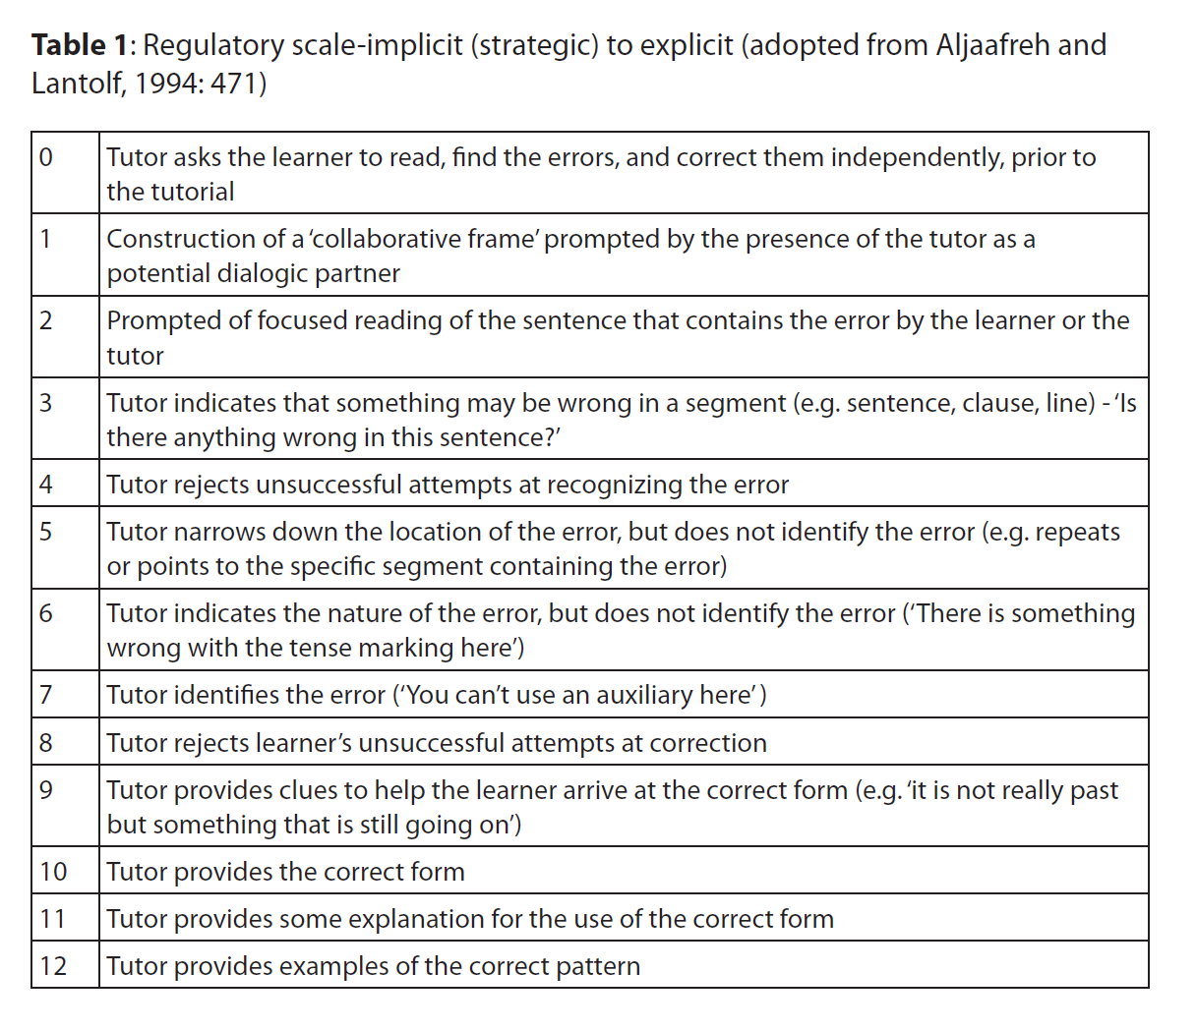
A Vygotskian socio-cultural perspective: ESL writing tutoring as a dialogic mediation
L2 DYNAMIC ASSESSMENT：AN APPLICATION OF ZPD
Aljaafreh and Lantolf ’s (1994) study is the first study that illustrate tutors using hierarchical feedbacks from implicit to explicit in ESL writing tutoring. Mediation are graduated and contingent.
Rahimi et al (2015)
Notes:
Here I need to introduce V and SCT a little bit.
And then introduce “mediation” a little bit.
Conclusion:
The quality of the interaction, mediation matter because it affect how students regulate。

Slide 9
Pedagogy: Dynamic assessment-informed writing tutoring practice
Guidance and collaboration:
Leading questions
Open-ended questions
“Tell me more about …”
“Walk me through …”
→ Assess where the students are
→ Engineer participation (Johnson et al, 2020)
Build on students’ responses
Acknowledge their contribution
Modeling
Relate to what you are tutoring
Provide guidance from implicit to explicit and be flexible!

Slide 10
Discussion: benefits and drawbacks
Individual difference
Rapport: tutoring is a relationship
ESL Students’ autonomy and development
Can be challenging for novice tutors

Slide 11
Reference
Harris, M., & Silva, T. (1993). Tutoring ESL Students: Issues and Options. College Composition and Communication, 44, 525-537.
Johnson, K.E., Verity, D.P., & Childs, S.S. (2020) Praxis-oriented pedagogy and the development of L2 novice teacher expertise. The European Journal of Applied Linguistics and TEFL. 9(2) 3-23.
Lantolf, J. P., & Poehner, M. E. (2014). Sociocultural theory and the pedagogical imperative in L2 education: Vygotskian praxis and the research/practice divide. Routledge
Nordlof, J. (2014) Vygotsky, Scaffolding, and the Role of Theory in Writing Center Work. The Writing Center Journal, 34(1), 45-64
Poehner, M. E. (2018). Probing and Provoking L2 development: The Objects of mediation in Dynamic assessment and mediated development. In Lantolf, J. P. and Poehner, M. E. with Swain, M. (Eds.), The Routledge Handbook of Sociocultural Theory and Second Language Development (pp.249-265). Routledge.
Rahimi, M., Kushki, A., & Nassaji, H. (2015). Diagnostic and Developmental Potentials of Dynamic Assessment for L2 writing. Language and Sociocultural Theory
Rahimi, M., Kushki, A., & Nassaji, H. (2015). Diagnostic and Developmental Potentials of Dynamic Assessment for L2 writing. Language and Sociocultural Theory, 2(2), 185–208.
Vygotsky, L. S. (1978). Mind in society. The development of higher psychological processes. Cambridge, MA: Harvard University Press.

