Slide 1
INSPIRING TUTORS TO MOVE BEYOND COMPETENCE AND COURTESY TO COMPASSION ONLINE
Katherine Schmidt, Ph.D.
Writing Center Director Western Oregon University
Sean Tellvik, B.A.
Writing Center Lead Tutor
Western Oregon University

Slide 2

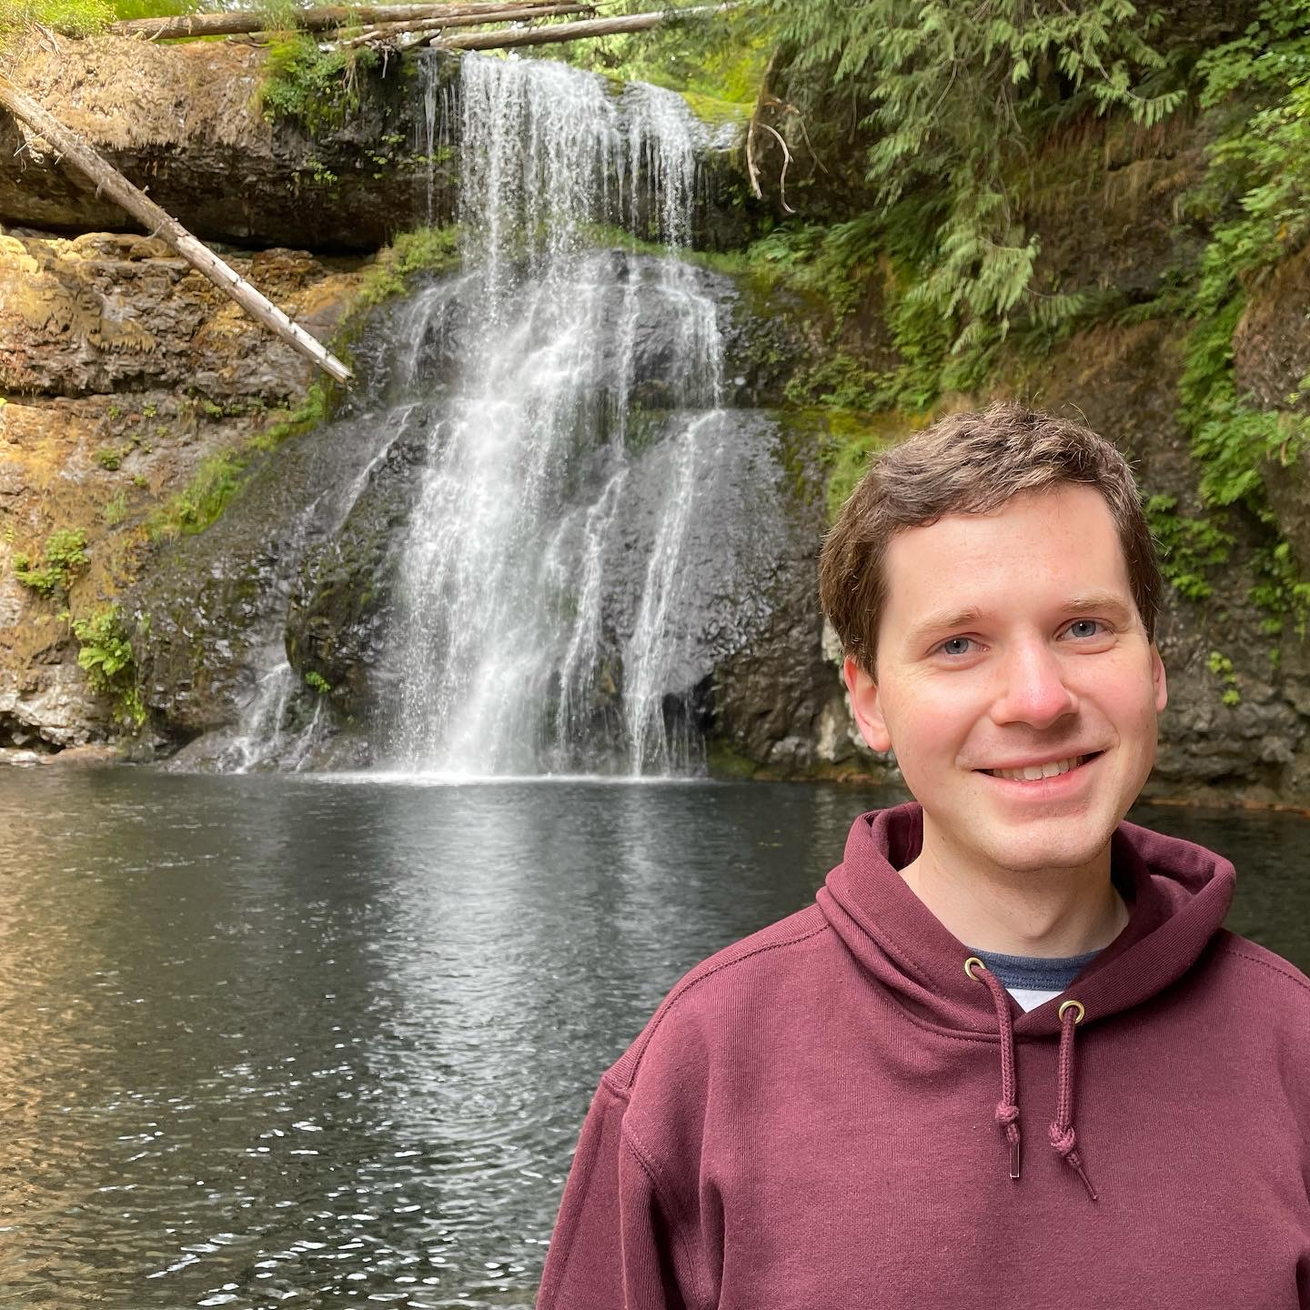
PRESENTER BIOS
Katherine Schmidt, Ph.D.
Writing Center Director and Professor
Western Oregon University
Sean Tellvik, B.A.
Writing Center Lead Tutor
Western Oregon University

Slide 3

OUR MISSION
writerly self-efficacy
strategically
repeatedly
over time
Notes:
ST: Years ago, after engaging in quantitative research on writing self-efficacy, we changed our mission: “As an academic support service that promotes the educational mission of Western Oregon University, the Writing Center [SPACE]
advances the writerly self-efficacy of every writer who uses the [SPACE X 3]
Writing Center strategically, repeatedly, and over time.”
And what we soon learned was that the key [SPACE]

Slide 4

CULTURE
INVESTING IN OUR EMPLOYEES

Slide 5
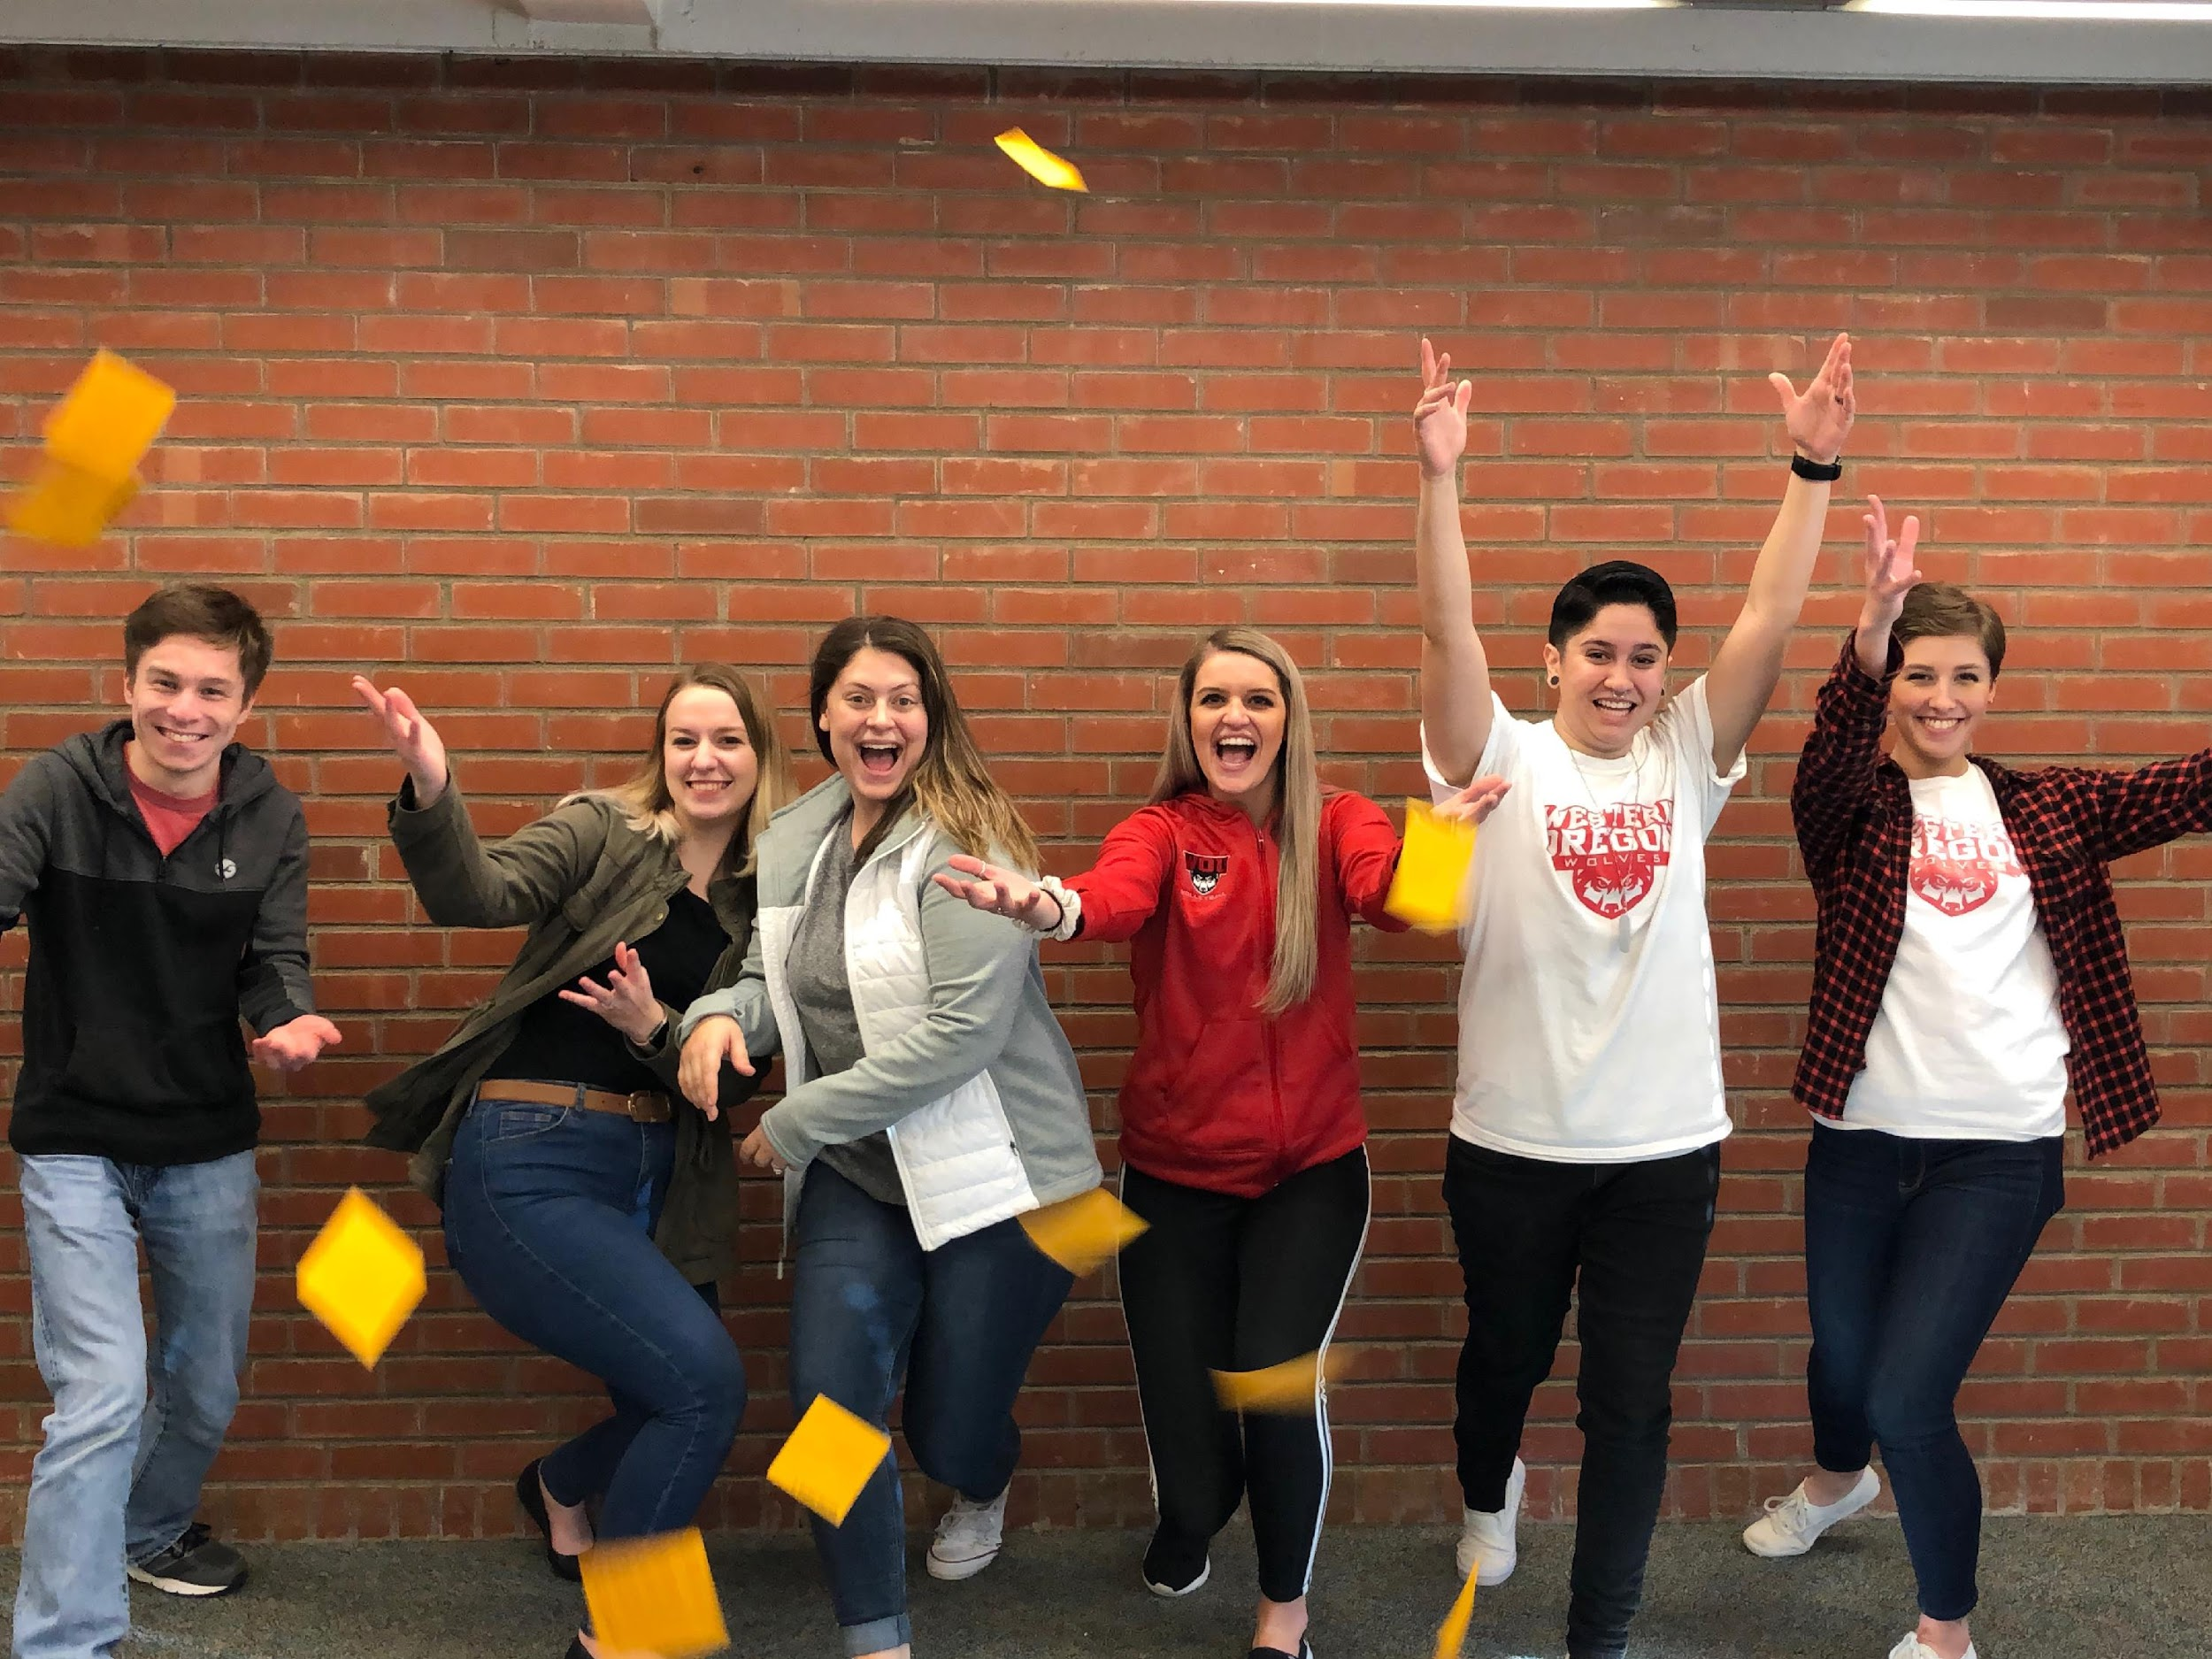
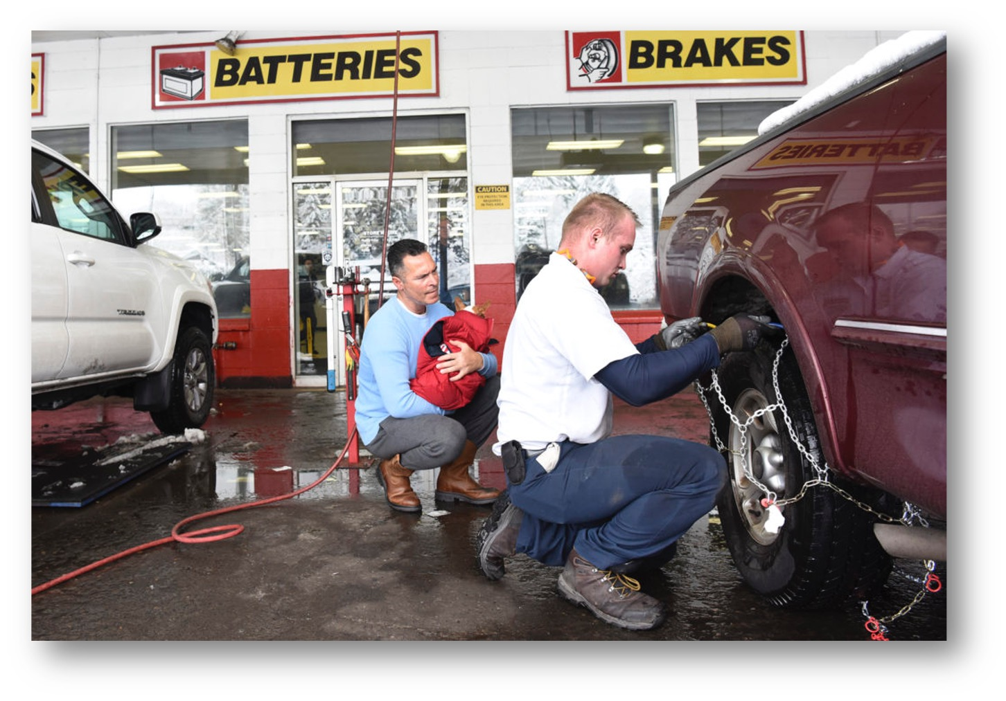
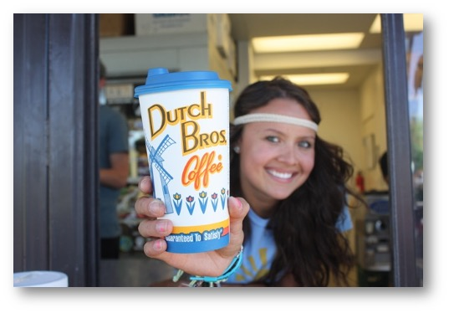


Slide 6

SCRIPTS SESSION OBSERVATIONS LIVE TUTOR-TO-TUTOR CHAT SUPPORT

Slide 7
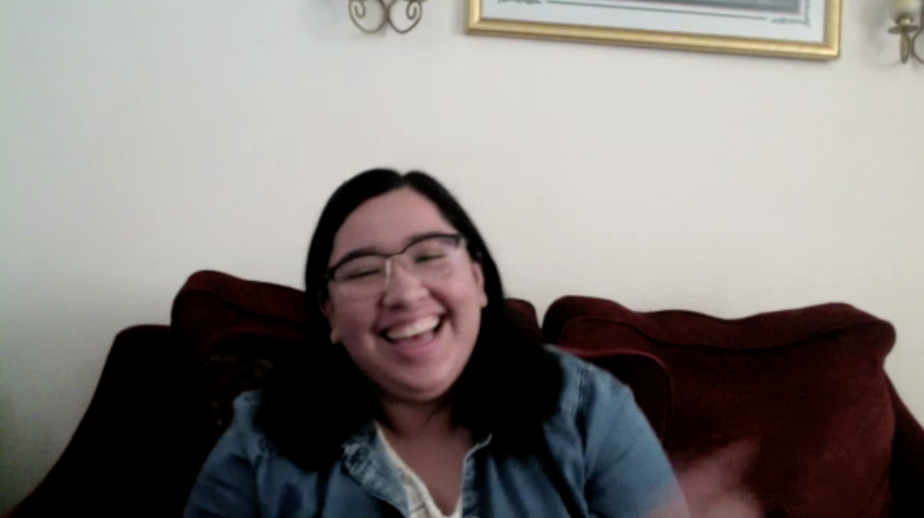
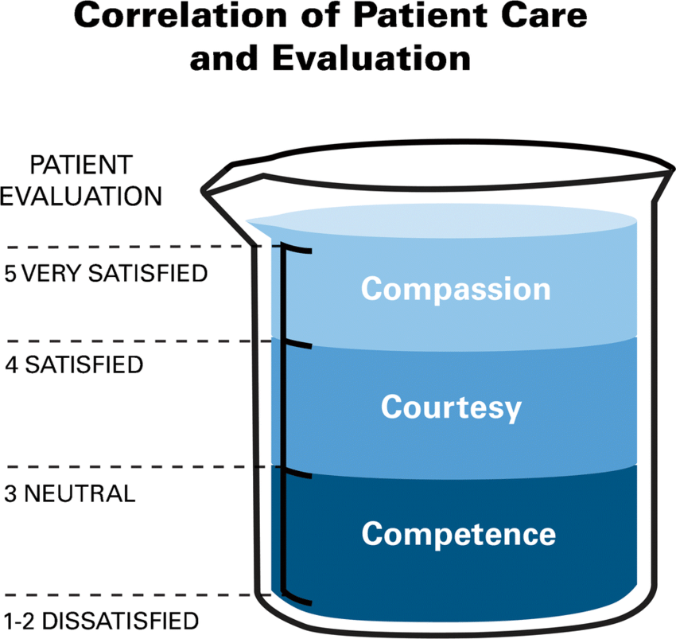
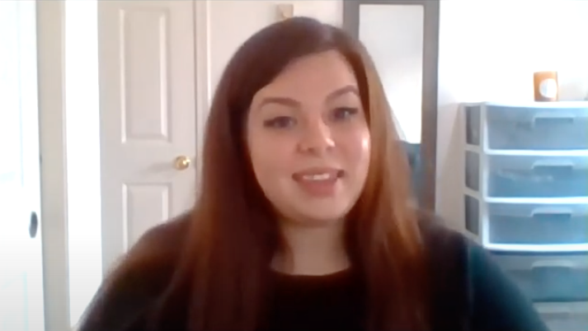
LEVELS OF CARING

Slide 8
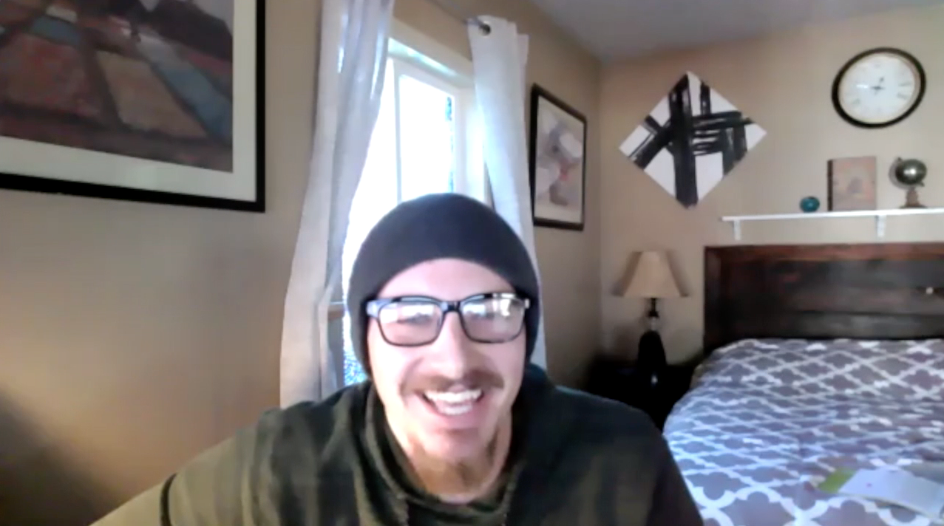
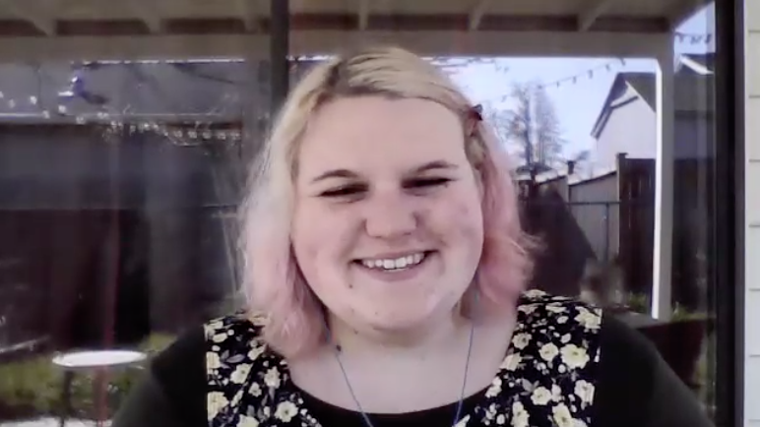
LEVELS OF CARING

Slide 9
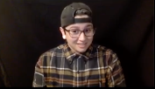
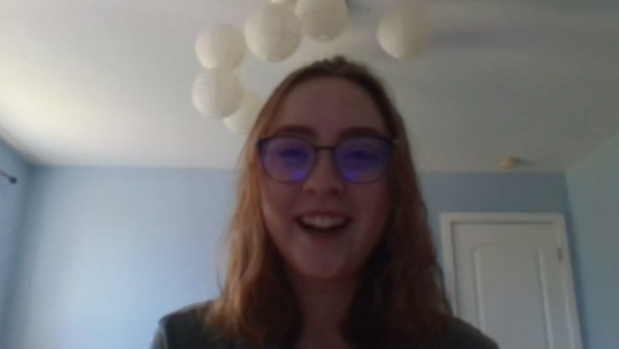
LEVELS OF CARING

Slide 10
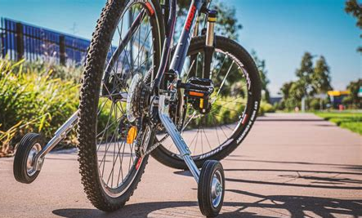
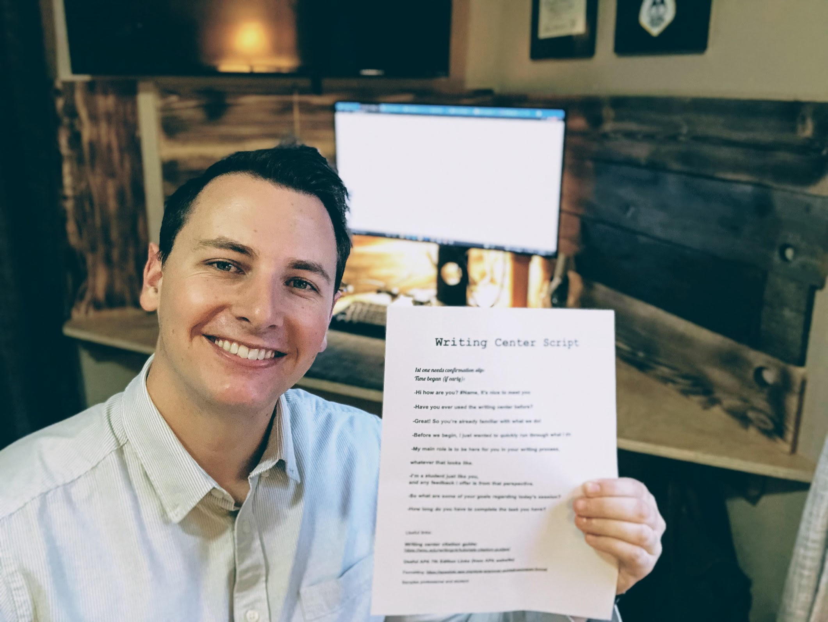
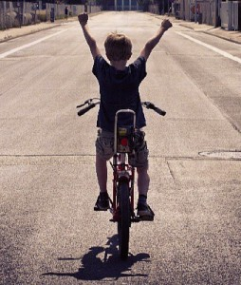
SCRIPTS

Slide 11
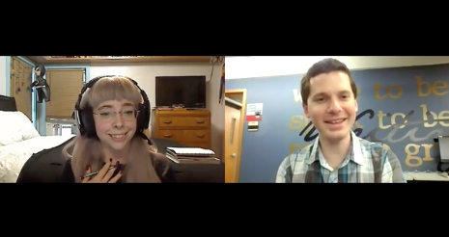
SESSION OBSERVATIONS

Slide 12
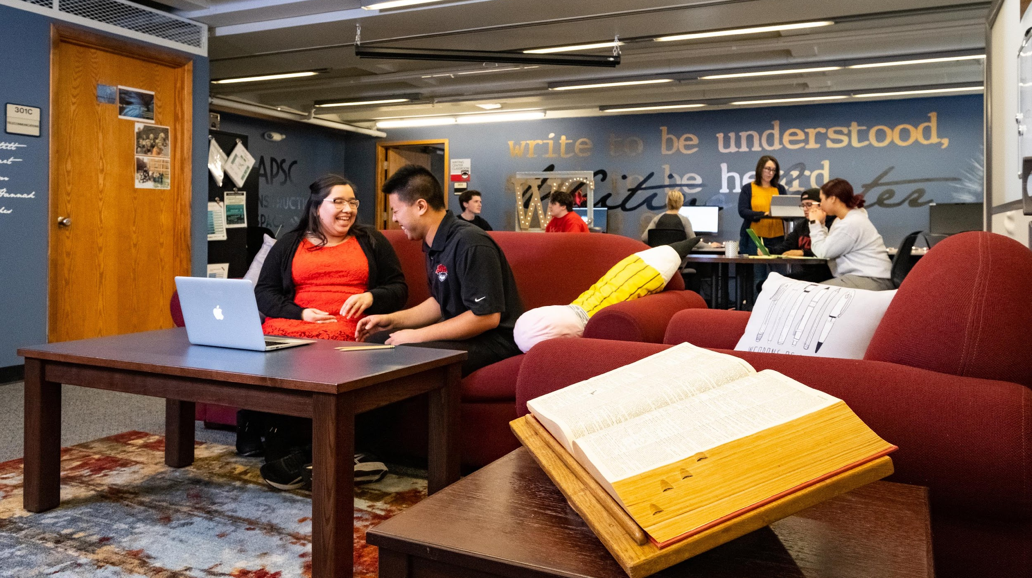

Slide 13
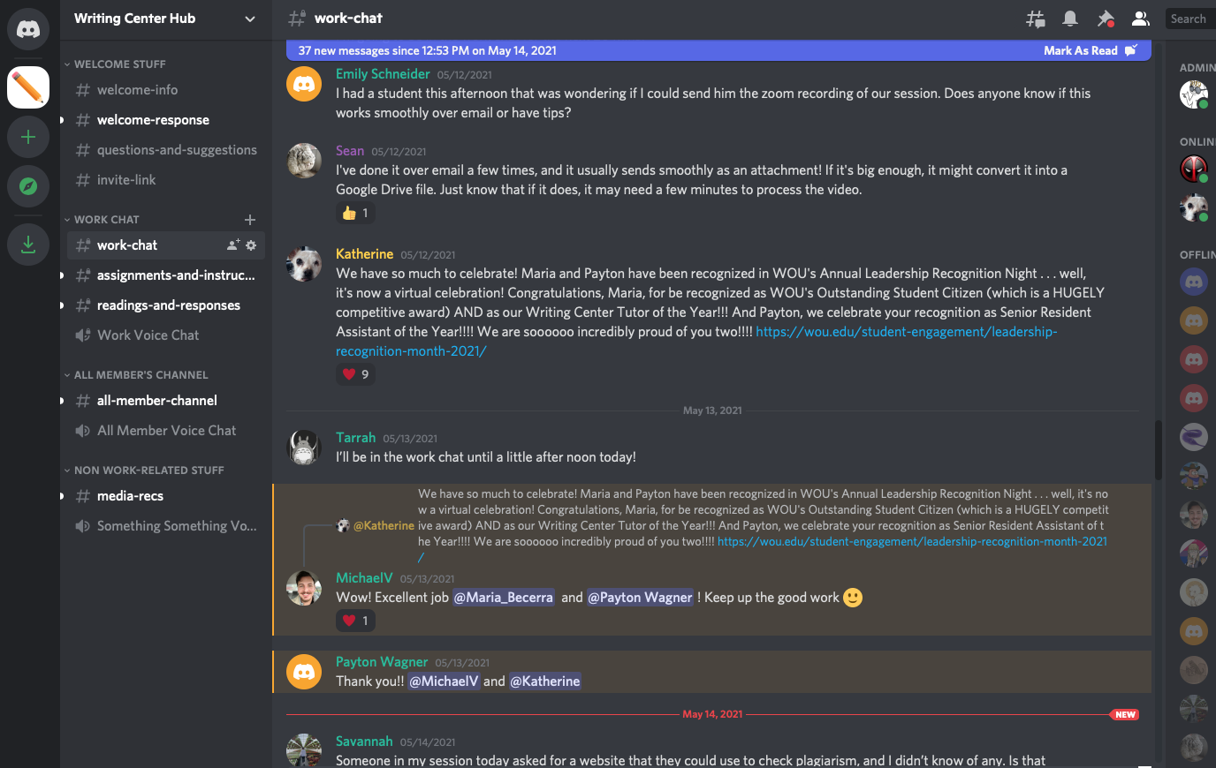
LIVE TUTOR-TO-TUTOR CHAT SUPPORT

Slide 14
COMMENTS OR QUESTIONS?
Katherine Schmidt and Sean Tellvik
writingcenter@wou.edu

Slide 15
WORKS CITED
Costello, K. “Naming and Negotiating the Emotional Labors of Writing Center Tutoring.” Wellness and Care in Writing Center Work. Press Books. 2020.
Johnson, D. W. & Johnson, R. T. (2017). The use of cooperative procedures in teacher education and professional development. Journal of Education for Teaching, 43(3), 284-295. https://doi.org/10.1080/02607476.2017.1328023
Lee, F. If Disney Ran Your Hospital 9½ Things You Would Do Differently. Second River Healthcare Press. Bozeman, MT. 2004.
Sze, Raymond & Vera, Chido & Hogan, Laurie & Iyer, Ramesh. (2019). “If Disney ran your pediatric radiology department: a different approach to improving the patient and family experience.” Pediatric Radiology. 49. 493-499. 10.1007/s00247-018-4308-4. (IMAGE ON SLIDE 8)

