Slide 1
Experimenting With Peer Mentoring:
Models for Professional Development
Emily Gresbrink, University of Minnesota
Michelle Cohen, Medical University of South Carolina
Paula Rawlins, Yale University
Beth Nastachowski, Walden University

Slide 2
Piloting a Mentor Program:
Experiences and Lessons
Emily Gresbrink
University of Minnesota
gresb008@umn.edu

Slide 3
Program Overview
Origins
  Why a mentoring program?
  Why industry and academia combined?
Where the program stands today
Notes:
I will begin by giving a bit of background about the mentoring program which laid the foundation for my interest and experience within mentor program implementation, development, and administration. At my home institution, the University of Minnesota, I was working with Dr. Lee-Ann Kastman Breuch and Dr. Ann Hill Duin in the summer of 2018 as a research assistant for the department’s technical communication advisory board (or, tee-cab). The three of us came together in a meeting early in the school year to brainstorm an idea for a mentoring program which bridged together students working in academia, and industry professionals - mainly those working in technical communications adjacent positions, but also some alumni of the writing studies graduate program as well. Towards the end of fall semester of 2018, we launched the program with a handful of mentor-mentee pairings with the goal of keeping pairings together for at least one semester.
So, why a mentoring program? Quoting Breuch, Duin & Gresbrink (forthcoming), academia exists within a bubble, and real-world workplaces are difficult to recreate in an academic setting without students taking on intern or externships or working roles. In the context of the advisory board, this was the closest that students in the department could get to real-world, hands-on experience while remaining in academia.
Now, why an industry and academia combined? Why not a mentoring program just within the department or on campus? Drs. Breuch and Duin and I went for industry and academia combined because, based on conversations, the mentor program with industry experts was an experience that students couldn’t get in a course to date at the U of M; and, we hypothesized an experience like this could strengthen academic and professional experiences before entering the workforce or continuing into higher education.
As a quick side note: the TCAB (advisory board) itself is still going strong. The mentoring program itself, as of 2021, is still operational and has paired mentors and mentees together with successful outcomes for undergraduate and graduate students, as well as industry and academia professionals. The program’s status is TBD for this upcoming fall semester. I would guess it's still going to happen if interest is in place, which would mark its third year.

Slide 4
How the Program Works
Pairing process
Meetings and activities
Goals, and outcomes
Notes:
Next, I’ll briefly explain how the mentoring program works. In the pairing process, when I worked with the program, we began with two separate paths. Mentors on the advisory board, as well as some external mentors with connections to the program, expressed interest in serving as mentors. They provided a list of skills, based on a prescribed list of common competencies and terms found in a TPC program. Then, we put out a call to students - undergrad and graduate - to join the program. We had them list interests (the same as mentors), and write a paragraph about why they wanted to join. Based on this qualitative and quantitative data, we made pairs based on best matches; this was usually based on industry expertise or interests.
The program itself had a kick-off meeting, where mentors and mentees met in person and spent the session getting to know each other, discussing goals for mentorship, and gathering contact information using a guided worksheet. Activities during the program, after that point, were contingent on mentor-mentee decisions; we recommended a few meetings (I believe 2-4), but they could meet more often or less frequently as the relationship allowed. They could occur at the mentor’s workplace, on Zoom or Google Hangouts, or at a neutral location.
The goals and outcomes of this program were to narrow the gap between academia and industry, as informed by a community of practice theory and framework. For those interested in theory and research: a good resource for this here is Duin and Tham (2018), and Wenger (1998), and Kline and Barker (2012). We also wanted the program to build relationships that enhance professional development for all parties, help the student develop a personal learning network (PLN), and articulate clear goals for professional development.

Slide 5
Implementation
Program logistics
  Planning and prep tools
  Research considerations
  Mid-program modifications
What worked
What didn’t work
Notes:
Finally, let’s reflect a bit on the experience. I genuinely love mentorship and mentoring programs, and perhaps coordinating things a little too much. So, for me, the opportunity to help pilot a program with something I am passionate about (like mentoring) was a dream. That said - from a logistics perspective, a lot more than I anticipated went into this. Having a blank slate and many slate pencils was the dream, yes, but it was a lot! I’m forever grateful to Drs. Breuch and Duin, and remain grateful for those who continue to support mentorship program development and program launches. It’s not an easy feat and it's very contextual, no matter where you go.
Returning to the U of M: from a planning and preparation stance, we had to prepare the program from a two-fold approach. Not only did we have to take into consideration the needs and wants of the students, but the mentors as well; if the goal was to have a mutually beneficial project, then all needs across the board had to be considered and met as broadly as possible. Not the easiest feat when you have a lot of stakeholders in the game! But, definitely worth it. And, research considerations also were in place from day one. As a research assistant at the time, I knew I wanted to do some tangible research with this subject. The process of getting IRB approval, documenting, interviewing, and writing up the study was time consuming as well. But, again, definitely worth it.
Finally, we know some things will inevitably go wrong. So, midway through the program, people will fall off the face of the earth, there will be complaints, meetings will get scheduled and rescheduled - but things will also go really well, and that’s a big reward of mentorship and scholarship related to it.
And, overall, things did go well in this pilot study. Some things that specifically went well were the overall experience; mentors and mentees had overwhelmingly positive responses to the program, including satisfaction with the pairs and goal achievement. Students felt the program was successful in bridging the gap between industry and academia as well, with mentees specifically mentioning a deeper understanding of industry insights and procedures.
And some things that did not work were, generally speaking, dissatisfaction with pairings, not being able to meet as often, or confusion with the goals - these are not inherently complaints with the structure of the program itself, but more of an insight into user contexts; it would have been interesting, in hindsight, to know exactly what went wrong besides “I didn’t like my mentor.” Why specifically, or what would have worked better?

Slide 6
Implications and Future Directions
What does this mean for the program?
  Longevity in relationships with mentors
  Longevity in programming for mentoring and mentee opportunities
  Networking opportunities
What does this mean for me?
  Project management skills
  Networking
  Academia-Industry Transference
Notes:
So, what does all this information mean going forward? A big thing here is the idea of community - the gap between industry and academia and the duration of community (or, the longevity of the program). The program itself was successful and continues to be, which is good! I am curious to see how things go as we enter the second/third year of the pandemic, too; how does moving this online impact the program outcomes and thoughts, and what can we learn about community, user experiences, and goal-setting that we can apply to other mentorship work and mentoring programs?
That covers my part of this presentation and some thoughts and lessons picked up in my work piloting and working with mentor programs. Thanks for taking the time to listen and reflect with me.

Slide 7
Creating “Mentorship Groups”
Among WC Staff
Michelle Cohen, PhD
Medical University of South Carolina
cohenmi@musc.edu
Notes:
Slide 1: Hi all, I wanted to share with you my experience developing a collaborative professional development program that we used with our tutoring staff at my previous institution

Slide 8
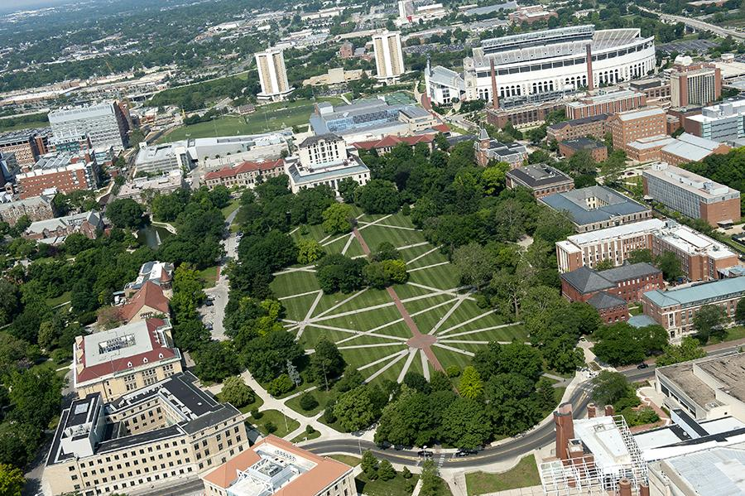
Context
Large public institution
WC staff of 30+, including:
Undergrad & graduate peer tutors
3-5 graduate Assistant Coordinators (ACs)
1 Coordinator/Director
2014: Initiated ongoing PD at weekly staff meetings
Notes:
That institution was huge--and our Writing Center staff was relatively large as well. We had a tutoring staff of around 35 undergraduate and graduate students. At the time I worked there, we also had 5 graduate students (myself included), employed as “assistant coordinators” or “ACs.” Broadly, our job was to act as liaisons between the coordinator and the tutoring staff. More specifically, we each oversaw different “zones” of administrative work to help the center run smoothly, from scheduling staff to coordinating our center’s writing groups.
When I was hired as an Assistant Coordinator circa 2014, my job was to oversee training and professional development. Previously, we had had weekly (paid) staff meetings really just as check-ins on logistical problems, but we provided no regular, ongoing PD after our pre-semester training. In my first year as AC, I spent hours each week planning hands-on large- and small-group activities and inviting university partners and even individual tutoring staff to present on their areas of expertise. I wanted staff meetings to prompt reflection, connection, and engagement among our staff. At the end of the year, though, we surveyed our staff and found that they felt staff meetings felt a little too much like class--which wasn’t quite our goal.
That year, I attended a workshop at the Eastern Central Writing Center Association (ECWCA) Conference with my colleague Sara Franssen Wilder (also an AC at the time). In the workshop, the facilitators talked about a program in which they paired each new consultant with a returning or “veteran” consultant. Building off of this idea, Sara and I decided (rather than doing one-on-one pairings) to create small-group mentoring opportunities for our own staff.
Image is of large university campus. Image credit: https://www.osu.edu/initiatives/corporate-engagement/

Slide 9
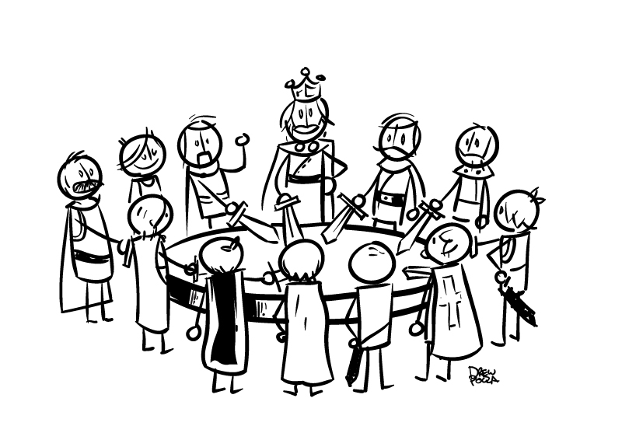
Mentorship Group Rationale
Emphasize WC as a (largely) nonhierarchical space
Formally encourage peer mentoring
Allow staff to set the agenda
Invite in more (all!) voices
Notes:
The concept behind these new “mentorship groups” was to emphasize the nonhierarchical ideals of the writing center. Of course, we did have an explicit hierarchical reporting structure (between admin and tutoring staff). And we were also also somewhat aware that our center had an implicit social hierarchy (where, for example, an undergrad tutor reported feeling some imposter syndrome around graduate tutors)--our goal was to move towards something more like the “Knights of the Round Table” (the cartoon you see on this slide) so that each staff member felt welcome and valued.
As a peer-to-peer writing center, we really did believe in the power of peer mentoring, and we wanted to formally sanction a space for that sharing to happen. Actually, this was an important goal to compensate for our physical space in particular, because we didn’t have a very accessible breakroom where consultants could talk confidentially in between their sessions. Mentorship groups could be a safe space for consultants to reflect on their sessions.
We also wanted consultants to be able to decide what their own PD would look like. To plan meaningful all-staff meetings, I had put so much work into identifying consultants’ professional needs and planning activities to meet those needs. But mentorship groups could give consultants room to reflect on and explore their own concerns much more organically.
So together, all of these goals meant we wanted each writing center staff member to feel like an equal and active partner in their own learning and professional growth.
Image credit: http://globalperspectives.info/clipart/k/king-arthur-clip-art.html

Slide 10

New PD Logistics
Weekly mentorship group meetings
  3-6 tutoring staff + 1 administrator
  Assigned based on scheduling availability
Monthly all-staff meetings
  Featuring mentorship group presentations
Notes:
To create the mentorship groups, we assigned usually around six staff members to a group (fewer during the summer), with one administrative facilitator (either an AC or the director). Sara and I tried to create some balance in each group, mixing students of different academic levels (grad or undergrad), WC experience, gender, etc. But most of our group assignments still came down to scheduling--as I’m sure others here know how difficult it is to schedule your staff.
During the regular school year, mentorship groups met three weeks out of the month. In the fourth week, we brought everyone together for an all-staff meeting so we didn’t lose out on our large-group fellowship. At most all-staff meetings, a different mentorship group would present or facilitate. This also gave each mentorship group a common goal to work towards during their sessions together.
Image description: Multicolored strands, braided together

Slide 11
Lessons Learned
Pros: Welcomed more voices, including undergrad and L2 student tutors (Aberl
& Wilder, 2016)
Established regular contact between tutoring and admin staff
Freed up PD planning time
Cons: Challenges in finding common ground (esp. between admin and tutors)
Lopsided motivation & success, depending on the group
Considerations: Challenges can point to areas for growth
Can/should staff take even more ownership in grouping
themselves?
Notes:
So--lessons learned from this experience: While I was an Assistant Coordinator, I learned a lot from facilitating mentorship groups (I facilitated a different group each semester)--although more formal evaluation is needed (as some of my data has been lost while transitioning to new institutions).
From what I saw: First, students did tell us that they felt more welcome in mentorship groups, especially undergraduate students, L2/international students, or students who were just a little quieter (and felt less comfortable speaking up in a large group). In fact, Sara and an advanced undergraduate tutor, Katelyn Aberl, co-presented on this mentorship group outcome at CWPA [i.e., Council of Writing Program Administrators Annual Conference (Aberl & Wilder, 2016)]--and by the way, I love that from the coauthoring of that presentation, we can see a peer tutor and graduate admin collaborating on scholarship.
I also witnessed students take initiative in these groups to contribute to the center. For example, one group I was in drafted and proposed a new observation protocol after surveying other mentorship groups. In PD evaluations, it was neat to see students say positive things, like that they valued the opportunity to help shape the center, that they felt like collaborators with the administrative team, and that they regularly got to use us (the admin team) as resources--whether to ask questions or to have a direct line of reporting (and solving!) problems in the center.
As the PD AC, I can also say that mentorship groups freed up planning time--massively. All that time I had spent planning meetings and drafting meeting minutes was suddenly time I could use to support other activities in the center.
On the other hand, I’d like to share some problems or disappointments I encountered. I will note note that these are based on my own experiences and perception, rather than more objective data:
First, as an admin with no scheduled tutoring hours, my regular work didn’t look like that of my groupmates. So in one group, for example, we did weekly “highs and lows,” and I struggled to balance transparency with discretion. Whereas a consultant could use the group to troubleshoot problems they had had with a client, I avoided sharing lows that were often really the crux of my job: that is, navigating internal interpersonal challenges among our large administration and staff. I always felt a bit awkward about my own role in the group, although I really valued learning more about my groupmates’ troubles and triumphs and just “talking tutoring” each week. And on the whole, that group was such a wonderful mix of graduate and undergraduate women, and they continued to meet and socialize informally because they so enjoyed our time together.
But some other groups struggled with common ground as well in other ways, particularly when motivation or buy-in was lopsided. Students who were less interested in growing in their writing center practice would regularly miss group meetings or disengage from their groupmates. These weren’t necessarily new PD problems for us, but they seemed more prominent in this small-group format; it could really disrupt that energetic, inquisitive, and collaborative dynamic we were after. Each term, some groups just gelled better than others.
I do think, though, that these issues weren’t a result of the mentorship group model; rather, they pointed to some underlying areas of where our center as a whole could improve (like assigning admin tutoring hours, or working to reduce burnout among our staff). I have wondered, though, if in the same way that all that PD work was alleviated by mentorship groups, maybe we should have given students more control over who was in their group and when they met. Could that increase buy-in and consistency across groups? Overall, there are many options for designing group mentoring and reflecting upon those choices, and so I am excited to be working with the OWCA Mentoring committee and to hear the experiences and takeaways that my copresenters are sharing on this panel today.
Citation: Aberl, K. and Wilder, S. (2016, July). Considering hierarchies of perspective: A critical conversation on mentorship groups in a writing center. Council of Writing Program Administrators Conference. Raleigh, NC.

Slide 12
Promoting Belonging through Group Mentorship:
One Writing Center’s Work in Progress
Paula Rawlins, PhD
Assistant Director, Yale College Writing Center
Yale University’s Poorvu Center for Teaching and Learning
Paula.Rawlins@yale.edu
Notes:
Hi everyone, and thanks for joining us today! I’m Paula Rawlins, and as this slide says, I’m the Assistant Director of the Yale College Writing Center, which means I support the teaching of writing specifically for Yale’s undergraduate students. I have to begin my talk by thanking Michelle. Not only for her great presentation but for helping me imagine and talk through ideas for the mentoring program we are fostering this year in our Center.

Slide 13

New Role, New Challenges
Objectives:
  Build community
  Increase diversity
Challenges
  Online only
  Staff size
Notes:
First, I’ll provide some background for what led to our Center piloting a mentoring program in the fall of 2021. I began my position in Yale’s Writing Center in February of this year. While I wanted to make sure I didn’t come in and start changing too many, if any, aspects of the Center right away; I did immediately begin to notice ways I could bring my own administrative philosophy to the center. These ideas largely fell under two objectives: 1) create a greater sense of community or belonging among our tutors, or Writing Partners (WPs) as we call them, and 2) recruit and hire a staff of Writing Partners that more closely represented the diversity of our college’s student body as a whole. According to the Yale Daily News, more than 50 percent of non-international Yale College students admitted in 2019 self-identified as a race or ethnicity other than white (Wei). For me, this signaled that while hiring a more diverse staff would require a pro-active and mindful effort, it was a goal very much within reach.
However, the former objective of creating a greater sense of community in the Center would prove more challenging, yet all the more important due to a more diverse incoming staff. I will never forget how I felt I had found my people when I first began working in a writing center as a sophomore at my undergrad institution. While I know not everyone will identify as a “Writing Center person” for the rest of their career, I do strive to create a sense of community and belonging in whatever Center I help direct. And, especially as Diversity, Equity, and Inclusion efforts spread across many campuses, it’s important to remember that a sense of belonging can be one of the greatest predictors of students’ success (Gopalan and Brady). Fostering a sense of belonging seemed an exceptional challenge at first due to our services being completely online thanks to the continuing pandemic in Spring 2021. A second challenge was our staff’s size.
When I first realized the size of our staff, I was almost incredulous that any sense of community could be realized. Despite being a comparatively small school overall, with about 4,500 undergraduates, our Center is fortunate enough to employ an average of over 100 Writing Partners annually. This year we rehired 60 returning tutors, hired 33 new undergraduate tutors, and hired 20 new graduate tutors for a total of 113 Writing Partners. Certainly nothing like the close-knit group of tutors I became a part of when working at other Centers would be possible. This is where Michelle and the rest of this panel comes into play. While serving on OWCA’s Mentoring and Scholarship Committee, I was introduced to the idea of group mentoring. With its clear alignment with the theory and goals of writing center work, a plan for how to slowly build a greater sense of belonging for our tutors began to emerge.
Image source: https://pixabay.com/illustrations/keywords-change-fish-individuality-2488210/

Slide 14

Inclusive Excellence Framework
From Williams, Berger, and McClendon’s (2005) )Inclusive Excellence Change Model
The Inclusive Excellence Framework (IEF) used to examine objectives’ alignment with diversity, equity, inclusion, and social justice goals
Keys to Success:
  Co-created
  High-impact
  Mission-driven
  Equity-focused
  Transparent
  Measurable
Notes:
As I have developed my plan, I have repeatedly referred to The Inclusive Excellence Framework (IEF), which is used by various educational and government organizations to examine how change can be implemented in a manner that honors diversity, equity, inclusion, and social justice goals. Scholarship gives us six “Keys to Success with IEF” that I have repeatedly returned to while imagining and implementing our new mentor program.
According to an Inclusive Excellence Framework, any projects should be Co-Created so that anyone who will potentially benefit or be involved with the program has a role in developing the program. Second, programs should be High-Impact and maximize the benefit for everyone involved. What did the current Writing Partners feel about their experience working in the Center? Aligning myself with IEF principles, I wanted to ensure any initiatives I implemented took cues from the Partners themselves. So, during the spring of this year, I developed and ran four focus group sessions.
Image Source: https://pixabay.com/illustrations/group-therapy-counseling-health-2351896/

Slide 15
Focus Group Questions
What excites you about your current role and overall work in the YCWC?
What opportunities do you see for the YCWC to grow?
What are the biggest challenges and concerns for the YCWC in your eyes?
How do you feel about the amount of feedback and communication you receive from within the WC?
What was the hiring process like for you? How did you first hear of the Writing Center?
What elements of the training process did you find most valuable when you first started working as a WP?
Looking back, is there anything you wish had been included in your training as a new WP?
What expectations do you have for Paula as she enters the role of Assistant Director?
Notes:
All writing partners were invited to sign-up for a focus group or provide answers to the same questions asked in the focus group via an anonymous survey. Here, I share a list of questions asked during these focus groups. I provided opportunities to tell me what excited them about working in the Center and to provide feedback on challenges and opportunities for growth in terms of the Center’s overall work and the hiring and training processes specifically. Through asking these questions,I aimed to honor the keys of Co-Creation and High-Impact as I developed potential programming for the upcoming academic year.

Slide 16

Focus Group Findings
Staff meetings were a highlight of work
Desire for Individualized Feedback
Desire for More Professional Development
Notes:
During focus groups, I was pleasantly surprised to hear staff meetings were a highlight for some Writing Partners. They described how time with other Writing Partners and the Writing Center administrators provided an intellectually stimulating environment to ask questions and discuss concerns. Some noted how this atmosphere was a welcome change from meetings in other departments or organizations on campus.
Two other findings, though, reified my belief that a mentoring program would be a welcome addition to the Center. Multiple Partners expressed disappointment that they rarely, if ever, received individualized feedback after initial training. Others voiced a desire for more professional development opportunities, including more focused and intensive training. Based on these findings, I proposed a mission for our Writing Partner Mentor Program: to promote a greater sense of belonging among Writing Partners and to offer Writing Partners more opportunities for professional development. Thus, my objective became Mission-Driven, a key aspect of IEF.
Image Source: https://pixabay.com/illustrations/magnifying-glass-looking-for-find-1019982/

Slide 17
Expectations for Mentors
During new Writing Partner (WP) training and staff meetings, WP Mentors will be expected to lead small group activities and discussions
After training is complete, each Mentor will be assigned a “pod” consisting of 3-4 new WPs and a handful of more experienced WPs.
Mentors will be responsible for actively checking in with the members of their pod at least once a month.
WP Mentors agree to serve as a model for other Writing Partners by being observed
WP Mentors agree to act as an observer for other Writing Partners and provide constructive feedback
We hope to be able to provide funds that allow for Mentors to plan at least one small in-person social event for their pod later this term
WP Mentors will be expected to meet with WC Directors as a group two to three times each term.
Notes:
With this mission in mind, I drafted the expectations provided to our inaugural group of Mentors. These expectations include facilitating small groups during training and serving as an observer upon request for WPs in their assigned pod of both new and returning tutors.
I should note, though, in the spirit of “co-creation” and “high impact,” I did leave expectations purposefully vague in places. For example, I did not define what it means to “actively check-in” on other WPs, as I wanted to discuss what this might look like with our inaugural group of Mentors, who did indeed each bring their own ideas about working with their pod of mentees.

Slide 18
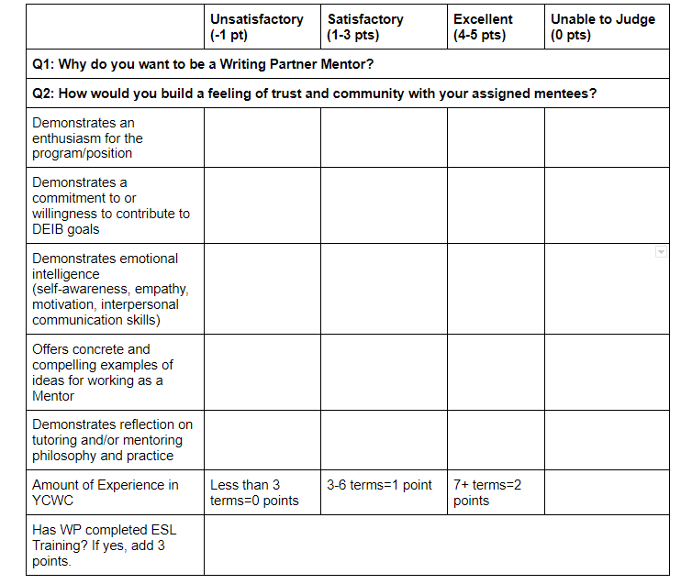
Notes:
Interested Writing Partners were asked to write brief responses to the questions “Why do you want to be a Writing Partner Mentor?” and “How would you build a feeling of trust and community with your assigned mentees?” To select our Mentors, we used a rubric that evaluated applicants on a scale ranging from Unsatisfactory to Excellent in five categories. First, we evaluated their combined responses to our two questions in five categories: Demonstration of an enthusiasm for the position; Demonstration of a commitment to or willingness to contribute to Diversity, Equity, Inclusion, and Belonging goals; Demonstration of emotional intelligence in the form of self-awareness, empathy, motivation, and interpersonal communication skills; Offering of concrete and compelling examples of ideas for working as a Mentor; and, finally, Demonstration of a reflective tutoring and/or mentoring philosophy and practice. In addition to the points earned based on their written application, we also awarded WPs who had worked for us for three to six terms an extra point and WPs who had worked for us seven or more terms two points. Finally, if a WP had completed our optional month-long ESL training, we gave them another three points. As I reviewed the 15 applications we received, I was struck by how many of our graduate tutors cited being a part of mentor programs at their undergrad institution as a reason for being interested in this program. One student’s response specifically referred to a group mentoring format, “At my undergraduate university's Writing Center, there was.a similar mentorship program with "Head Fellows" who were responsible for groups of new and veteran writing partners. As a new Writing Partner, I found this mentor (and the group overall) to be critical for establishing my comfort and confidence in the writing conference. After a year or two under my belt, the space that my head fellow offered gave me a place to renew my strategies and tools for working with students in the writing center.”
One of our undergraduate Writing Partners wrote in their application, “I’d love to serve as a Writing Partner Mentor because I’m in love with the concept. I wish it’d been around when I was just starting out! As a recently-hired sophomore, the thought of helping fellow Yale students was exciting. But it was also incredibly daunting, and it lent itself to imposter syndrome-esque feelings. ‘Who am I to help this fellow student with their paper?’ ‘Why should they listen to what I have to say?’ These feelings subsided with experience, but I think a mentor would’ve alleviated them from the get-go.” Such testimony reified my belief that group peer mentoring program would be a great asset for our students. Using our rubric described above, my Director and I chose our 12 inaugural Writing Partner Mentors.

Slide 19
Meeting with Mentors
Restorative Justice Circle
  Community agreements include respect for one another and privacy of the circle
  Everyone invited, not required, to speak and share from the heart
Considered the questions:
  Check-in round: Please share one rejoice, one challenge that you are bringing with you into the circle today.
  Round 1: What is something you wish you had realized or learned about working as a writing tutor earlier than you did?
  Round 2: Share with us about a time when you felt a sense of belonging in a learning community (class, sport, etc). What helped you feel like you belonged? (conversely, you can share a time you felt you did not belong)
  Round 3: After actively listening: what resonated with you that someone said in circle?
Notes:
As I prepare this presentation, we are still early in the fall 2021 semester, so for now, I can only report on the success of our first meeting with our Mentors. I began this meeting with a key from IEF: Transparency by sharing the full story of how we arrived at a mentor program, as I have here today. Then, I chose to use the format of a restorative justice circle for our conversation, believing this offered one way to remain equity-focused.
I view circle work as equity-focused because while it invites everyone to speak, no one is required to speak and participants are reminded to “make space, take space.” In other words, those who are commonly the most talkative or overly represented in conversations are asked to self-monitor, while those who find it harder to speak up are asked to bravely share more than they normally would.
Our sharing started with a check-in question that allows the group to acknowledge the full humanity of each person and what they bring to the circle. Our Mentors, our Director, and I also shared about a time when we felt (or did not feel) a sense of belonging in a learning environment. As we left the meeting, we were all tasked with reflecting on what we heard in the circle and how we could use our and others’ experiences to encourage a sense of belonging among our incoming Partners.

Slide 20

Going Forward
Continue to prioritize a program that is:
Co-created
High-impact
Mission-driven
Equity-focused
Transparent
Figure out how to create a program that is:
Measurable
And provide more formalized training for Mentors.
Notes:
Going forward, it is my hope and belief that the sense of belonging and care experienced during our first Mentors meeting will be felt by our incoming hires. My spirits were buoyed when, a few hours after our first meeting, I received an email from a Mentor saying, “I’m really enjoying all that you’re bringing to our meetings, especially with restorative justice circle meeting styles and an emphasis on belonging. I’m already feeling a huge difference in the community of writing partners/writing partner meetings here… and it’s somewhat striking to me given that we haven’t even met in person yet.” This feedback suggests I am on the right track to overcoming the challenge of virtual community building, and I am excited to continue experimenting with our mentors. However, I know that creating an inclusive and welcoming environment will necessitate consistent reflection and openness to feedback. I and our Mentors will continue prioritizing a program that is Co-Created, High-Impact, Mission-Driven, Equity-Focused, and Transparent.
One component of IEF I am unsure how to leverage in this mentoring experiment, however, is making the program Measurable. For now, I plan to use assessment opportunities such as surveys and focus groups again, as well as rates of return among Writing Partners hired this year, to Measure success of our Mentoring program. I hope that my esteemed colleagues on this panel and those of you kind enough to join us today will provide constructive feedback on what I’ve presented and ideas for how we might measure the success of mentorship as we move forward together.
Image source: https://pixabay.com/photos/refugees-economic-refugees-1015294/

Slide 21
Works Cited
Gopalan, Maithreyi, and Shannon T. Brady. “College Students’ Sense of Belonging: A National Perspective.” Educational Researcher, vol. 49, no. 2, Mar. 2020, pp. 134–137, doi:10.3102/0013189X19897622.
Wei , Kelly. “Yale Grows More Diverse.” Yale Daily News, 12 Nov. 2019, yaledailynews.com/blog/2019/11/11/yale-grows-more-diverse/.
Williams, Damon A., Joseph Buryl Berger, and Shederick A. McClendon. Toward a model of inclusive excellence and change in postsecondary institutions. Washington, DC: Association of American Colleges and Universities, 2005.
A special thanks to Dr. Marie Bakari for introducing me to the Inclusive Excellence Framework!

Slide 22
Re-Envisioning OWCA’s Mentoring Program
Beth Nastachowski,
Associate Director, Writing Center, Walden University, beth.nastachowski@mail.waldenu.edu

Slide 23
Re-Envisioning OWCA’s Mentoring Program
Mentor Matching:
In response to the pandemic
21 mentors, matched with 15 mentees from 2020--2021
Group Mentoring Program:
How can we create a more robust learning experience for mentees?
How can we balance the time requirements a mentor/mentee relationship requires?
How can we incorporate tutoring pedagogy into a mentoring program?
Notes:
I’m going to start by talking about the origins of mentoring in OWCA, which started in early 2020 with the pandemic when OWCA was still the Online Writing Center Community. When the pandemic began and so many universities were forced to move their services online, we recognized that there could be a unique opportunity to connect our community and support many writing centers who were having to re-think their services overnight.
Over 2020 and 2021, we had 21 mentors on our roster, and we matched with 15 mentees. The program itself was simply a matching program, so an individual would request a mentor, we’d match them the best we could, and then the mentor/mentee pair would connect how and when they preferred.
When the Online Writing Center Community transitioned to a formal organization and we developed a committee to work on mentoring, we took the opportunity to analyze our goals for mentoring and re-envision the mentoring program. This included asking ourselves the following questions:
How can we create a more robust learning experience for mentees?
How can we balance the time requirements a mentor/mentee relationship requires?
How can we incorporate tutoring pedagogy into a mentoring program?

Slide 24
Group Mentoring in Writing Center Literature
Mentoring can support career advancement, professional identification, and personal development (McBride & Rentscher, 2020; Geller & Denny, 2013), along with being “a part of larger efforts to dismantle institutional biases and exploitative practices” (CCCC Statement of Professional Guidance for Mentoring Graduate Students, 2019).
Mentoring for writing center professionals in particular is important due to a lack of training and other professionals at the same institution in the same job.
Mentoring programs need some structure and support to be successful, including the following: guidelines, formal training, and resources for mentors/mentees (McBride & Rentscher, 2020). Training should also place an emphasis on inclusionary practices (CCCC Statement of Professional Guidance for Mentoring Graduate Students, 2019).
Traditional dyad mentoring relationships can reinforce hierarchies and paternalistic models/relationships (McBride & Rentscher, 2020)
Alternative mentoring models can disrupt hierarchies, resulting in higher psychological benefits for participants: reducing feelings of isolation, increasing confidence, supporting career advancement, and facilitating a better understanding of higher education culture/politics (Darwin & Palmer, 2009).
Notes:
To begin to answer these questions, we first looked at the literature, focusing on writing center or rhet/comp literature about mentoring relationships. As we looked at this literature, we found the importance of mentoring to help with career advancement, professional identification, and personal development. The CCCC Statement of Professional Guidance for Mentoring Graduate Students in particular emphasized how mentoring can be a force for social change within institutions as well. This literature underscored the importance of mentoring, but it also discussed the importance of mentoring for writing center professionals due to the isolated nature of writing center positions at institutions. So, we knew that mentoring would be important for our organization.
When we looked at the literature on the format of mentoring, our initial thought that mentoring pairs can be limiting was supported. While mentoring pairs can and do result in fruitful and robust mentoring relationships, they can also reinforce hierarchical relationships and when they don’t work well, they don’t work at all. Thus, our group looked into group mentoring approaches, which the literature reported can disrupt hierarchies and can result in many benefits, like reducing feelings of isolation, increasing confidence, supporting career advancement, and facilitating a better understanding of higher education culture/politics.

Slide 25
OWCA’s Group Mentoring Program: Mission & Objectives
Mission: Innovate, Connect, Reflect, Grow
The mission of the OWCA mentoring program is to support online writing center tutors and administrators through peer-to-peer mentoring groups. These mentoring groups will be responsive to individual mentee needs and help mentees develop online writing tutoring pedagogy and practices.
Objectives:
Innovate: Disrupt the traditionally hierarchical nature of mentee-mentor relationships by embracing a peer-to-peer group mentoring model.
Connect: Develop sustainable and meaningful relationships and connections between OWCA members.
Reflect: Provide synchronous and asynchronous opportunities for OWCA members to reflect on, share, and solicit feedback on their writing center’s online tutoring from multiple perspectives.
Grow: Encourage the development of meaningful and effective online writing center pedagogy and practices.
Notes:
Based on this literature, and our own experiences with mentoring, the committee developed a revised mentoring program for OWCA, one that relies on a group mentoring approach. Our mission is to promote innovation, connection, reflection, and growth among participants and in the writing center field as a whole. These mentoring groups will be responsive to individual mentee needs and help mentees develop online writing tutoring pedagogy and practices.

Slide 26
OWCA’s Group Mentoring Program: 2022 Cohorts
Two cohorts in 2022:
Cohort 1: January--June 2022
Cohort 2: July--December 2022
Structure:
Kick-off meeting in January, along with group facilitator training
Monthly synchronous meetings, with asynchronous collaboration depending on group interest
Wrap-up meeting in June
Applications currently open for mentor participants and group facilitators!
Notes:
We are excited that applications for our first cohort of 2022, starting in January, are currently open. Our first cohort of mentoring groups will begin in January, running through June, with the second cohort starting in July and running through December. Each cohort will have a kick-off meeting, monthly synchronous meetings, and a wrap-up meeting, with each group identifying any other mode or frequency of communication.
Note that applications are open for group mentoring participants, as well as group facilitators. Facilitators will be provided with additional training, resources, and support, and so while they won’t be expected to be “in charge” of the group, they will provide administrative and facilitation support to the groups to provide structure.

