Slide 1
Consulting on Multimodal Texts October 2021
Jacob Herrmann, Ph.D.
Assistant Director
Center for Academic and Professional Communication
Rice University
Notes:
Hello, everyone! In this session we are talking about consulting on multimodal texts. I’m Dr. Jacob Herrmann, and I’m the Assistant Director of the Center for Academic and Professional Communication at Rice University. My pronouns are “he/him/his.” I’ll begin by briefly discussing multimodality and tutoring. Then everyone will have some time to discuss their experiences with multimodal projects within their own institutional contexts. This is meant to be an introduction to multimodal projects – a starting place for discussion. Throughout the workshop, feel free to stop me at any point to ask questions.

Slide 2
Agenda
Overview of multimodality and new media
Main principles for consulting on multimodal texts
Narrative
Design
Oral Presentation Skills
Tutoring strategies
Activity: Considering multimodal tutoring in your center
Notes:
Here is the agenda for the workshop:
We will begin by briefly defining multimodality and new media, as well as look as some examples.
We will examine three main principles for consulting on multimodal texts. Those are:
Narrative
Design
Oral Presentation Skills
We will cover some additional tutoring strategies.
We will break into small groups to discuss multimodal tutoring within our own centers.

Slide 3
Rice University Context
7,282 students (3,989 undergrads; 3293 graduates)
Heavily STEM-focused majors
Noted for applied science programs, such as structural chemical analysis and nanotechnology
The Center for Academic and Professional Communication is a multimodal tutoring center based on a traditional writing center model
Many of the projects we see at the center include first-year composition essays, pre-med personal statements, oral presentations, research posters, PowerPoints, and dissertations
Notes:
Before we discuss multimodality, I thought it was pertinent to tell you a little about my own institutional context. At Rice University, we have 7,282 students – 3,989 of which are undergrads and 3,293 graduates. The university is heavily STEM-focused, and it is often noted for its applied science programs, such as structural chemical analysis and nanotechnology. The Center for Academic and Professional Communication is a multimodal tutoring center based on a traditional writing center model. As such, the type of projects we see varies greatly. This includes first-year composition essays, pre-med personal statements, oral presentations, research posters, PowerPoint slides, and dissertations, among many other type of projects.

Slide 4

Overview of Multimodality and New Media
Notes:
Let’s start by looking at some working definitions of multimodality and new media.

Slide 5
What are multimodal projects?
Multimodal projects are compositions that communicate through multiple modes. Those modes include:
Audio design (voice, music, or sounds effects)
Spatial design (how things are used in space)
Gestural design (movement and gesture)
Visual design (colors, fonts, and images)
Linguistic design (delivery and vocabulary)
Notes:
Multimodal projects are compositions that communicate through multiple modes. Those modes include:
Visual design (colors, fonts, and images)
Linguistic design (delivery and vocabulary)
Audio design (voice, music, or sounds effects)
Gestural design (movement and gesture)
Spatial design (how things are used in space) – I think of 3-D models, how desks in a classroom are organized, or how a presenter uses the space around them
We are most familiar with the written aspect of linguistic design in writing center practice, but the truth is, we are all constantly engaging in multiple modes of communication.

Slide 6
New media is just one form of multimodality
New media are “interactive forms of communication technologies”
Transcend traditional word-based forms of print
Examples:
Websites
Blogs
Social media platforms
Virtual reality
Notes:
The term “New Media” is frequently used when discussing multimodality. New media are “interactive forms of communication technologies” that transcend traditional word-based forms of print. Some examples include websites, blogs, social media platforms, and virtual reality. These are texts that we frequently think about when we think of multimodality; however, I want to stress that “New Media” only constitute a small fraction of multimodal genres.

Slide 7

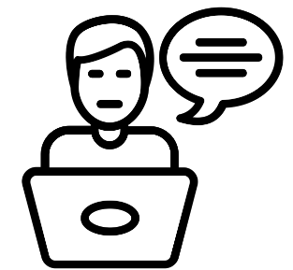


Examples of multimodal projects
Research Posters
Research
Reports
Oral Presentations
PowerPoint
Slides
Notes:
Here are some examples of multimodal projects that might be brought to the writing center outside of traditional academic essays. These include genres such as research posters (for conferences or science fairs), research or lab reports, oral presentations (which are frequently combined with some of these other genres), and PowerPoint or Prezi slides.

Slide 8
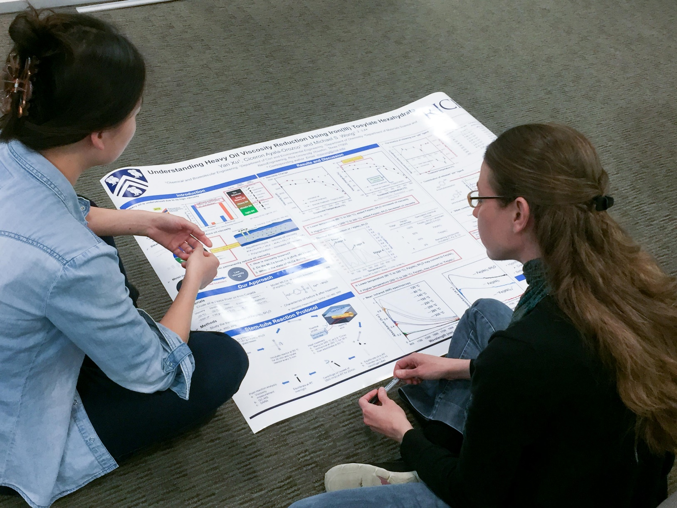
Main Principles for Consulting on Multimodal Texts
Notes:
Let’s now look at what I consider to be three main principles for consulting on multimodal texts: narrative, design, and oral presentation skills. Tutors don’t need to be multimedia or design experts; they simply need to know some basic principles and what questions to ask.

Slide 9

All texts contain a narrative
All texts – whether written, visual, or oral – contain a story
To communicate effectively, an author of any text must take into account the rhetorical situation:
Audience
Purpose
Situation
Notes:
The first principle that students need to understand is narrative. All texts – whether written, visual, or oral – contain a narrative. Consultants can help students working on multimodal projects by bringing their attention to the rhetorical situation. Just as with text-based papers, writers must understand what story they are trying to tell. To communicate effectively, the author must consider the audience – who is the intended recipient of the project? Purpose – what do you want your audience to learn or know? And, context – what is the physical and temporal situation? In other words, what is the context of the presentation and how will it be delivered?

Slide 10
Research as a narrative arc
Exposition – introduces the “characters” and the complication
Rising action – shows the obstacles in the way to resolving the complication
Point of insight – provides a revelation or key finding
Resolution – resolves the conflict
Complication
Climax
Exposition
Resolution
Notes:
To take this idea further, we might consider any form of research as containing a narrative arc. This includes the exposition, or the issue the “characters” or researchers are trying to solve; the rising action (the obstacles in the way to resolving the complication); a point of insight or key findings; and the resolution or central conclusions drawn from the research.

Slide 11
Questions consultants can ask about narrative
Who is the intended audience for this project? What is their educational background and how familiar will they be with your topic?
What information do you want to convey to your audience with this text?
How is this piece organized? How do you move from subtopic x to subtopic y?
In what format do you plan to deliver this presentation? Will you use a PowerPoint? Handouts?
Notes:
Like with text-based papers, tutors can interrogate the rhetorical situation of multimodal texts. They can ask questions such as
Who is the intended audience for this project? What is their educational background and how familiar will they be with your topic?
What information do you want to convey to your audience with this text?
How is this piece organized? How do you move from subtopic x to subtopic y?
In what format do you plan to deliver this presentation? Will you use a PowerPoint? Handouts?

Slide 12
Follow basic design principles
Contrast – key elements should stand out
Repetition – repeat visual elements to show unity
Alignment –everything is visually connected
Proximity – placement of related objects close together
Notes:
Some basic design principles can help consultants identify places for improvement in visual presentations, such as PowerPoint slides or research posters. These four different design principles or CRAP principles are contrast (making key elements stand out – such as I am doing here with the use of blue bolded letters); repetition (repeating visual elements to show unity); alignment (shows that elements that line up are visually connected); and proximity (placement of related objects close together).

Slide 13



Make intentional use of color
Notes:
Another important element to visual design is the intentional use of color.
“What color is easier to see, red or blue?”
Be careful with colors of similar intensity. Presenters often think red will draw attention, so they use it on slide backgrounds that are blue, but blue and red are of similar intensity (saturation), so actually the red is more difficult to see than the LIGHT BLUE.
Also, color should be used for emphasis, not for meaningless decoration – it should help the audience follow the presenter’s slides – everything design choice should have a purpose.

Slide 14
Make your font visible
Serif (good for slides) vs. San Serif (good for print)
Make sure text can be read from a distance
18-20pt font for figure text
24-30pt font for slide text
36pt font or larger for slide titles
*Keep in mind that some design elements can change whether or not presentations are being displayed virtually
Notes:
Font should be made visible to the audience. That means using serif fonts (such as Arial or Calibri) for slides and other virtual multimodal texts and Sans Serif fonts (such as Times New Roman or Courier) for print. Serif means the letter has little lines or “tails” at the end of the stroke which were created to help readers read printed documents (creates underlines that help you not lose your place in a paragraph) and to delineate where letters begin and end.
Font size is also an important consideration. Text should be able to be read from a distance if the presentation is in-person. 18-20pt font for figures; 24-30pt font for slide text; and 36 font or larger for titles. Keep in mind that these design elements can change based on whether or not presentations are being displayed virtually.

Slide 15
Questions tutors can ask about design
Is this project intended to be presented in-person or virtually?
What do you want to emphasize with this image? What is the most important piece of data or information?
Why did you choose to group images x and y together? In what ways are they related?
Why did you choose this color scheme for your project? What connotations might these colors convey to your audience?
Notes:
Tutors can get to the heart of the rhetorical choices behind multimodal project design by asking questions such as
Is this project intended to be presented in-person or virtually?
What do you want to emphasize with this image? What is the most important piece of data or information?
Why did you choose to group images x and y together? In what ways are they related?
Why did you choose this color scheme for your project? What connotations might these colors convey to your audience?

Slide 16
Consider differences in delivery mode
In-Person Presentations
Online Presentations
Eye contact
More focus on gestures and body movement
Making use of the physical space
Voice projection
Camera contact
More focus on facial expressions
Intentionality of zoom background
Audio and microphone
Notes:
For those multimodal projects that have an oral presentation component, it’s first important to consider the delivery mode. Is the presentation in-person or online? For in-person presentations, tutors should focus on giving feedback on key presentation techniques, such as maintaining eye contact with the audience, the intentional use of gestures for emphasis, and how the student uses their physical classroom space. However, this standard advice needs to be modified for online presentations. Instead of eye contact, this means making sure that the student looks directly into the camera. While body language is less evident on a Zoom screen, you can still make use of intentional hand gestures. Students will also want to consider technical aspects of presenting, such as the use of a clean, non-distracting Zoom background and using either a headset or microphone for clear audio.

Slide 17
Be intentional about volume, pace, and presentation clarity
Tailor volume to the venue
Do not trail off
Use slower pace for important details
Speed up for less important details
Speak fluidly
No informal pronunciations
Place emphasis on important points
Use inflection to add interest
Do not “up-talk” or use any tentative intonation pattern
Notes:
For all presentations, the use of volume, pacing and clarity is key. Tutors can give advice about tailoring appropriate volume, formality, and pacing of a presentation to the audience. Successful presentations also carefully use inflection and repetition to emphasize important points. In contrast, the speaker can speed up or de-emphasize less important details. Finally, it’s important to avoid uptalk—sentences or clauses that ends like a question and have a rising inflection, since this can be perceived as lacking confidence in the eyes of the audience.

Slide 18
Monitor (count) fillers
Uhm….
Like
You Know
So…
Basically
Tip: Position tongue behind teeth when you are not speaking
Do not be afraid of pausing to think…
Notes:
One of the most common issues with oral presentation is the overuse of filler words, such as “uhm . . .”, “like,” “you know,” “so,” and “basically.” We use fillers for a variety of reasons – nervousness, uncertainty in the content, or simply because we are forming our next idea. Tutors can help count these “filler words,” and encourage students to become more comfortable with brief dialogue pauses. Another common bit of advice is to practice positioning your tongue behind your teeth when you’re not speaking.

Slide 19



Provide feedback on non-verbal communication and body language
Notes:
Non-verbal communication is also an important part of presentation – closed body postures, tense shoulders, lack of eye contact, and tugging at clothes or fidgeting can portray a lack of confidence or nervousness. Tutors can provide feedback on body language and posture as a way to improve presentations.

Slide 20
Tutoring tips
Focus on global issues, such as narrative and overarching organization.
Help students work toward concision in both content and design. More does not always equal better!
Discuss presentation anxieties
Record or videotape presentations for students to review.
Provide oral feedback and a list of written key takeaways.
Notes:
Tutors can provide the most help during a consultation by focusing on global issues first, such as narrative and overarching organization. Frequently, students will pack too much content into a presentation, which is quickly lost by the audience. Focusing on concision and clarity can help improve a presentation’s message. More is not always better. This also applies to design elements. Design elements should emphasize or demonstrate key concepts, rather than distract or clutter a presentation.
Finally, oral presentation techniques can be helped by having an open, honest discussion about presentation anxieties. Recording or videotaping a presentation can help students identify both content and oral delivery issues. Providing on-the-spot feedback immediately following a practice presentation, as well as providing students with a short list of written key takeaways can help them leave a consulting session with concrete areas of improvement.

Slide 21
Activity
In a group of 4-5 participants, please discuss the following questions:
In what ways do multimodal projects differ in-person vs. virtually? What environmental conditions change the way in which the audience perceives the written, visual, and oral modes of communication?
How might we consider all writing in an online consulting setting as multimodal texts? If we consider all online writing as inherently multimodal, does that change the way in which we approach tutoring practices?
Notes:
In a group of 4-5 participants, please discuss the following questions:
In what ways do multimodal projects differ in-person vs. virtually? What environmental conditions change the way in which the audience perceives the written, visual, and oral modes of communication?
How might we consider all writing in an online consulting setting as multimodal texts? If we consider all online writing as inherently multimodal, does that change the way in which we approach tutoring practices?

Slide 22
Activity cont.
Discuss your own institutional context. What types of presentations do consultants encounter at the center? What kinds of texts do you encounter that have multimodal components? Consider graphs/charts in journal articles, class presentations, etc.
What types of professional development are needed for the consultants at your center to provide feedback more effectively on oral and visual presentations?
Notes:
Discuss your own institutional context. What types of presentations do consultants encounter at the center? What kinds of texts do you encounter that have multimodal components? Consider graphs/charts in journal articles, class presentations, etc.
What types of professional development are needed for the consultants at your center to provide feedback more effectively on oral and visual presentations?

Slide 23
Works consulted
Clements, Jessica. “The Role of New Media Expertise in Shaping Writing Consultations.” How We Teach Writing Tutors: A Digital Edited Collection, edited by Karen Gabrielle Johnson and Ted Roggenbuck, WLN, 2019.
Eyman, Douglas. “Multimodal and Multimedia Projects in the Writing Center.” Connecting Writing Centers Across Borders, 4 June 2019, WLN: A Journal of Writing Center Scholarship, https://www.wlnjournal.org/blog/2019/06/multimodal-and-multimedia-projects-in-the-writing-center-by-douglas-eyman/. 3 Sept. 2021.
Sabatino, Lindsey A. ed. Multimodal Composing: Strategies for Twenty-First-Century Writing Consultations. University Press of Colorado, 2019.
Wilson, Jennifer Shade. “Presenting a Scientific Journal Article.” Center for Academic and Professional Communication, Rice University. PowerPoint Presentation.
Notes:
Works consulted:
Clements, Jessica. “The Role of New Media Expertise in Shaping Writing Consultations.” How We Teach Writing Tutors: A Digital Edited Collection, edited by Karen Gabrielle Johnson and Ted Roggenbuck, WLN, 2019.
Eyman, Douglas. “Multimodal and Multimedia Projects in the Writing Center.” Connecting Writing Centers Across Borders, 4 June 2019, WLN: A Journal of Writing Center Scholarship, https://www.wlnjournal.org/blog/2019/06/multimodal-and-multimedia-projects-in-the-writing-center-by-douglas-eyman/. 3 Sept. 2021.
Sabatino, Lindsey A. ed. Multimodal Composing: Strategies for Twenty-First-Century Writing Consultations. University Press of Colorado, 2019.

