Slide 1
Videoconferencing is Not a Replication of Face-to-Face Tutoring
Training Tutors to Prepare for Technology Interdependence in Synchronous Tutoring

Slide 2
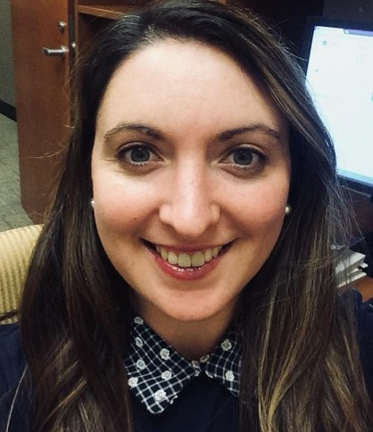

Videoconferencing is Not a Replication of Face-to-Face Tutoring:
Training Tutors to Prepare for Technology Interdependence in Synchronous Tutoring
Kim Fahle Peck
Writing Center Director
York College of Pennsylvania
The ideas of this presentation were developed in collaboration with:
Megan Boeshart
Writing Center Director
Old Dominion University

Slide 3

The Desire for Replication
Grutch McKinney (2010): tutorials using videoconferencing “come closer to replicating what is good about face-to-face tutorials than asynchronous tutorials do” (p. 11, emphasis mine).
Summers (2013): “we wanted to replicate the meaningful exchanges we experienced during face-to-face appointments” (p. 11, emphasis mine).
Replicate rows
SBTS, IN
https://thenounproject.com/term/replicate-rows/1779606/

Slide 4
Similarities and Differences
In-Person Tutoring
Synchronous Video
Located in different spaces
Share physical space
Build Rapport
Communication mediated through computer or mobile device
Ask Questions
Can view any documents & materials together
Cognitive & Motivational Scaffolding (Mackiewicz & Thompson, 2014)
Use Technology to view documents or materials

Slide 5
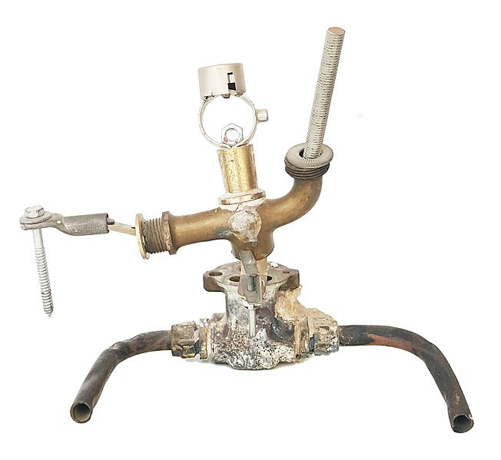
Assemblage
Grise (2015): “The entities or components that constitute assemblages have their own characteristics and dynamics, have potential to enact change, and are separable from an assemblage in which they participate” (p. 61).
Sculpture-assemblage Hara-kiri, Art Treize, https://commons.wikimedia.org/wiki/File:Sculpture-assemblage_Hara-kiri.jpg#filelinks

Slide 6

Space and Environment
Tutors and writers no longer occupy the same space which has been designed to support writing center work.
Space Challenges:
Spaces could include distractions
Individuals might not feel comfortable displaying their environment
Place might not have strong internet connection
No Internet Icon
Vectors Point, PK
https://thenounproject.com/term/no-internet/3242241/

Slide 7
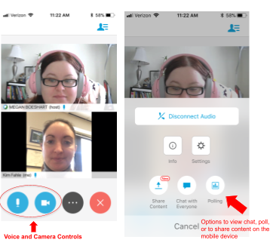
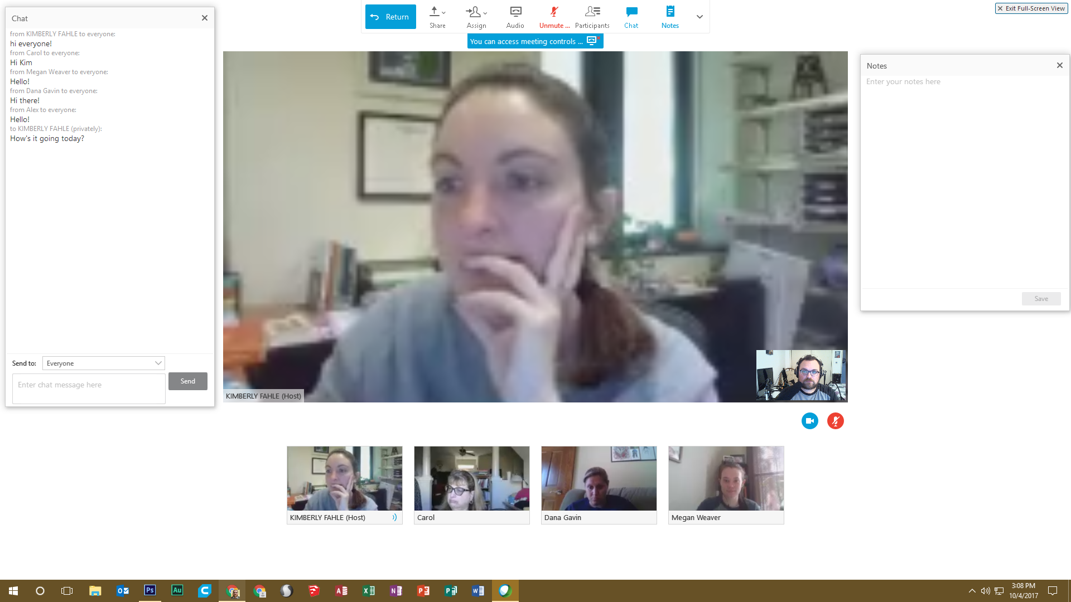
Technology Variation

Slide 8

Create a Technology Plan
Will someone share their screen, and if so, who?
Will the tutor and writer work together in a collaborative whiteboard space or collaborative document?
What features of the collaborative document or space will be used in the session?
Will/how will the chat be used?
Will cameras be turned on for the session?

Slide 9

Troubleshooting Technology
Tutors need to gain familiarity with the interfaces that will be used to facilitate synchronous video sessions, getting both a tutor and student view.
Tutors should help facilitate the problem solving process students encounter when they have technology issues.
Tutors should have a backup plan in place for when tech issues happen:
Using text communication instead of audio
Using a different platform or low-tech communication option like a phone call
Luis Prado, US
https://thenounproject.com/term/help/28807/

Slide 10
Preparing Tutors to Embrace Flexibility
Tutors will need to be comfortable users of the technologies used to facilitate synchronous online sessions, but I think even more important than that, they need to be comfortable with adapting their strategies to match the complex ecologies of each session.

Slide 11
Contact Information & References
For questions, or to continue the discussion of this presentation, please reach out at kfahle@ycp.edu
References
Cornelius, S. (2014). Facilitating in a demanding environment: Experiences of teaching in virtual classrooms using web conferencing. British Journal of Educational Technology, 45(2), 260-271.
Daft, R.L & Lengel, R.H. (1986). Organizational information requirements, media richness and structural design. Management Science, 32 (5): 554–571.
Deleuze, G. & Guatarri, F. (1987) A thousand plateaus: Capitalism and schizophrenia. Translated by Brian Massumi. Minneapolis, MN, University of Minnesota Press.
Gries, L. (2015). Still life with rhetoric: A new materialist approach for visual rhetorics. Utah State UP.
Grutsch McKinney, J. (2010).Geek in the center: Audio-Video-Textual Conferencing (AVT) options.” The Writing Lab Newsletter, 34(9): 11-13
Grutsch McKinney, J. (2013). Peripheral visions for writing centers. University Press of Colorado.
Mackiewicz, J., & Thompson, I. (2014). Instruction, cognitive scaffolding, and motivational scaffolding in writing center tutoring. Composition Studies, 42(1), 54-78.
Ryan, L. & Zimmerelli, L. (2010). The Bedford guide for writing tutors. Boston: Bedford/St. Martins.
Summers, S. (2013). Delivering distance consultations with Skype and Google Docs. The Writing Lab Newsletter, 37(7-8): 10-13.
Wisniewski, C. et al. (2020). Questioning Assumptions About Online Tutoring: A Mixed-Method Study of Face-to-Face and Synchronous Online Writing Center Tutorials. The Writing Center Journal, 38(1-2): 261-294.
Yergeau, M., Wozniak, K. & Vandenberg, P. (2008). Expanding the space of f2f: Writing centers and audio-visual-textual Conferencing. Kairos: A Journal of Rhetoric,Technology, and Pedagogy, 13(1), Retrieved from https://kairos.technorhetoric.net/13.1/topoi/yergeau-et-al/

