Slide 1

Aligning with the Language of Justice in the Writing Center OWCA Oct. 2021
Cynthia Cochran, Joshua Knight, Justine Kennedy, & Katelyn Scott, Illinois College
Thanks also to Mackenzie Prewitt and the Campus Writing Center staff

Slide 2
Problems
In the wake of the conflict caused by George Floyd’s murder, we became increasingly concerned about gender, racial, and other social inequities and injustices
We could see evidence of problems on our campus and in ourselves
The staff wanted to be pro-active to improve ourselves and our campus
Notes:
In the midst of the Black Lives Matter movement on our small, private PWI college campus, our writing center staff (made up of undergraduates) expressed the desire to do something about racism on our campus. Our campus is much like any other, with strands of progressivism and strands of prejudice. We talked about what we could do to change the situation. Realizing that communication and online tutoring was even more precarious than in face-to-face sessions, we knew we needed to do something. Following the logic that "interdependence can help centers recognize their role in helping writers become members of communities: learning to perceive important components of a writing situation, work with others, and interpret feedback" (OWCC CFP 2021), we thought a two-pronged effort made sense. For true collaboration to take place, all parties must be included in the work, and all parties need to learn to use language in a non-racist inclusive way. Thus, to create a truly inclusive presence whether online or in person and to encourage the language of justice in student writing, we decided to form committees of center consultants to draft policies on language and outreach materials to help those who use our services to become more socially effective interlocutors. We also decided to add an emphasis of social justice to our annual writers' conference.

Slide 3
Today’s Talk
Background
Efforts We Are Taking
This presentation discusses
the context of our PWI campus
the writing center’s history and our former inclusive practices
our new goals for better language practice
principles we are forming
materials we are developing
changes to our annual writers’ conference.
We will end by discussing plans for our future.

Slide 4
Illinois College Overview
Small liberal arts college, ~1100 students, Midwestern, rural, predominantly White (a PWI)
We serve students from metro Chicago and St. Louis, small towns from mostly a 100-mile radius of the college, and other nations and states

Slide 5
Race & Ethnicity (from Illinois College Fact Sheet)
African-American students: 10.4% (114)
American Indian/Alaskan: 0.2% (2)
Asian students: 0.7% (8)
Caucasian students: 72.7% (797)
Hispanic students of any race: 7.3% (80)
International students: 3.1% (34)
Native Hawaiian or other Pacific Islander: 0.2% (2)
Two or more races: 3.0% (33)
Not Reported/Unknown: 2.5% (27)

Slide 6
Campus Writing Center Overview
Piloted in 1996, begun in 1997
500-1000 visits annually
Staff is marginally diverse along gender, race, and ethnicity, predominantly white, many majors, all undergrad.
Staff often has a greater ratio of people identifying as LGBTQ+ than the rest of campus

Slide 7
Inclusionary Practices at the Time
Training session, each focusing on special topics, such as LGBTQ+ issues, minority status, ESL, & disabilities
We attempt to weave these considerations into other training sessions, e.g., the use of “they” in contemporary writing
No mention of anti-racism or inclusionary language on websites nor in outreach materials… issues that are even more important with our online consulting

Slide 8
Goals for Staff Policies and Campus Materials
Create training and policies to improve staff understanding and habits
Create outreach materials for everybody else
Use Inclusive Language
Avoid Anti-Racist Language
Use Nonviolent Language
Use Socially Just Language
Comport with guidelines set out by OWCA and IWCA, as well as APA.
Notes:
The next speaker will be Joshua Knight.

Slide 9
Anti-Racist Language
People use racial and ethnic terms to identify themselves, making these terms a serious topic.
We must be conscious of how our writing presents race and ethnicity.
Notes:
One of the areas we feel our community needs education on is the topic of Race and Ethnicity in writing. The reason writing about Race and Ethnicity is to be taken seriously is because they are terms that people use to identify themselves. In order to be effective and empathetic communicators, we must take into account how our writing presents Race and Ethnicity so that we do not harm others with our words.

Slide 10
Inclusive Language
When writing about a specific community or an overall population, be as respectful as possible.
We should not discriminate against people with our writing.
Notes:
We also feel that our campus has been lacking in the area of inclusive writing in general, so our campus writing center wants to emphasize that, when we are writing about specific communities or populations, we should be as respectful as possible, and only use terms with which those communities would identify themselves. In addition, we should avoid writing that discriminates against people from all walks of life so that we do not make our writing community an exclusive one.
In 2021, we have undergone research and writing projects that aim to create materials for our continued education on writing about race and ethnicity. In doing so, we have decided to implement several principles that will help us to improve the way we write about race and ethnicity, and help our community change their writing styles as well.

Slide 11
Anti-Racist & Inclusive Language
Principles to HONOR
Emphasize that Race and Ethnicity are Different
Do Away With “Umbrella Terms” and Do Your Homework
Treat All Acceptable Terms Equally
Notes:
So far, we have focused on three main principles when it comes to using Anti-Racist and Inclusive language:
First, that the topics of race and ethnicity are different and refer to different kinds of physical and cultural distinctions.
Second; we need to assert that “umbrella terms” or essentialist writing should be done away with, especially when referring to gender, sex, race, or ethnicity.
Finally, we must assert that all racial terms, ethnic terms, or terms that denote gender or sex must be treated equally in the sentences we write.

Slide 12
Anti-Racist & Inclusive Language
Situations to AVOID
Nonparallel Comparisons
Stereotyping & Essentialism
Assuming Gender and Using Sexist Language
Notes:
In addition, we are going to further emphasize the kinds of situations that writers (and speakers) should avoid in composing, such as including non parallel comparisons of race, ethnicity, and gender, using stereotypes, or assuming gender and using sexist language. With this in mind, we are going to create materials that can be handed out to both students and consultants at the campus writing center for distribution.

Slide 13
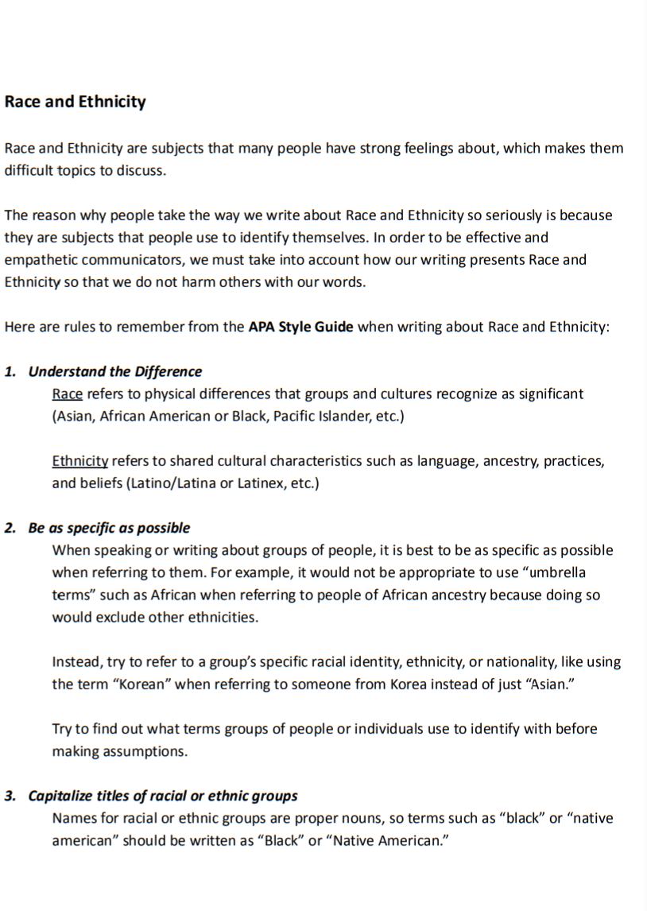
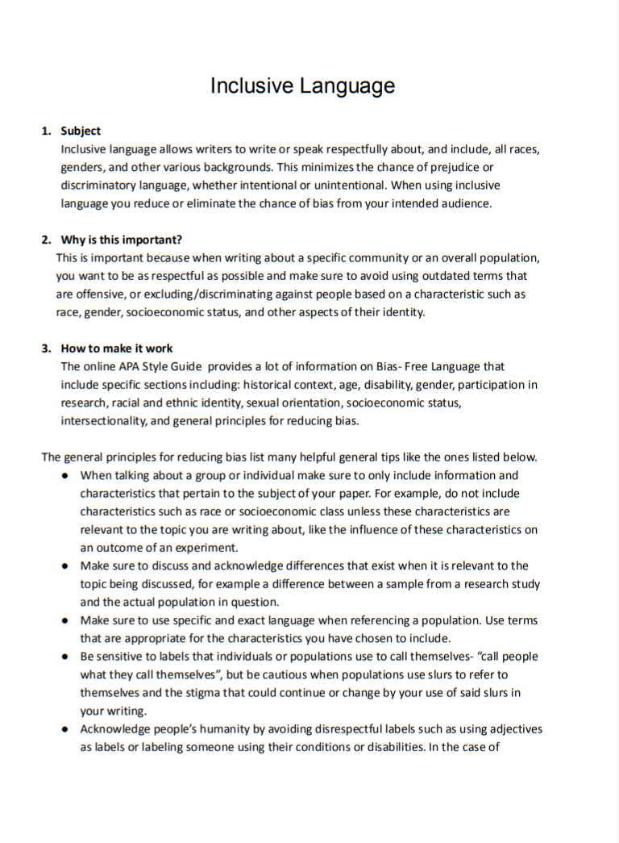
Example of Outreach Materials
Notes:
The images in this slide are examples of potential handouts that would be give at the Illinois College Campus Writing Center in the future. Each handout would include rules for writing about race, ethnicity, and using anti-discrimination writing, including specific examples of both respectful writing and writing that should be avoided. At the moment, we plan to improve upon the research that we have already done to create these materials so that we may soon distribute them as official documents. The next speaker will be Justine Kennedy.

Slide 14
Nonviolent/Socially Just Language
Ethics and Personal Writing Choices
Thinking critically about writing
Biases, Clarity, and Minimizing Aggression
Listen to feedback
Notes:
My research was on writing in a socially just and nonviolent manner. Nonviolent writing is about expressing ideas in a way that minimizes hurting other. Next, I will discuss various techniques for checking writing before it gets put out into the world.
The first thing to consider is biases and privilege. Writer’s can consider their own biases and privilege in their writing. Researching multiple sides to a situation can help a writer understand the impact their writing might have on others. The second aspect of critical thinking in writing is clarity. One example of a problem that can arise with clarity is how some students use United States citizens versus residents. Students might argue that a certain problem affects citizens when they really mean all the residents. Being clearer in this situation is more accurate and doesn’t erase a group of people. The last aspect is minimizing aggression. This focuses on analyzing a person’s writing for its potential to hurt others. Replacing offensive terms or accusations with inclusive language is less aggressive. A good question to ask about statements that could be violent is, “how might this statement affect a reader from another background than me?”.
Listening
to feedback is equally as important to critical thinking in nonviolent writing.
It is highly encouraged that writers listen to and seek out feedback from
others on their writing to better determine the impact that the writing could
have on readers. When a reader says they feel hurt or offended by the writing,
some writers might see this as an attack or shut down at the criticism. It’s
important for writers to not become defensive and to judge feedback in an
objective matter, so that issues can be fixed and harm to the audience
decreased.

Slide 15
Nonviolent/Socially Just Language
Aggressive Sentence Example:
Republicans will support Trump no matter what he does.
Does not recognize diversity, attacks an entire group
Possible Revision:
It can be dangerous to support a politician completely.
Notes:
Lastly, this is an example of how the principles of nonviolent writing can be used. The following sentence might be interpreted as aggressive. “Republicans will support Donald Trump no matter what he does.” This sentence doesn’t recognize diversity within the Republican group and it could imply that they lack intelligence. The sentence is argumentative and to a certain audience it might even be damaging. A nonviolent approach to this sentence could be, “It can be dangerous to support a politician completely.” This sentence still presents a similar argument as the first and could reach a broader audience. It also avoids causing fear or anger from the audience. The next speaker will be Katelyn Scott.

Slide 16
Changes to Annual Conference
Illinois College Undergraduate Conference of Writers
Students submit any writing across any discipline
Called for papers regarding anti-racism, inclusion, diversity, peace, environmental justice, social justice, equity, or sustainable development
Half of our submissions fit this preference
Conference is open to the entire school
Over 80 students in attendance
Prizes awarded
Notes:
Our Campus Writing Center has created and has organized our annual conference (the Illinois College Undergraduate Conference of Writers) since the spring of 1998. At this conference, students are called to present their academic or personal writing. All types of writing are welcome, such as papers, stories, poems, or even speeches, and we accept pieces from any discipline. For our 2021 conference, we wanted to feature pieces related to anti-racism, inclusion, diversity, peace, environmental justice, social justice, equity, and sustainable development. We released posters and emails to the school calling for works that focused on these topics. In total, we received eleven submissions, six of which corresponded with our conference’s preference. Students recorded themselves presenting their piece, and these recordings were posted online for all Illinois College students and faculty to view. The conference was opened to the entire school, and we had over 80 students in attendance. After the conference, our writing center consultants voted on their favorite pieces that fit our preference, and monetary prizes were awarded to the winners.

Slide 17
Changes for Next Conference
Better outreach for student organizations that advocate for social justice and inclusion
Attend meetings
Establish partnership, join organizations, attend events
Introduction segment
Explain importance of preferred pieces
Main speaker did not match preference
2022 Annual Conference Improvements
Notes:
As we continue to increase our awareness and knowledge of social inclusion, we realize that there are changes that need to be implemented for next year’s conference as well. To start, our outreach to student organizations that advocate for social justice and inclusion should have been more extensive. Although emails were sent to these organizations informing students about the conference’s preference for papers, consultants should have asked to attend a meeting of these organizations to personalize the invitation to present. Furthermore, attending these meetings would have allowed us to further explain our conference’s preference or answer any questions that students had about the conference. But we should not have only promoted our event. Instead, we should establish a partnership with these student organizations to create a strong community. Our consultants should take the time to attend general meetings and their campus events. Additionally, we could have written a longer introduction segment that explained the significance of the preferred pieces. Because the conference was held completely online, we only had a few minutes to introduce every piece that was submitted, so students in attendance may not have understood why we wanted to feature those pieces or their importance. Instead, we should have had a more extensive introduction that explained the importance of our featured writers and their pieces. Finally, we did have an alumni speaker at our conference; however, the topic of his speech did not match our conference’s preference. One change we could make is finding alumni who are passionate about inclusive language and inviting them to speak at our conference. Our conference is coming up again this April, so we will continue to improve our conference in a more inclusive way.

Slide 18
Plans for Future
Examine more writing center websites
Continue to improve material
Create extensive guides for consultants
Create distributable handouts
Revise our mission statement and web page
Update our consultant manual
Consider outreach ideas with campus partners
Partnering with student organizations that promote inclusion and justice for future events and for advice
Notes:
As we continue to learn more about anti-racist, nonviolent, and inclusive language, we also continue to set goals for ourselves and the rest of our campus writing center. Our first goal for the future is to continue to improve our material. As the semester progresses, we will continue to add to our research and our documents to learn more about anti-racist, nonviolent, and inclusive language. We would like to create extensive guides for our consultants once we gather enough research so that all of our consultants can have the proper training in our new guidelines. Additionally, we would like to create handouts that can be easily distributed to all students on campus so that everyone can practice inclusive language. To continue our research, we will examine more writing center websites to see how other campus writing centers are practicing inclusive language. One of our top priorities for this year is to revise our Writing Center materials. For example, we want to update our mission statement to highlight our advocacy for social justice. We also want to update our consultant manual so that new consultants-in-training are aware of our guidelines regarding social justice. Finally, we want to make these same changes to our web pages so that students are aware of our policies on all platforms. Our last plan for the future is to consider reaching out and partnering with other organizations on campus that promote social justice, especially the student organizations to further ensure that our new policies truly include everyone.

Slide 19
Sources of Inspiration
American Psychological Association. (2019) Bias-Free Language. https://apastyle.apa.org/style-grammar-guidelines/bias-free-language
IWCA (2010) Racism, Anti-Immigration, and Linguistic Intolerance; (2015) IWCA Position Statement on Secondary School Writing Centers; (2018) IWCA Position Statement on the Singular Use of “They.” https://writingcenters.org/position-statements/
OWCA. (2021) Commitment to Anti-racism. https://www.onlinewritingcenters.org/anti-racism/
Notes:
The following sources were used for inspiration for the creation of our guidelines:
-The American Psychological Association
-The International Writing Centers Association
-The Online Writing Centers Association

Slide 20
More Sources of Inspiration
A great many writing center websites, including
“Gender-Inclusive Language.” The Writing Center • University of North Carolina at Chapel Hill, 13 May 2020, writingcenter.unc.edu/tips-and-tools/gender-inclusive-language/.
“Inclusive Language.” University of Houston-Victoria, www.uhv.edu/university-college/student-success-center/resources/e-p/inclusive-language/.

