Slide 1
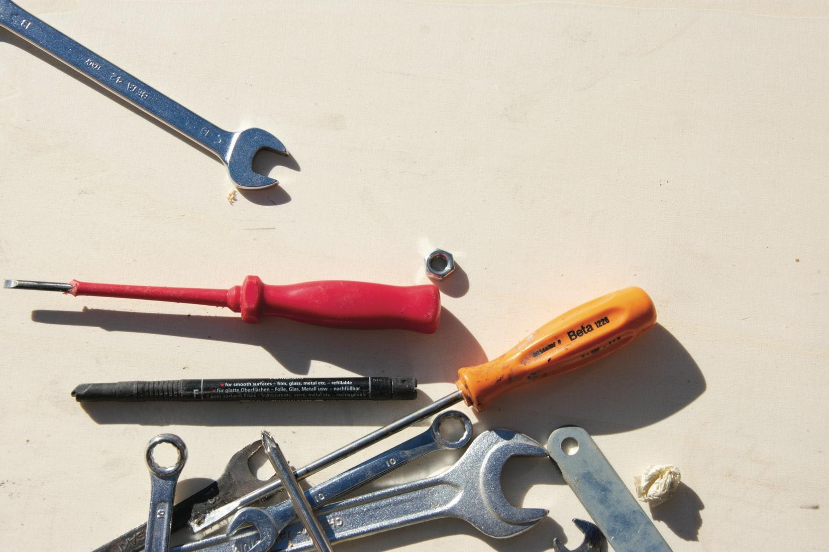
Expanding Disability Access: Developing your Multimodal Toolkit for Tutoring Sessions
Ellen Cecil-Lemkin
Lisa Marvel Johnson
Notes:
Lisa: Hello, and welcome to our workshop on “Expanding Disability Access: Developing your Mulitmodal Toolkit for Tutoring Sessions.” I’m Lisa Marvel Johnson, and I’m a Faculty Associate in the Writing Center at University of Wisconsin-Madison.
Ellen: And, I’m Ellen Cecil-Lemkin, and I’m also a Faculty Associate in the Writing Center.
Lisa: We’re excited to have you at our workshop today! This workshop is intended for writing center tutors who have very little experience with accessibility practices, disability theory, and universal design for learning, but who want to learn more about them and apply these ideas to their practices. If you’re not a tutor, welcome! We also think this workshop can be helpful for you as you think through ways to make your tutors’ sessions more accessible to a wide range of audiences.

Slide 2
Access Statement
We’ve used the principles of Universal Design for Learning to guide the structure of this workshop. In doing so, we hope we have made this workshop accessible for you. However, we recognize there may be access needs that we have not accommodated for, so we would like to invite you to share with us your access needs or any concerns you may have.
Please feel invited to engage in this space as it feels most comfortable and accessible for you to do so. For example, if you would prefer to keep your camera off and respond using the chat feature, please do so.
Notes:
Ellen: Before we get too deep, I’d like to first pause and talk about access in our workshop. We recognize that there are likely disabled audience members in our audience, so we’ve used the principles of Universal Design for Learning to guide the structure of this workshop. In doing so, we hope we have made this workshop accessible for you. However, we recognize there may be access needs that we have not accommodated for, so we would like to invite you to share with us your access needs or any concerns you may have. You can raise your hand now or you can private message us in the chat.
[pause for comments]
Furthermore, we invite you to engage in this space as it feels most comfortable and accessible for you to do so. For example, if you would prefer to keep your camera off and respond using the chat feature, please do so.

Slide 3
Materials
tiny.cc/OWCAwork
Slideshow
Transcript
Multimodal Toolkit
UW-Madison Multimodal Toolkit
OWCA Multimodal Toolkit
Additional readings
Notes:
Lisa: Next up, we’d like to provide you access to our materials. You can access our materials by navigating to tiny.cc/OWCAwork. There, you’ll find this slideshow, our transcript for today, a copy of our multimodal toolkit, and articles for additional reading.

Slide 4
Agenda
Social Model of Disability
Ableism in the Writing Center
Developing an OWCA Multimodal Toolkit
Multimodal Toolkit Intro
1
2
3
4
Notes:
Ellen: Now that you have access to our materials, let’s talk about our overall plan for the rest of the workshop. First, we’ll introduce you all to the social model of disability, which informs how we approach and understand disability in this workshop. Next, we’ll discuss what ableism is and how it operates in the writing center. Then, we’ll turn to the concept of the multimodal toolkit, which is a response to this endemic form of bias. Finally, we’ll move into an activity where you’ll modify our existing multimodal toolkit and create a new OWCA multimodal toolkit.

Slide 5
Disability
Notes:
Lisa: We want to begin our workshop by talking about disability and creating a framework for us to conceptualize disability. First, we think it’s important to recognize that disability isn’t a bad word or a word that carries shame. This might come as a surprise because there seems to be a message in mainstream culture that disability is shameful, that disabled is a bad word, and that individuals do not want to be called disabled. In fact, for many disabled people, disabled is the preferred term and identity first language or disabled person, is the preferred terminology. Indeed, disability can be a key, positive marker of identity and a point of pride. So, we’re pushing against the notion that disability is a problem.

Slide 6
Social Model of Disability
The social model of disability is defined in opposition to the medical model, which views disability as a problem residing in the individual that must be corrected and is always cause for pity.
The social model forefronts the environmental, cultural, and social barriers that prevent full access for disabled individuals.
Margaret Price (2011) explains “it shifts the ‘problem’ of disability away from individuals and toward institutions and attitudes” (p. 4).
Notes:
Ellen: The reclaiming and framing of disability as a positive marker of identity comes hand-in-hand with the social model of disability. To understand the social model, you need to understand another model of disability, the medical model. The medical views disability as a problem residing in the individual that must be corrected and is always cause for pity. In other words, a disabled individual needs to solve or fix this problem in order to live a full life.
The social model, however, pushes against these ideas. Instead, it forefronts the environmental, cultural, and social barriers that prevent full access for disabled individuals. So, instead of seeing this problem as located within an individuals, it looks at the other sources that prohibits someone from full engagement.
The social model is explained by Margaret Price (2011) as “shift[ing] the ‘problem’ of disability away from individuals and toward institutions and attitudes” (p. 4).

Slide 7
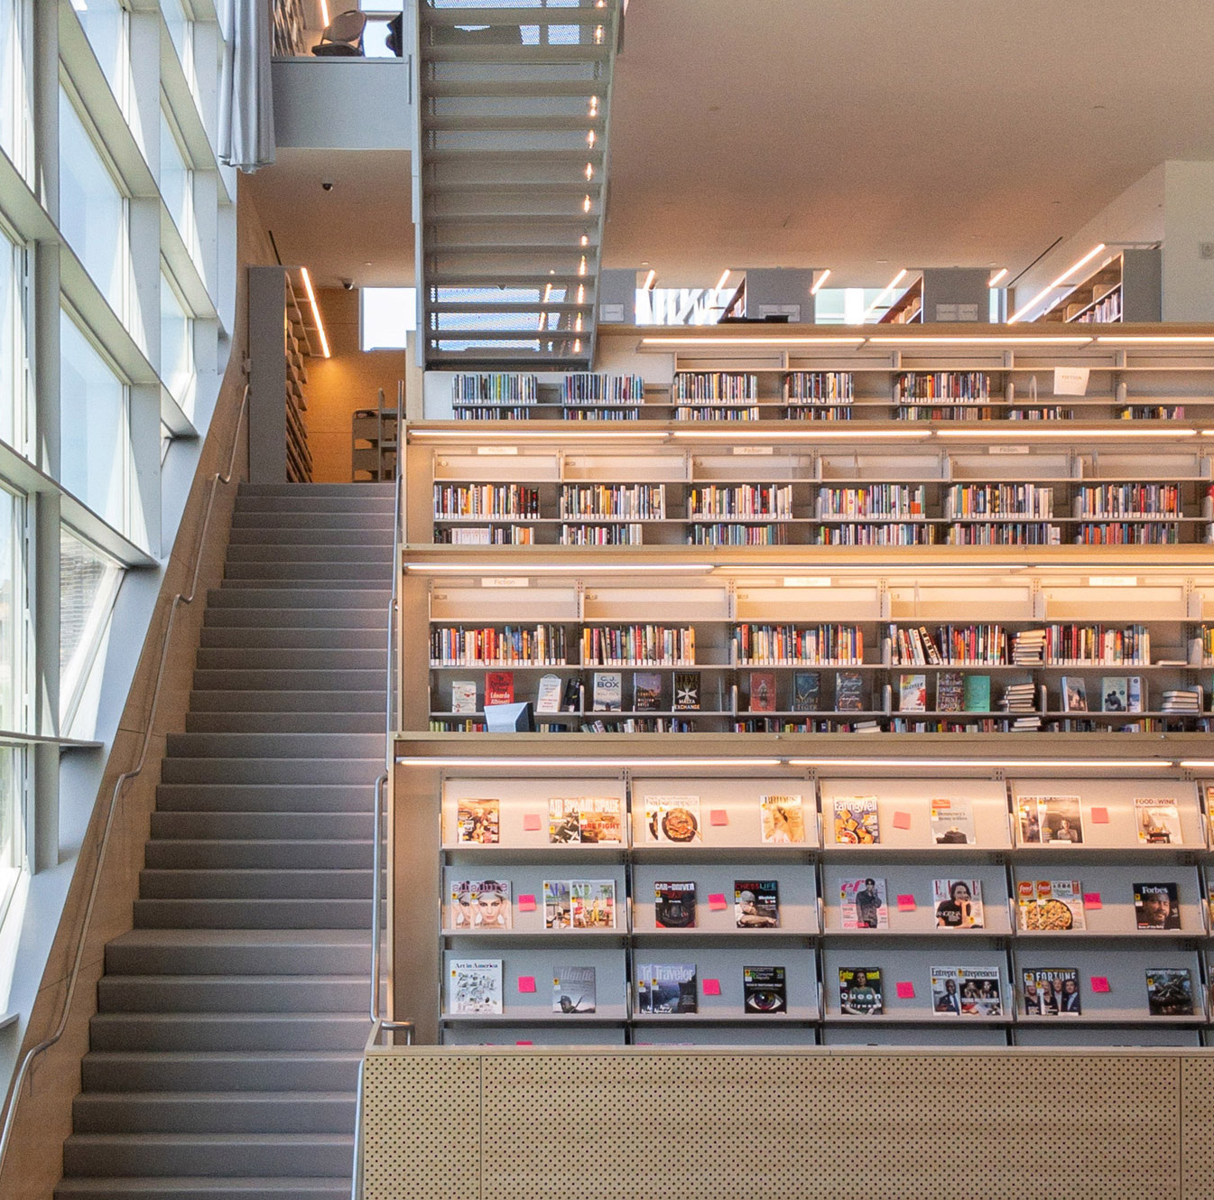
Example
Wheelchair users being denied entry because there are not access ramps or automatic doors into a building.
What’s inaccessible about the design of this room?
Notes:
Lisa: To better understand how these models operate, let’s talk about an example. If we have a wheelchair user attempting to enter a building with stairs up to the entrance, a medical model of disability would suggest that instead of fixing the environment, we should “fix” or “cure” the disability that’s preventing access. In other words, the disability is the source of the inaccessibility, not the environment. In a social model of disability, we would look at how the environment is preventing access to the building. Instead of placing it on the individual to figure it out or no longer be disabled, it would be up to the building designers and managers to plan ahead and build in access ramps, elevators, and/or automatic doors.
So, I’ve just talked about one example. Let’s take a look at another example and think through the environmental barriers that are preventing access. On the screen there’s an image of the interior of a library. It features rows of bookshelves filled with books going up along a staircase. What’s inaccessible about the design of this room?
[Facilitates discussion]

Slide 8
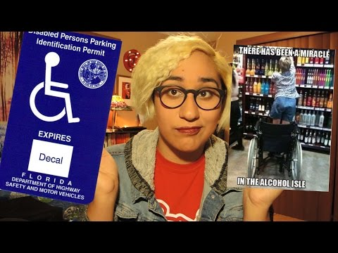
Ableism
Discrimination, biases, and prejudice against people who are disabled.
Microaggressions
Inaccessible designs / policies / practices
Notes:
Ellen: As we’re thinking about the barriers that keep disabled people from full participation, we want to keep the idea of ableism or discrimination, biases, and prejudice against people who are disabled at the forefront. Ableism can result in microaggressions and the implementation of inaccessible designs, policies or practices. To give you a better understanding of some of the ableism disabled individuals encounter, we have a short video we’d like to play for you. In this video, you will see a young woman named Annie, who identifies as a chronically ill, disabled, queer, Latinx, woman of color. She has bleached blond hair and round glasses, and she’s sitting in what appears to be her bedroom.
[Watch video]

Slide 9
Discussion: Ableism in the Writing Center
Let’s discuss the ways that we see ableism operating in the writing center.
You may want to think about practices, policies, assumptions, environments, etc.
Please feel free to use the “raise hand” button or the chat.
Notes:
Lisa: Ableism does not stop at the doors of the university or even at the door of our writing centers. Although we work to avoid this, ableism is an entrenched part of the culture of the university, and so rooting it out is a process that we must be actively engaged in. J.M. Dembsey argues that “We need to tell the truth: writing center discourse has a long history of discriminating against disabled people” and her article “Naming Ableism in the Writing Center” chronicles a number of ways that writing center work is invested in ableist practices in order to make clear that despite many writing centers’ progressive ideology, there is still a lot of work that needs to be done.
Ellen: So, following in Dembsey’s footsteps, let’s take some time to name ableism that we notice in our writing centers or in writing center work more generally. If you’d like to contribute to this conversation, please feel free to use the “raise hand” button in Zoom or use the chat feature. [facilitates discussion]

Slide 10
Multimodal Toolkit
Notes:
Lisa: Transition: One of the great things about the writing center is that we have a lot of flexibility in how we go about tutoring our students. We do not have to ask them prying questions about their disability status or try and diagnosis them. Instead, we can (1) challenge our own ableism and (2) offer them flexible approaches from the start to taylor the sessions to best suit their needs. These flexible approaches are collected in a “Multimodal Toolkit,” and we’ll spend the second half of this workshop defining this concept, explaining how it’s been used at the University of Wisconsin, and then thinking about how to apply it in other contexts--like your own writing center.

Slide 11
The Multimodal Toolkit
Defined by Allison Hitt in “Access for All: The Role of Dis/Ability in Multiliteracy Centers”
According to Hitt, “Developing a multimodal toolkit involves developing rhetorical strategies that push against fixed communicative interactions and present more opportunities for students. The idea is not to max out all sensory options but to provide flexibility.”
The toolkit is a set of writing center teaching strategies that account for a wide range of students and abilities
Notes:
Ellen: The term, “Multimodal Toolkit,” comes from an article written by Allison Hitt: “Access for All: The Role of Dis/Ability in Multiliterarcy Centers.” This article is available in our Google Drive folder for this workshop, if you’d like to read it. According to Hitt, “Developing a multimodal toolkit involves developing rhetorical strategies that push against fixed communicative interactions and present more opportunities for students. The idea is not to max out all sensory options but to provide flexibility.” Practically speaking, creating a multimodal toolkit involves compiling strategies that account for a wide range of students and abilities. For Hitt, accessibility means maximizing all students’ and tutors’ ability to make use of both the physical and intellectual space of the writing center. When tutors have access to this toolkit, they can expand the kinds of teaching they do in their writing center sessions so that their teaching is more accessible to a wider array of students.

Slide 12
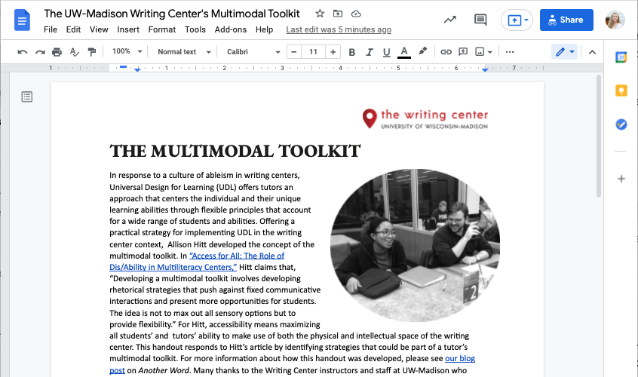
The University of Wisconsin at Madison’s Multimodal Toolkit
tiny.cc/
UWMMToolkit
Notes:
Lisa: After reading through Allison’s article, Ellen and I were eager to think about how to take this idea of the Multimodal Toolkit and make it into a reality at our Writing Center. We wanted to help our tutors break out of patterns of teaching that had become “standard” in order to move toward writing center teaching that was truly accessible for all students. In order to accomplish this goal, we worked with writing center tutors in order to compile a long list of different types of writing center teaching strategies. We read through the list and organized strategies into different categories (like “Brainstorming” “Grammar,” and “Logic”). Our intention was to include strategies that would work for a wide variety of students so that a tutor could easily give students many different options for how they could improve a particular aspect of their writing.
You can find our toolkit at tiny.cc/UWMMToolkit. It’s also available in the Google Drive folder that we shared at the beginning of our workshop. Let’s all take a few minutes to skim through it. We probably don’t have time to read through the whole thing, but we’d like you to skim through the strategies listed so that you have an idea of its components.

Slide 13
Creating a Multimodal Toolkit- OWCA Version
Check out our starter draft of an OWCA multimodal toolkit: tiny.cc/OWCAMMToolkit
In suggesting mode, please:
Revise any strategies or language that should be edited
Add strategies (or categories) that are relevant to your writing center or your experience of writing centers generally
Notes:
Ellen: Now that we’ve read through the toolkit that was created at the University of Wisconsin at Madison, we’ll spend the last part of our workshop thinking about how you can apply a similar approach to your own writing center work. Our goal will be to create a new version of the multimodal toolkit--an OWCA version, which will be based on this toolkit that was developed at our university, but will be revised so that it is relevant to contexts outside UW-Madison and takes into consideration all of the great perspectives that you’re bringing to our workshop.
Lisa: So, we’d like to ask you to check out our starter draft of the OWCA version of the multimodal toolkit. It’s available in our Google Drive folder and also at tiny.cc/OWCAMMToolkit. After you do this, in small groups, we’ll ask you to do some editing work in order to make the strategies in this toolkit more diverse, more relevant to a wider variety of students, more pertinent to your writing centers, and more accessible. As you do this, think about what we’ve talked about earlier--about the social model of disability and ableism.
Ellen: In suggesting mode, please (1) revise any strategies or language that should be edited and (2) add strategies (or categories) that are relevant to your writing center or your experience of writing center generally.
[Breaks up participants into smaller groups.]

Slide 14
Discussion: Creating a Multimodal Toolkit- OWCA Version
What did you change and why?
Did any questions or conundrums arise as you edited or suggested new strategies?
How do you envision bringing this information back to your writing centers?
Notes:
Lisa: Thanks for spending some time working to create an OWCA version of a multimodal toolkit. I hope that your conversations were productive and interesting. As we come back together, we want to hear what you discussed. Here are some questions to get us started: (1) What did you change and why? (2) Did any questions or conundrums arise as you edited or suggested new strategies? (3) How do you envision brining this information back to your writing centers?
Again, please feel free to use the “raise hand” button on Zoom or use the chat to make a comment.
[Facilitates discussion]

Slide 15

Thank you!
Ellen Cecil-Lemkin |cecillemkin@wisc.edu
Lisa Marvel Johnson | lmjohnson32@wisc.edu
Notes:
Ellen: Thank you so much for your time today, we really enjoyed speaking with you about this powerful tool for writing center work. If you want to continue this conversation, we invite you to email us. My email address is cecillemkin@wisc.edu and Lisa’s email address is lmjohnson32@wisc.edu.

