Slide 1


Using Computer-Assisted Language Learning
to Foster Self-Editing Skills:
The Interdependence of Writers, Tutors, & Technology
Center for Communication Excellence, Graduate College
Kimberly Becker, Sarah Huffman, & Kristin Terrill
Copyright © 2021 Iowa State University, All Rights Reserved.
Contact Dr. Elena Cotos, ecotos@iastate.edu, 515-294-1958
Notes:
Kim

Slide 2
Goals for this Presentation / Agenda / Outline
Overview of the Center for Communication Excellence
Background
Overview of technologies used
Student evaluations of workshops
Notes:
Kim

Slide 3
​​
Center for Communication Excellence
Program Context
Communication center serving
Graduate students (including ITAs)
Postdoctoral scholars
One-on-one consultations with trained graduate student consultants
Workshops/seminars (e.g., research writing, job applications, grant proposals, etc.)
English language development
Oral English Certification Test for ITAs
English 180
Online resource hub
CCE VISION:
Foster excellence in the communication skills of developing scholars by providing advanced written and oral communication support that is grounded in scholarship of discourse studies, teaching, and learning.
Notes:
Kim

Slide 4
Background
Academic (research) writing is a non-native language for graduate students (Casanave, 2014)
Professors unable or unwilling to provide guidance (Brooks-Gillies, Garcia, Kim, Manthey, & Smith, 2015; Curry, 2016; Eley & Murray, 2009; Hallett, & Tierney, 2011; Kamler & Madden, 2016; Murray, 2013; Sallee, Simpson, 2016; Starke-Meyerring, 2011; Thompson, 2014)
Support from writing centers is limited and short-term
Technological tools afford …
Additional writing support that extends the influence of tutoring
Distribution of agency among grad students/postdocs and tutors
Application of technological tools allows writers to enhance decision-making authority (Caldwell, 2014)
Notes:
Kim

Slide 5
Language learning is complicated.
Complexity
Accuracy
Fluency

Slide 6
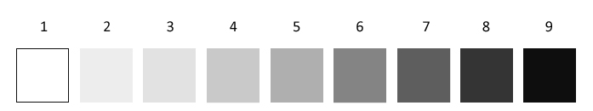
REAL LANGUAGE
(especially academic language)
Notes:
Kim
The study of language is a social science.
So, there is some gray area.
We have very few “always” or “never” rules that we can memorize and apply.
We have to evaluate each instance within its context.
In any science, when we don’t know the answer to a question, we do an experiment.
The same is true with the social science of studying language: We do an experiment, and we build evidence.
For that we need data:
COCA is our database.
We’re not looking for “right answers” … we’re accumulating evidence to support a hypothesis.

Slide 7
To meet those three needs of our students, we devised a series of 3 workshops on technology-enhanced language learning:
The Research Writing Tutor (RWT)
Grammarly Premium
The Corpus of Contemporary American English (COCA)
Notes:
Kim

Slide 8



Language learning is complicated.
Complexity
RWT
Accuracy
Fluency
Grammarly
COCA
Notes:
Kim

Slide 9
The Research Writing Tutor
Notes:
Kim --> Sarah

Slide 10




Teaches you about research writing
Points out writing goals and strategies
Evaluates your disciplinary writing
Offers feedback specific to your field
What is the RWT?
A web-based tool that …

Slide 11



First, some RWT vocabulary
moves
Linguists have studied the goals and strategies of research articles.
steps

Slide 12

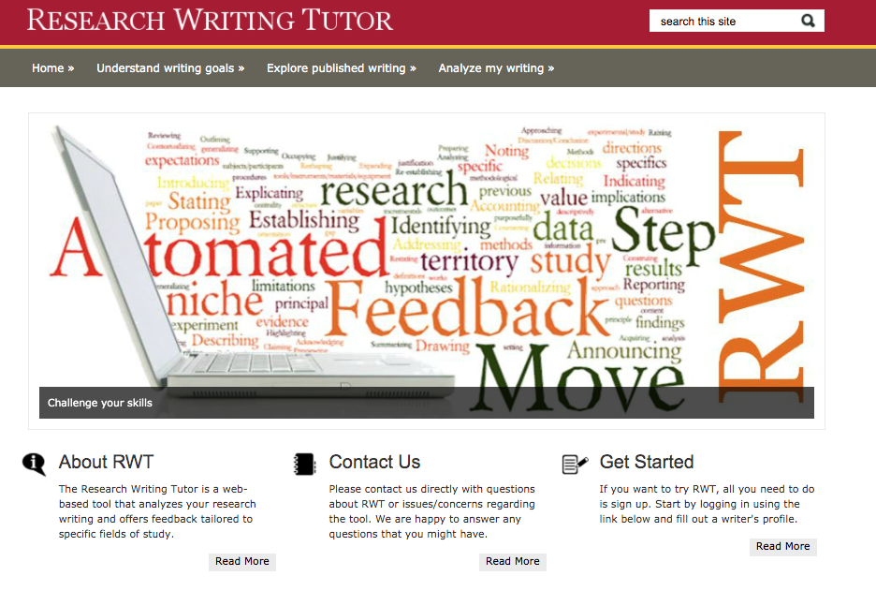
The RWT helps us identify moves (goals) and steps (strategies).
Complexity

Slide 13

Let’s learn about the features of this tool.
How to use
The RWT

Slide 14
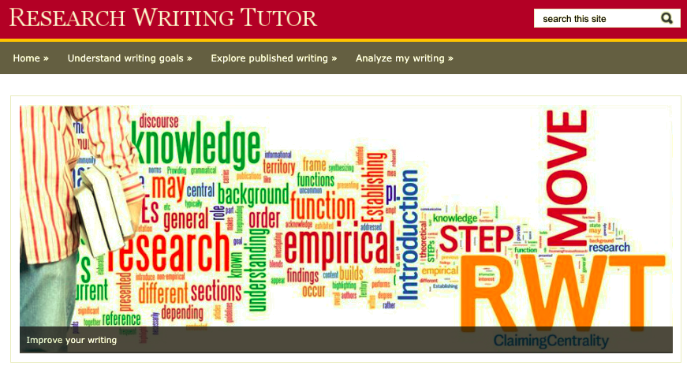
The RWT has 3 main features.

Slide 15
1. Learning about goals/strategies.

Slide 16


Slide 17
2. Exploring goals/strategies.

Slide 18
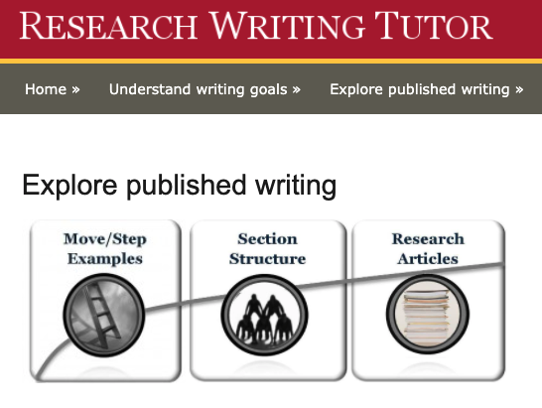

Slide 19
3. Analyzing your own writing.

Slide 20
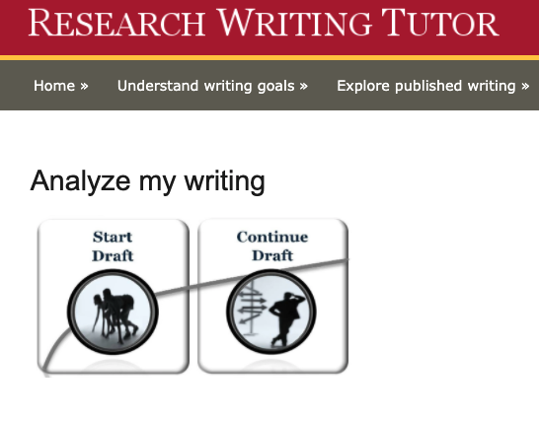

Slide 21
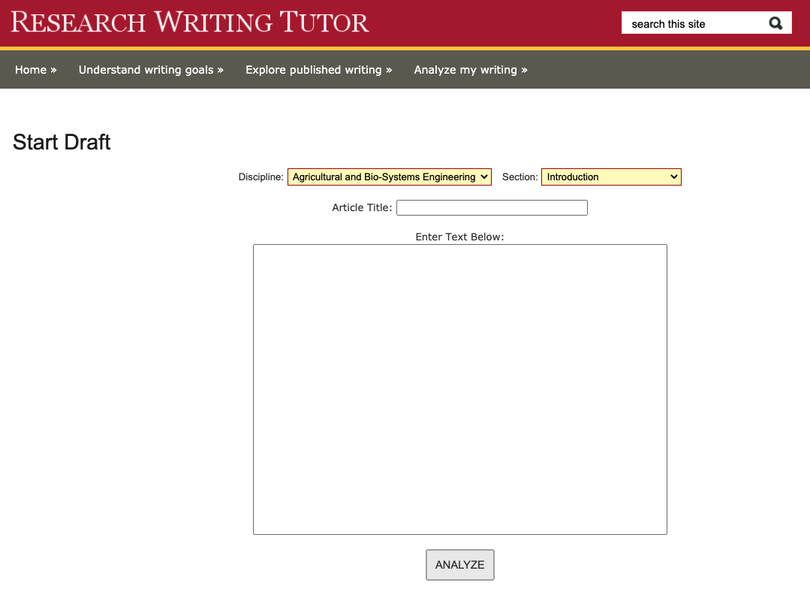

Slide 22
Two Overall Concerns
No one speaks “research English” as a native language.
Many research writers know what they want to say but not how best to say it.

Slide 23
Why learning (and teaching)
self-editing skills matter
“This paper addresses a number of potentially significant matters, but it has numerous problems. It is, in places incoherently written. There are many grammatical errors. Paragraphs do not flow easily from one to another. Acronyms are used without elaboration. And the writing overall is primitive.”
Riyad Shahjahan
Associate Professor of Higher, Adult, and Lifelong Education (HALE) at Michigan State University
National Center for Faculty Development and Diversity 2014 guest webinar presenter on the topic of
“How to overcome shame, the impostor syndrome and become a prolific scholar”
Notes:
Feedback Riyad received the first term of his doctoral study that initiated his writing shame and made him want to drop out of his doctoral study

Slide 24
Grammarly
Premium

Slide 25
Two Self-editing Concerns
Recognizing non-academic phrasing and grammar.
Identifying alternative phrasing and grammar.

Slide 26
What is Grammarly Premium?
Accuracy
Center for Communication Excellence, Graduate College
Grammarly Premium is an automated self-editing tool
It can help any writer identify issues in their writing
Grammarly compares your writing to edited writing to identify concerning differences

Slide 27
Using the Grammarly Premium Editor

Slide 28
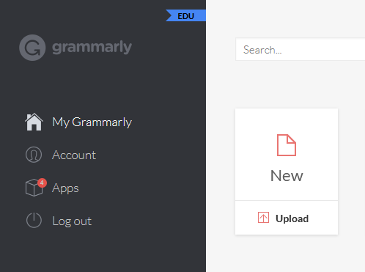
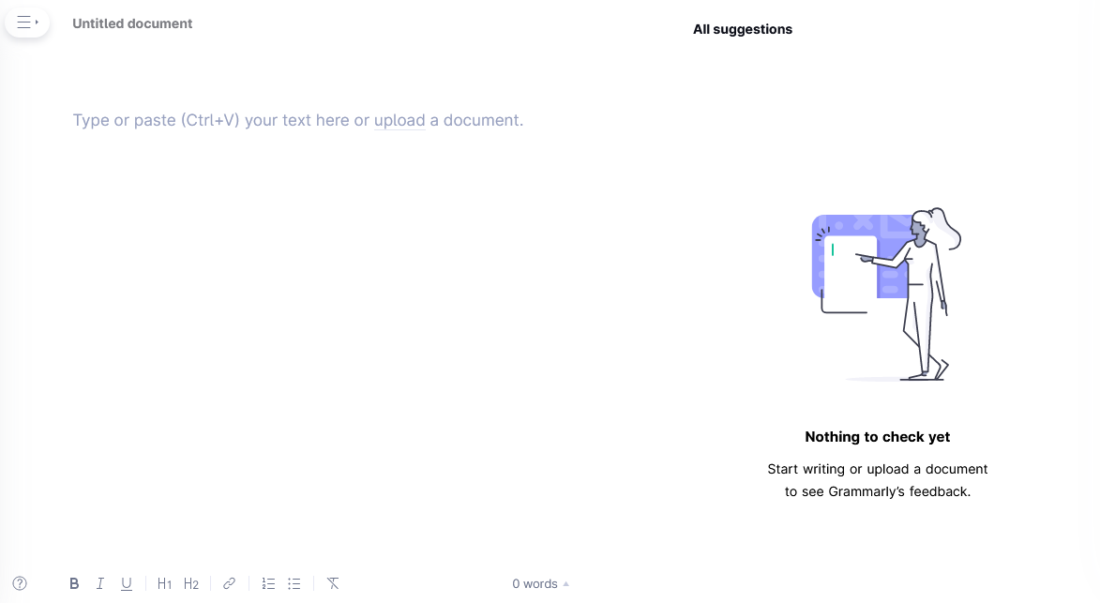
Click ‘New’ to start a new document…
…then paste your text into the text field.

Slide 29
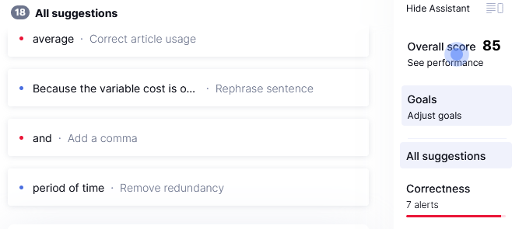
Adjust your goals

Slide 30
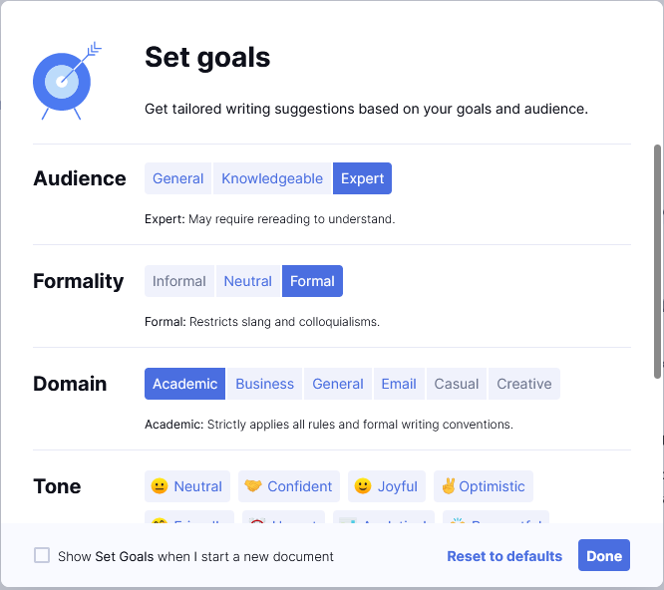
Adjust your goals

Slide 31
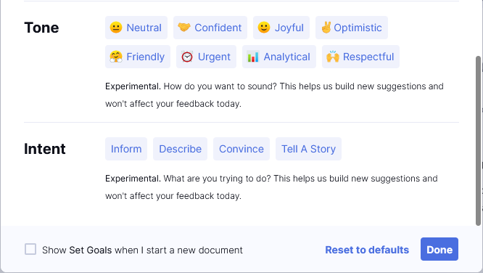
Adjust your goals
Notes:
These goals are experimental. You may choose to set goals in the tone and intent category if you want to help Grammarly establish standards for these types of writing.

Slide 32
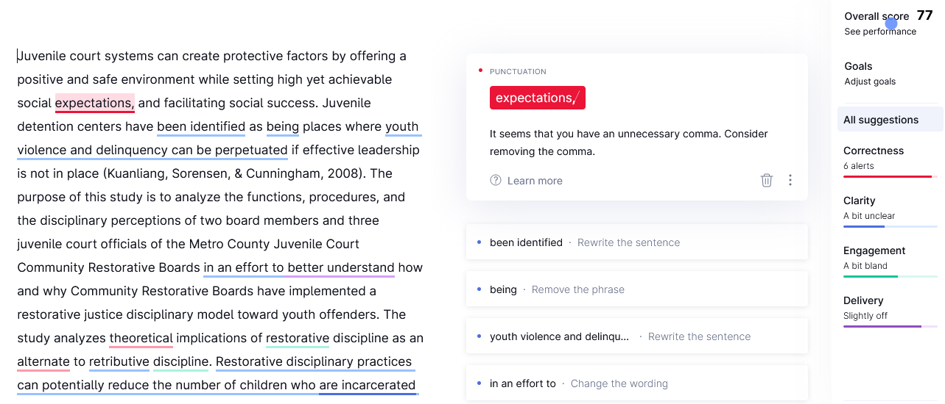
Your text
Score and categories
Current suggestion
Remaining suggestions

Slide 33
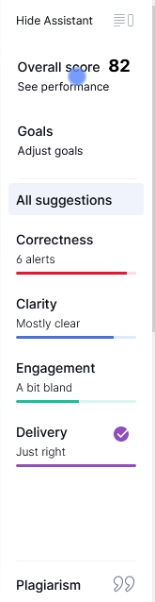
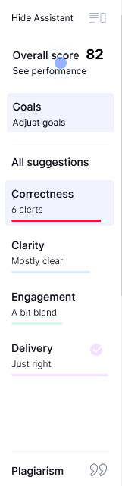
Click to show only “Correctness” suggestions

Slide 34
Recommendations
Accept: Correctness
Punctuation suggestions (e.g., commas, hyphens, semicolons, etc.)
Grammar suggestions (e.g., articles, subject/verb agreement, count/noncount nouns, etc.)
Ignore:
Suggestions about clarity, engagement, delivery (save those for a one-on-one meeting with a writing consultant!)
Suggestions related to scientific vocabulary; these can be checked with literature.

Slide 35
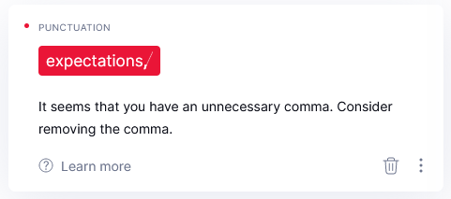
Using the Grammarly Editor
Click to accept suggestion
Click to reject suggestion
Click to send feedback to Grammarly
Click for a detailed explanation

Slide 36
COCA:
The Corpus of Contemporary American English

Slide 37
Two Overall Issues
No one speaks/writes “research English” as a native language.
Many research writers know what they want to say but not how best to say it.
Recognizing non-academic phrasing and grammar.
Identifying alternative phrasing and grammar.
Grammarly
COCA
Notes:
Research English (academic English) is universally and inherently non-native
Academics (researchers) know their content because they are experts in their field/discipline, but they may not know how to articulate their knowledge in a clear way.
This creates two concerns: (a) recognizing / finding non-academic phrasing and grammar/vocabulary and (b) discovering alternatives / solutions to “solve” or “fix” or “improve” the writing.
The previous workshop discussed concern A: recognition of the issues with Grammarly
This workshop will focus on finding solutions using COCA

Slide 38
A two-step process:
Finding potential issues via Grammarly.
Identifying potential solutions via COCA.
Notes:
Although these two programs are wonderful individually, they are even more powerful when used in tandem.
If you missed the previous workshop on Grammarly, please make an appointment with one of us and we can catch you up.
Many times you know that something is wrong, but you don’t know why. Even if you ask a native speaker, they may be able to recognize something as wrong, but unless they’re a language specialist, they likely won’t be able to explain WHY.
I could probably tell you, but you won’t always have someone to consult. So … you need to learn “how to fish.”

Slide 39
Recommended Self-Editing Process
Data-Driven Learning:
Use a corpus to confirm or correct language intuitions.
Generate a hypothesis
Test the hypothesis
Revise the hypothesis
Test the revised hypothesis . . . .
Notes:
Our suggestion is that you follow a process very similar to the scientific method:
1. generate hypothesis
2. Test hypothesis
3. revise hypothesis
4. test the revised hypothesis
This is a learning process that graduate students, postdocs and faculty are already familiar with.
Using a language database to gather evidence is one form of “data-drive learning” – we are basically going fishing for evidence to “confirm” or “correct” our language intuitions (or those of Grammarly!)

Slide 40
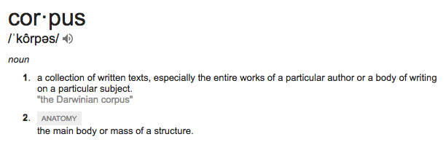
What is a corpus?
The plural form of corpus is corpora.
Notes:
Another word for “database” is “corpus.” What does this mean?

Slide 41
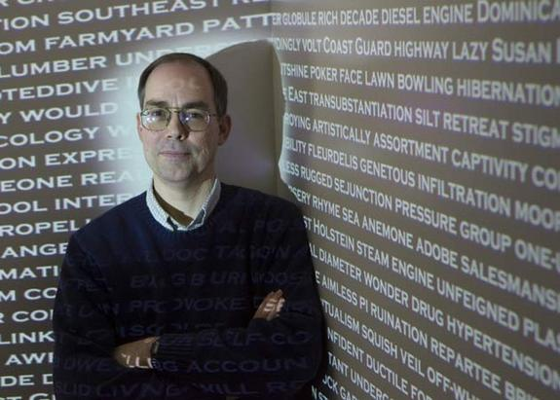
COCA
Who? | Mark Davies, creator 10,000 + people each month
What?
When?
Where?
How?
Why?

Slide 42
COCA
Who? | Mark Davies, creator 10,000 + people each month
What? | Corpus of Contemporary American English
When?
Where?
How?
Why?

Slide 43
COCA
Who? | Mark Davies, creator 10,000 + people each month
What? | Corpus of Contemporary American English
When? | Launched in 2010 Archives language from 1990-2020 8 text types: spoken, fiction, magazines, newspapers, academic texts, TV/Movies, blogs, other web pages.
Where?
How?
Why?

Slide 44
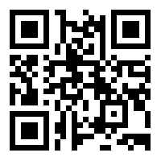
COCA
Who? | Mark Davies, creator 10,000 + people each month
What? | Corpus of Contemporary American English
When? | Launched in 2010 Archives language from 1990-2020 8 text types: spoken, fiction, magazines, newspapers, academic texts, TV/Movies, blogs, other web pages.
Where? | english-corpora.org → Use QR code for easy access.
How?
Why?

Slide 45
COCA
Who? | Mark Davies, creator 10,000 + people each month
What? | Corpus of Contemporary American English
When? | Launched in 2010 Archives language from 1990-2020 8 text types: spoken, fiction, magazines, newspapers, academic texts, TV/Movies, blogs, other web pages.
Where? | english-corpora.org → Use QR code for easy access.
How? | 1 billion words words from more than 500,000 texts 20 million words each year from 1990 to current
Why?

Slide 46
COCA
Who? | Mark Davies, creator 10,000 + people each month
What? | Corpus of Contemporary American English
When? | Launched in 2010 Archives language from 1990-2020 8 text types: spoken, fiction, magazines, newspapers, academic texts, TV/Movies, blogs, other web pages.
Where? | english-corpora.org → Use QR code for easy access.
How? | 1 billion words words from more than 500,000 texts 20 million words each year from 1990 to current
Why? | To identify academic English phrasing for expressing ideas.

Slide 47
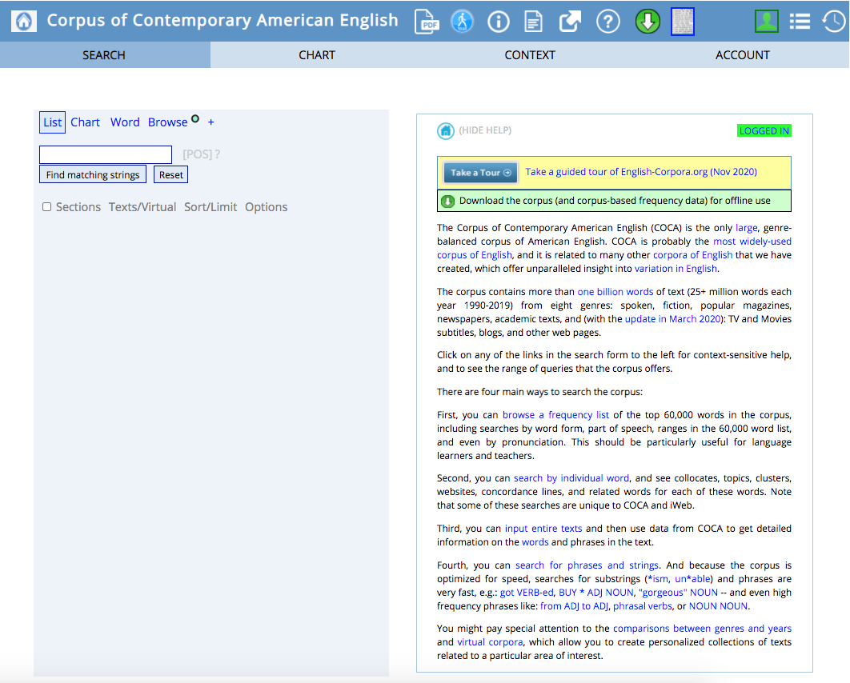
What can COCA do?
You can come back to these and learn them at any time (or make an appointment with one of us, and we’ll show you).
47

Slide 48
What can COCA do?
Synonyms
Phrasal verbs
Idioms
Prepositional Phrases
Grammarly gut-check
48

Slide 49
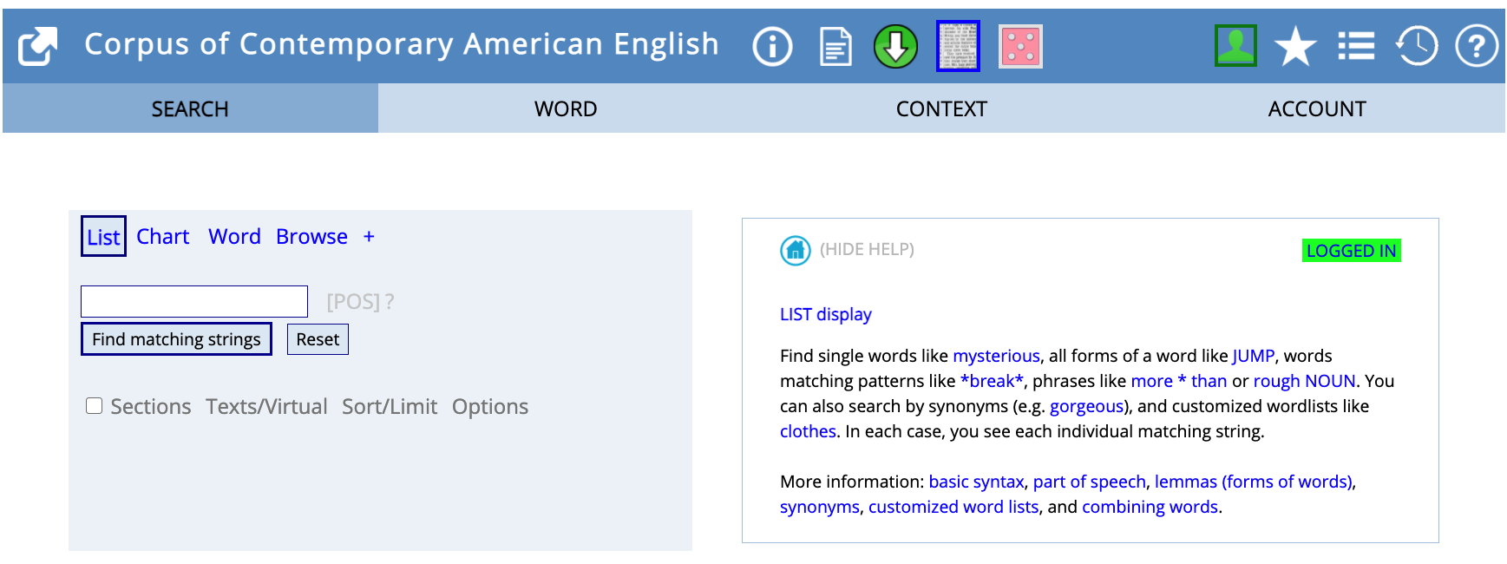
Using the “List” Function
Notes:
The first function we’ll discuss is called “List”
At this point, stop the slideshow and go to COCA and demonstrate typing a word and clicking on “find matching strings.”
On the right half of the screen, you can see that COCA provides a description of what you can do with the “List” function.
We’ll demonstrate some uses, but of course you can always come back and learn more anytime.
Basically, “list” is exactly what it sounds like: Searching for a word/phrase in “list” will result in a LIST of that work in context.

Slide 50
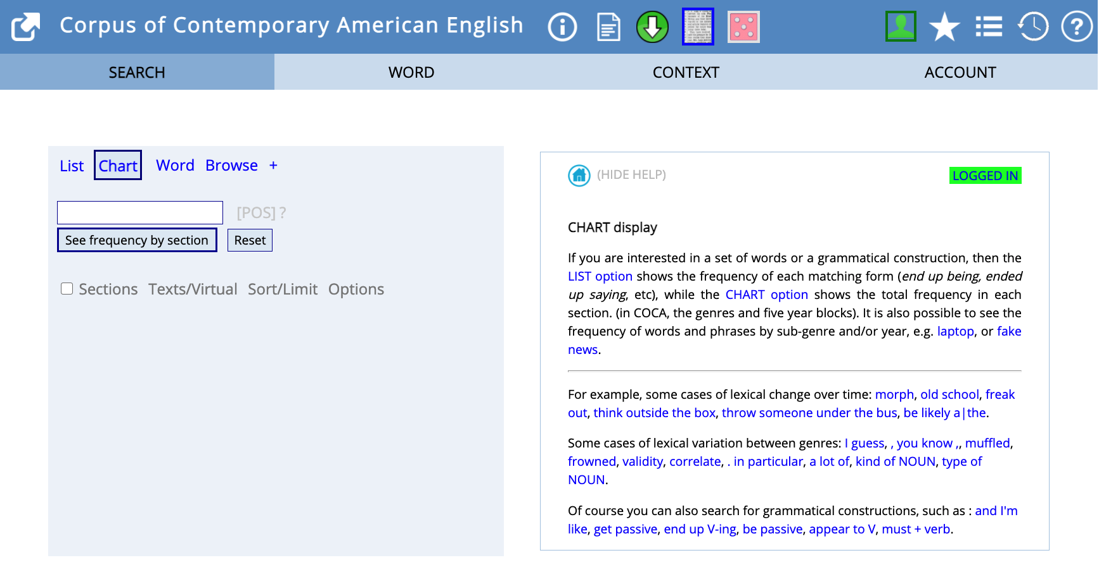
Using the “Chart” Function
Notes:
The next function we’ll discuss today is called “Chart”.
This function allows you to determine the formality level of a word.
Go to COCA and demonstrate looking for the word “Google.” → note that you can map this across genre and time.

Slide 51
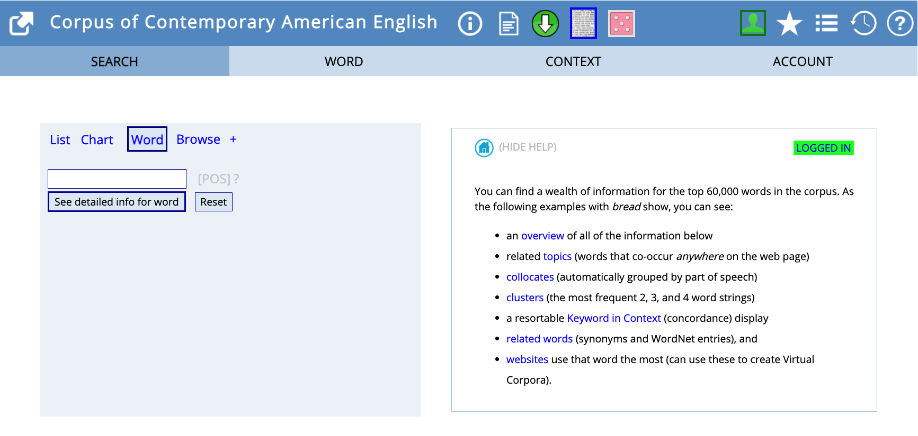
Using the “Word” Function
Notes:
The last function for today is called, simply, “Word.”
The Word function gives you a snapshot of many different aspects of a word (as noted on the right side of the screen)
Now go to COCA and demonstrate, using the word

Slide 52
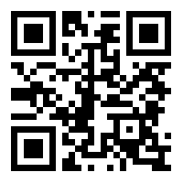
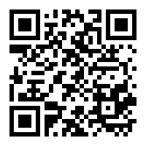
More resources for learning how to
self-check your English grammar/vocabulary
Have a one-on-one consultation about your research writing, job application materials, etc., at http://dwcisu.appointy.com/
Check out the CCE website resources http://cce.grad-college.iastate.edu/

Slide 53
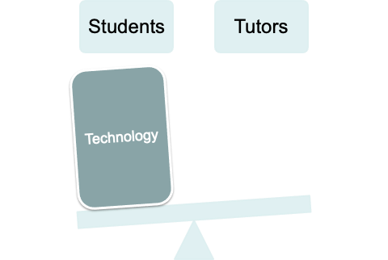
Rationale for Workshops

Slide 54
Evaluations

Slide 55
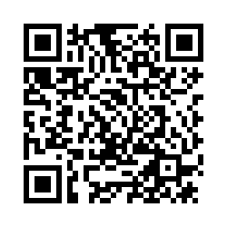
Collecting Feedback from Students
We always appreciate and use feedback to improve these presentations. Please complete a short survey?

Slide 56
Demographics of Attendees
Piloted over two semesters:
Spring 2021 – virtual (35 registrants)
Fall 2021- hybrid (57 registrants)
Participant composition:
Graduate students and postdocs
Across disciplines
Non-native and native speakers

Slide 57
Post-workshop evaluation data: Quantitative
Overall trends
Percentage
Substantial percentage increase in knowledge about writing these advanced tools prior to and after workshop sessions

Slide 58
Post-workshop evaluation data: Quantitative
Overall trends
“The material presented will be useful to me in my work”
26% Agree
74% Strongly agree
“The presentation met my expectations for writing with advanced technology tools”
37% Agree
63% Strongly agree

Slide 59
Post-workshop evaluation data: Qualitative
Overall trends: “What I liked most about the presentation was…”
Enabled practice using the technological tools
Ability to practice what is being taught
Practice using it
Prompted learner self-editing autonomy
Made me notice my own mistakes and that I can improve in future job applications
Incorporated authentic examples from actual discourse
Showing samples
The clarity and the examples
The examples and eagerness of the presenter to help us

Slide 60
Post-workshop evaluation data: Qualitative
Overall trends: “The presentation could have been better if…”
Consolidated user guide/resource to support use
There was a cheat sheet for using the corpus since it’s not so user friendly
An preview/outline of each type of doc was provided at the start so we would have an idea of what’s coming
More time to engage with practice and content
Too much important content which couldn't be covered in only one hour
More time

Slide 61
Key Takeaways
Communicative competence involves complexity, accuracy, and fluency
Different technologies empower students to develop these abilities outside the tutoring context
Academic writers achieve more agency using technologies to scaffold their existing skills

Slide 62
Thank you!
Kim Becker | kpb@iastate.edu
Sarah Huffman | shuffman@iastate.edu
Kristin Terrill | kterrill@iastate.edu

