Slide 1
Enacting Antiracism in Asynchronous Writing Consultations
Presented by:
Eric C. Camarillo

Slide 2
Outline
Background and Context
Need for more research
Pandemic
Recommended Texts
Definitions
Asynchronous
Antiracism
Analyzing comments
Frame for analysis
Comments
Conclusion

Slide 3
Context
A need for more research and pandemic-related Concerns

Slide 4
A Need for More Research
Traditional writing center consultations
Best practices
North, Lunsford, Brooks
Grappling with racism, colonialism, etc.
Grimm, Bawarshi and Pelkowski, Greenfield, Garcia
Synchronous online consultations
Online Writing Instruction
Borgman and McArdle, Hewett, Warnock
Antiracist instruction
Inoue

Slide 5
A Need for More Research
Asynchronous writing consultations
Best practices
Strategies
Methods
Kinds
Theories
Limitations
Borders and control

Slide 6
Definitions
What do asynchronous and antiracism mean?

Slide 7
Asynchronous
Phases of asynchronous conferences
A writer e-mails or electronically posts an essay to an online instructor.
The instructor reads the essay and provides feedback and instruction.
The writer reads or listens to the instructor's response and revises the essay (or not).
The writer desires further feedback and submits new essay draft
Hewett, The Online Writing Conference, 27

Slide 8
Antiracism
Kendi, How to be an Antiracist
"An antiracist policy is any measure that produces or sustains racial equity between racial groups. By policy, I mean written and unwritten laws, rules, processes, regulations, and guidelines that govern people" (18, emphasis added).

Slide 9
Analysis

Slide 10
Method and Methodology
Methods
Collected writing consultant comments from five papers on the same project
Coded comments along eight dimensions (eventually down to three)
Methodology
Suhr-Sytsma and Brown’s “Theory In/To Practice: Addressing the Everyday Language of Oppression in the Writing Center”

Slide 11
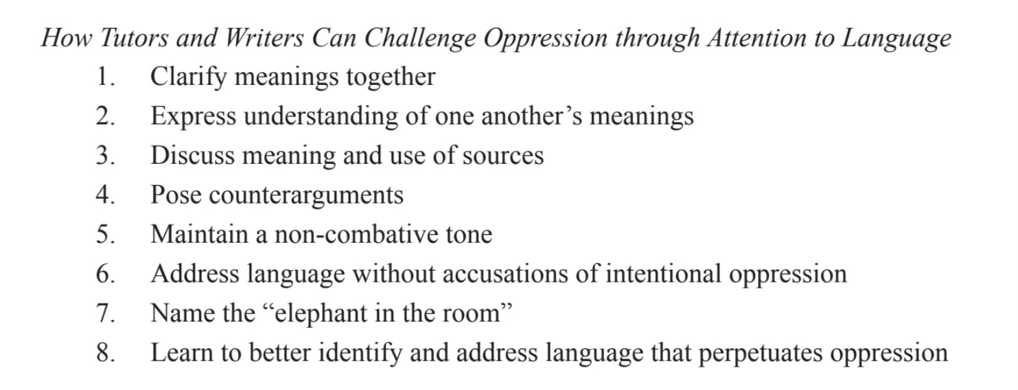
Surh-Sytsma and Brown

Slide 12
Clarify meanings together
Expressing understanding of one another’s meanings
Discuss meaning and use of sources (22)
Suhr-Sytsma and Brown

Slide 13
Engagement Comment Location Comment Frequency Modeling
Hewett’s Strategies

Slide 14
Some Findings
More time to think about comments
For both student and consultant
Shifts (some/more) power to the student
Whether or not to make changes
Consultants taking the viewpoint of a reader
Comments were often more directive
A potential best practice: Do X because Y
Actionable comments

Slide 15
Conclusion
Some final thoughts

Slide 16
Ongoing Questions and Ideas
Antiracism exists structurally
How can policies, procedures, and training affect antiracism within individual sessions?
What theories can we use to inform our online practices?
Activity theory
Decolonialism
Radical praxis?
How do consultants decide to make comments?

Slide 17
Recommended Texts

Slide 18
“The ‘Standard English’ Fairy Tale: A Rhetorical Analysis of Racist Pedagogies and Commonplace Assumptions about Language Diversity”
Greenfield

Slide 19
“Unmaking Gringo-Centers”
Garcia

Slide 20
The Online Writing Conference: A Guide for Teachers and Tutors
Hewett

Slide 21
"Beyond the Lore: A Case for Asynchronous Tutoring Research"
Denton

Slide 22
“Theory In/To Practice: Addressing the Everyday Language of Oppression in the Writing Center”
Suhr-Sytsma and Brown

Slide 23
Thank you
Eric C. Camarillo
Ecamaril@hacc.edu

