Slide 1

Racial Justice & Online Writing Center Praxis
Zandra L. Jordan, PhD
Director, Hume Center for Writing & Speaking
Stanford University
zljordan@stanford.edu
Oct. 2, 2020

Slide 2
Roll call! Raise a fist if…

Slide 3
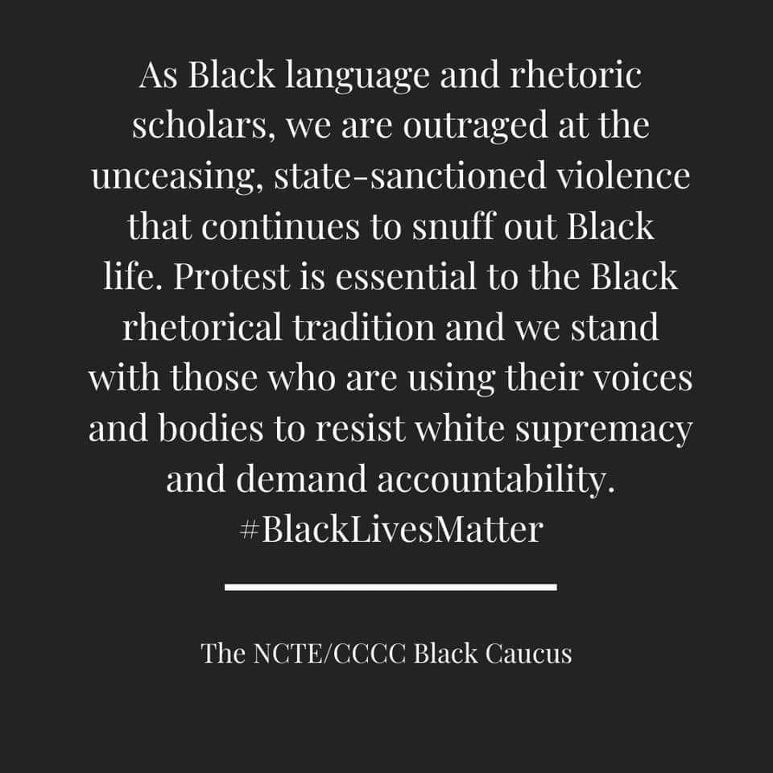

Slide 4
“Racial justice — or racial equity — goes beyond ‘anti-racism.’ It is not just the absence of discrimination and inequities, but also the presence of deliberate systems and supports to achieve and sustain racial equity through proactive and preventative measures.”
NEA Racial Justice in Education Resource Guides

Slide 5
Womanist ethics as a critical moral standpoint for antiracist (online) writing center praxis
“In a womanist garden, every person matters. Womanist theology is aimed at supporting all oppressed communities in the work of liberation while affirming black women’s capacities, wisdom, and independence.”
Marshall Turman, E. (February, 2019). Black women’s faith, black women’s flourishing: Womanist theology proclaims a future beyond the strongholds of racism, sexism, and injustice. The Christian Century.

Slide 6
radical subjectivity
ways that black women, aware of their own tripartite oppression, refuse to be “a victim of circumstance” and choose instead as “responsible, serious, in-charge women,” to claim their own sense of identity in response to “hegemonic” forces
Walker, A. (1983). In search of our mother’s gardens: Womanist prose. Harcourt Brace Jovanovich.
Floyd-Thomas, S. M. (Ed.) (2006). Deeper shades of purple: Womanism in religion and society. New York Univ. Press.

Slide 7
traditional communalism
expresses a commitment to work that liberates the entire black community. Individual stories of “womanish culture” become tools for elucidating the many “dimensions of black folk life” and dismantling legacies of oppression that belie the “traditionally capable” and “universalist” qualities of the black community
Walker, A. (1983). In search of our mother’s gardens: Womanist prose. Harcourt Brace Jovanovich.
Floyd-Thomas, S. M. (Ed.) (2006). Deeper shades of purple: Womanism in religion and society. New York Univ. Press.

Slide 8
redemptive self-love
rejects “perceptions of black women’s bodies, ways and loves as vile” and in so doing reclaims “their truer selves”
Walker, A. (1983). In search of our mother’s gardens: Womanist prose. Harcourt Brace Jovanovich.
Floyd-Thomas, S. M. (Ed.) (2006). Deeper shades of purple: Womanism in religion and society. New York Univ. Press.

Slide 9
critical engagement
takes black women’s tripartite oppression seriously and makes “no compromises” in seeking the greatest degree of “justice, freedom, and equality”
Walker, A. (1983). In search of our mother’s gardens: Womanist prose. Harcourt Brace Jovanovich.
Floyd-Thomas, S. M. (Ed.) (2006). Deeper shades of purple: Womanism in religion and society. New York Univ. Press.

Slide 10
Womanist ethics as a critical moral standpoint for antiracist (online) writing center praxis
Tutors should reflect the diverse demographics of the student body.
Training curriculum should center racial literacy and racial justice.
Tutor feedback should convey appreciation for linguistic diversity.
Tutors should honor writers’ video/audio preferences.
Tutors should engage in discussions about race(ism) and language attitudes.

Slide 11
appropriation and reciprocity
acts “in solidarity with and on behalf of Black women who have made available, shared, and translated their wisdom, strategies, and methods for the universal task of liberating the oppressed and speaking truth to power”
Floyd-Thomas, S. M. (Ed.) (2006). Deeper shades of purple: Womanism in religion and society. New York Univ. Press.

Slide 12
insert YOUR antiracist ethic here
OWI Principle 1: Online writing instruction should be universally inclusive and accessible.
How do we account for racial justice?

Slide 13
Collaborative reflection and visioning with Padlet
Things to Know:
Anonymous posts
Anonymous aggregation of responses
Alternative: post in the chat

