Slide 1
Online Writing Centers Association (OWCA)
Special Interest Group
@ IWCA’s Listen. Learn. Lead.
OnlineWritingCenters.org

Slide 2

Agenda for Today’s SIG
Introduction to the OWCA
Current Executive Board
Opportunities to get involved
Become a member
Apply for Executive Board openings
Join a committee
Donate to the OWCA
Questions
Discussion: How can we support you in 2021?

Slide 3

Introduction to the OWCA

Slide 4

History
Started out as Online Writing Centers Community (OWCC)
Idea formed at special interest group at IWCA 2017
OWCC website announced on July 23, 2018
Scholarship archive, SIGs, Virtual Conversation Hours
Transitioned to a professional association in 2020
August 29: became legally incorporated in the State of Ohio
September 16: voted in OWCA bylaws
October 13: officially announced the OWCA

Slide 5

What We’ve Done This Year
Started a mentorship program to support professionals moving online during the pandemic
Hosted 1 Virtual Conversation Hour and 3 Webinars
Developed Articles of Incorporation and Bylaws
Obtained legal status in Ohio
Submitted application for 501(c)(3) status with the IRS
Recruited 170+ members since October 13

Slide 6

Our Goals for 2021
Increase engagement with the organization
Obtain 501(c)(3) status with the IRS
Become an official affiliate of IWCA
Host regular webinars (or other virtual events)
Host first annual virtual conference
Create position statements on online writing center work
Expand and improve our scholarship archive
Expand our mentoring program
Create and invite OWC resources and training materials

Slide 7
Current Executive Board

Slide 8
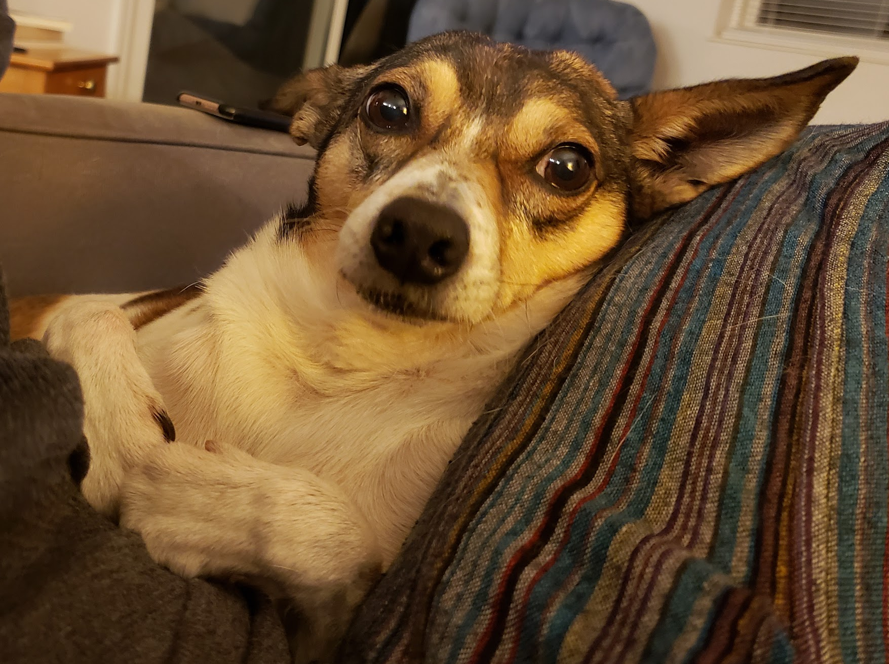
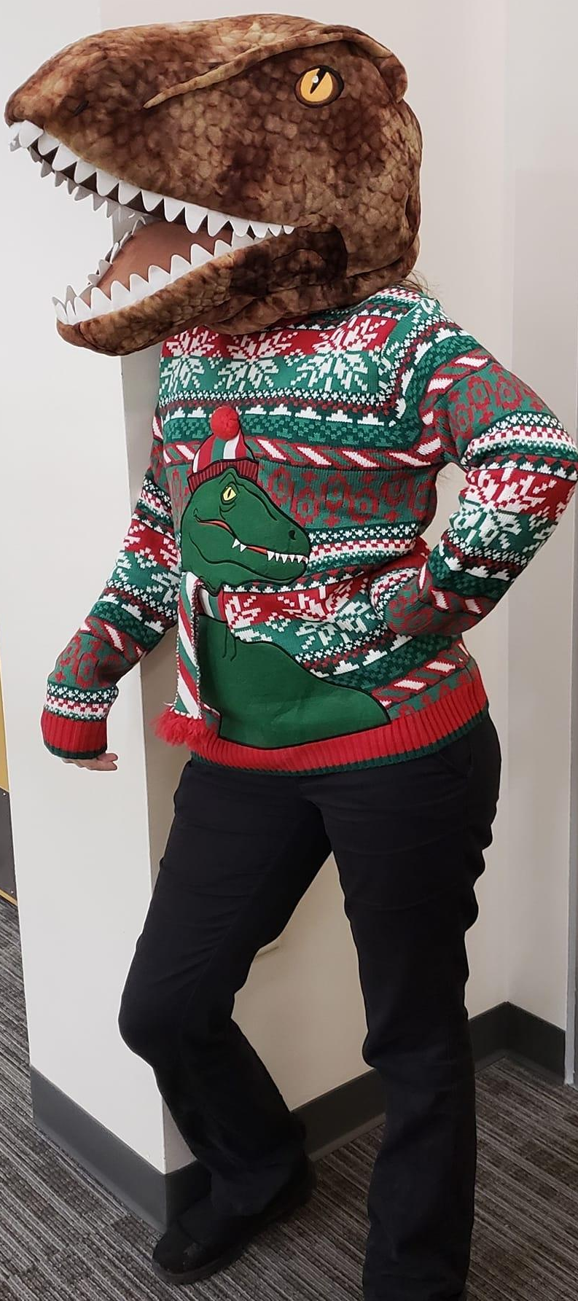
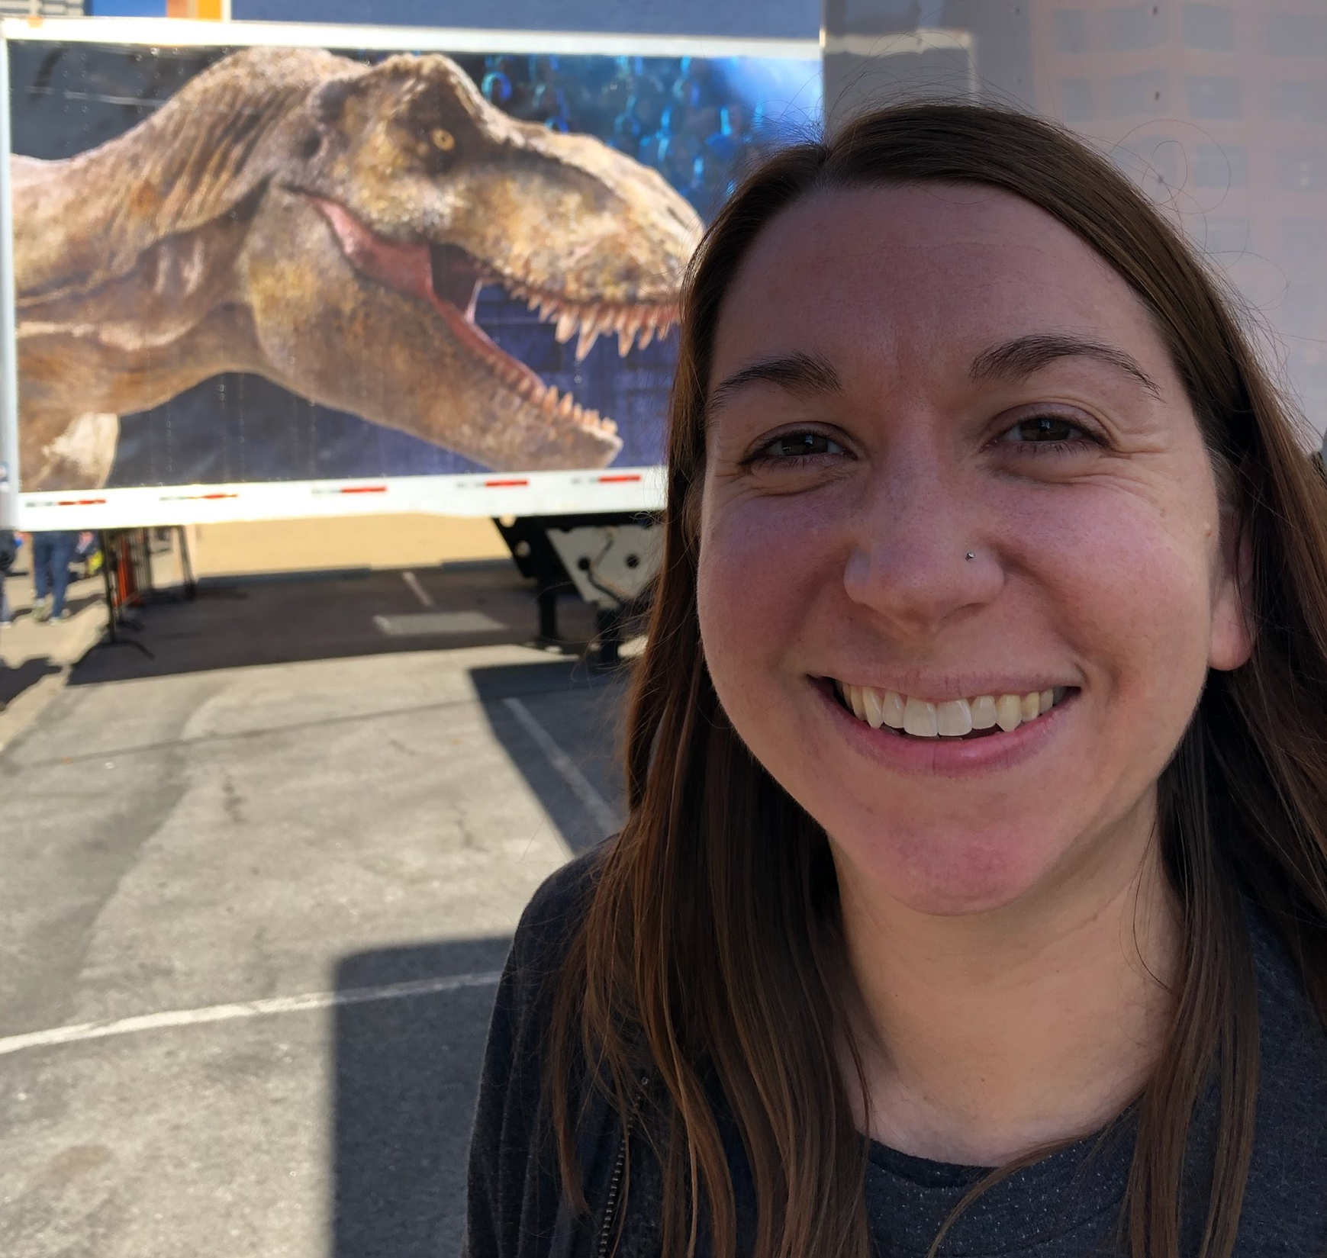
Jenelle M. Dembsey, Founding President
10+ years in writing centers
Undergrad & Grad Writing Tutor
Online Coordinator
Coordinator for Technology & Accessibility
Co-Founder of OWCC in 2018
Present: IRB Coordinator at Northcentral University
Research interests: online writing centers, disability, accessibility

Slide 9


Sarah Prince, Founding Vice President
15+ years in writing centers
Undergrad. & Grad. Writing Tutor
Graduate Writing Fellow
Professional Writing Tutor
Faculty, Undergrad. & Grad Writing Courses & Workshops
Present: Associate Director for Resource Management, Walden University Writing Center
Writing Assessment
Website
Webinars, modules, course visits,
Residencies
Co-Founder of OWCC in 2018
Research interests: online writing centers, WAC and WC partnerships, asynchronous writing center sessions

Slide 10


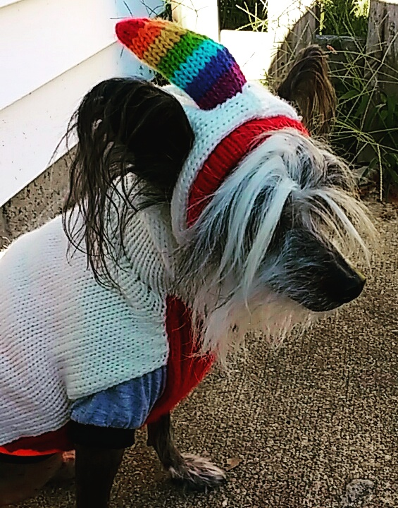
Elle Tyson, Founding Treasurer
5 years in writing centers
Professional Writing Tutor
Graduate Assistant Writing Tutor
Present: ePortfolio Student Support Coordinator at Old Dominion University
Research interests: online tutoring, asynchronous screencasting/video feedback
Co-treasurer of Humanities Behind Bars

Slide 11

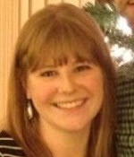
Beth Nastachowski, Founding Secretary
10+ years in writing centers
Undergrad. & Grad. Writing Tutor
Professional Writing Tutor
Faculty, Undergrad. & Grad. Writing Courses
Present: Associate Director for Office of Writing Instruction, Walden University Writing Center
Research interests: online asynchronous writing instruction

Slide 12
Opportunities to Get Involved

Slide 13

Become a Member
Types of Membership
Professional Membership
Student Membership
Both are currently free for 1 year
Executive Board will decide on a fee for membership dues in 2021
Go to: OnlineWritingCenters.org/join/membership

Slide 14

Apply for the Executive Board
1 Conference Organizer
3 At-Large Representatives
2 Student Representatives

Slide 15

1 Conference Organizer
1-year term, non-renewable
Voting member of the Executive Board
General Responsibilities
Chair the conference committee for that year
Plan the annual virtual conference
Will not need to use institutional resources (with exception of Zoom)
Will have support from the OWCA Treasurer, Diversity Committee, Accessibility Committee, Virtual Events Committee, and Website and Communication Committee

Slide 16

3 At-Large Representatives
2-year terms, non-renewable
Voting members of the Executive Board
General Responsibilities
Represent the interests of underrepresented individuals and/or institutions in online writing center work
Assist other officers with tasks, according to their interests and professional goals
Chair or co-chair at least 1 long-term committee

Slide 17

2 Student Representatives
1-year terms, renewable
Voting members of the Executive Board
General Responsibilities
Represent the interests of secondary school, undergraduate, and/or graduate students engaged in online writing center work
Assist other officers with tasks, according to their interests and professional goals
Chair or co-chair at least 1 long-term committee

Slide 18

How to Apply
Terms begin in January 2021
Estimated time commitment is 10-15 hours a month
Applications are due November 6, 2020
Email ~250 statement to board@onlinewritingcenters.org
See our website for questions to address in your statement: OnlineWritingCenters.org/join/board
The Board will contact applicants by November 20, 2020

Slide 19

Sign Up for a Committee
Diversity
Accessibility
Virtual Events
Website & Communication
Mentoring & Resources
Liaison

Slide 20

Diversity Committee
General Responsibilities
Assist OWCA with diversity and inclusion initiatives
Review organization resources and events for inclusivity
Create resources and position statements
Initial Tasks in 2021
Advise on inclusivity of virtual events and the 2021 virtual conference
Draft a position statement on anti-racism in online writing center work

Slide 21

Accessibility Committee
General Responsibilities
Advise on accessibility of events, website, resources, etc.
Ensure videos and materials are accessible before distribution
Initial Tasks in 2021
Advise on accessibility of virtual events and the 2021 virtual conference
Draft accessibility guides for presenters and attendees
Edit/review captioning and transcripts for 2021 webinars

Slide 22

Virtual Events Committee
General Responsibilities
Schedule and facilitate regular virtual events (webinars, etc.)
Does not include the annual conference
Initial Tasks in 2021
Schedule webinars in 2021
Develop webinar protocols for presenters and facilitators
Collaborate with the 2021 Virtual Conference Committee

Slide 23

Website & Communication Committee
General Responsibilities
Manage and update all content on the OWCA website
Including event registration, membership software, scholarship archive, conference website, etc.
Initial Tasks in 2021
Analyze current OWCA website and choose new template
Research options for developing 2021 conference website
Develop job aides for editing the website

Slide 24

Mentoring & Resources Committee
General Responsibilities
Coordinate the OWCA mentorship program
Develop and expand online writing center resources
Initial Tasks in 2021
Revise and expand the OWCA mentorship program
Expand entries and tags in the scholarship archive
Brainstorm additional resources to be created/collected

Slide 25

Liaison Committee
General Responsibilities
Attend annual conferences or events hosted by related associations, affiliates, or organizations
Act as liaison between OWCA and designated associations, affiliates, or organizations
Initial Tasks in 2021
Determine related associations, organizations, or IWCA affiliates
Secure liaison representation at related associations
Plan attendance at upcoming 2021 events
Build template for sharing across OWCA and designated associations

Slide 26




Short-Term Committees
OWCA can create additional short-term committees as needed
2021 Virtual Conference Committee
To be chaired by Conference Organizer
Possible committees for writing position statements

Slide 27

How to Sign Up
Committees will be assigned chairs and begin recruiting in January 2021
Sign up to be notified when recruitment begins:
Go to: OnlineWritingCenters.org/join/committee

Slide 28

Donate to
the OWCA
Our Costs
How to Donate

Slide 29

Our Current Costs
Website hosting and domain: $183 per year
MemberPress: $250 per year
Sign language interpreters: $260 per 1-hour event
Nonprofit incorporation: $99
501(c)(3) application to IRS: $275
Anticipated Total for 2020-21: $2,886

Slide 30




How to Donate
PayPal bit.ly/owcadonate
Credit/Debit Card
Through PayPal account
Cash App
Pay through app with cashtag $owcadonate
Open the camera on your phone to scan the QR codes
Go to donate page http://onlinewritingcenters.org/join/donate/
Online Writing Centers Association

Slide 31
Questions?

Slide 32
Discussion:
How can we support you in 2021?

