Slide 1

Shaping Online Tutoring Practice
Research & Reflection over Replication
An Online Writing Centers Community Webinar and Discussion with Dr. Lisa Bell

Slide 2

Where we are
Benefits of OWC work
Synchronous (benefits & myths)
Asynchronous (benefits & myths)
Why options matter
Reflecting our values
Discussion
Presentation Overview

Slide 3

Where We Are
Whether your online writing center work began in 2020 or 20 years ago, your work is important and worth recognizing.

Slide 4
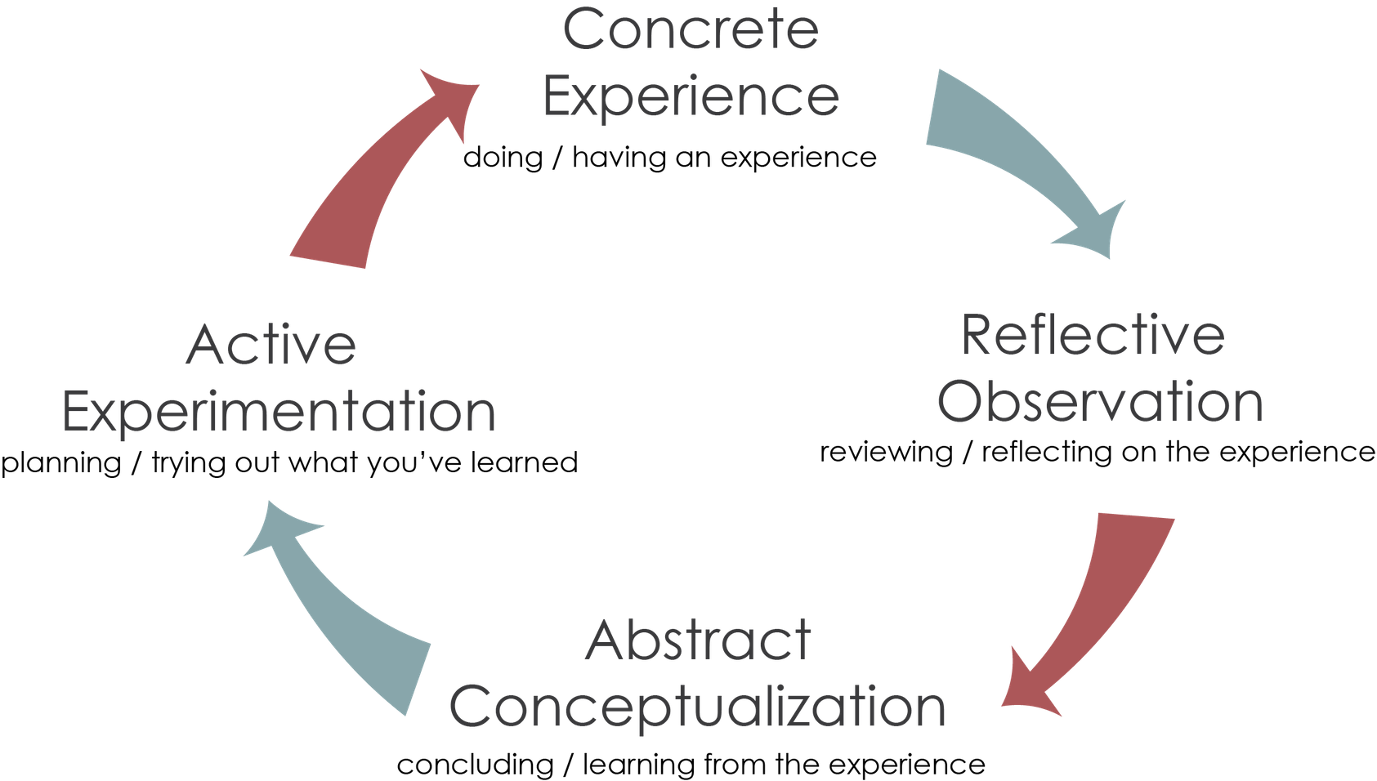
Where We Are
Kolb's Learning Cycle (as cited in University of Kansas, n.d.)

Slide 5

Reflection and Research over Replication

Slide 6



Benefits of Online Writing Center Tutoring
SUPPORT FOR ONLINE LEARNERS
INCREASED ACCESSIBILITY
INCLUSIVITY AND EQUITY
(The Conference on College Composition and Communication, 2013)

Slide 7

Benefits of Synchronous Online Tutoring
  allows participants to establish personal connections (Wolfe & Griffin, 2012; Mick & Middlebrook, 2015)
  provides opportunities to seek clarification and have an extended conversation and negotiation in real time (Mick & Middlebrook, 2015), which may be especially useful for ELL writers (Ene & Upton, 2018)
  can address issues of time and space and improve how participants work with and share drafts of papers (Van Horne, 2012)

Slide 8
SYNCH = SIMPLE CONVERSATION
SYNCH = SIMPLE CONVERSATION
Participants may lack the technology or bandwidth for a synchronous online exchange (Martinez & Olsen, 2015; Camarillo, 2020). Synch exchanges may also make use of multiple or new technologies (whiteboards, chat, screensharing, video, etc.)
Participants may perfer having time to prepare and respond within a tutoring session and may not be comfortable or ready to engage in real time about writing (Hamper, 2018; Ries, 2015; Camarillo, 2020).
Dispelling Myths about Synchronous Tutoring
SYNCH = PREFERABLE TO ASYNCH
SYNCH = MORE ALIGNED WITH WC WORK
Choices about online learning are shaped by a range of variables that include learning contexts and personal learning needs and preferences (Denton, 2017).
"Tutors . . . remarked that the process of creating [asynch] screencasting feedback helped them focus their efforts on holistic feedback in both written and verbal comments. This suggests the screencasting process itself encourages tutoring methods that more closely align with the mission of the writing center" (Boone & Carlson, 2011, p. 20).

Slide 9

Benefits of Asynchronous Online Tutoring
  allows writers choices about their use of time and space (Gallagher & Maxfield, 2019; Camarello, 2020), which may be particularly helpful to caregivers and working students (Hewett et al, 2019; Bell, et al., n.d.)
  reduces pressure on tutors and writers to respond right away, which may reduce anxiety and issues of cognitive, affective, or linguistic threshold (Hamper, 2018; Ries, 2015; Camarillo, 2020)
  allows writers to return to and review feedback (Mick & Middlebrook, 2015), particularly beneficial for ELL writers (Cunningham, 2017; Cranny, 2016)
  can also provide a resource-rich online learning environment (Séror, 2013; Anson et al., 2016)

Slide 10
ASYNCH = EMAIL TUTORING
ASYNCH = IMPERSONAL
Audio and visual technology can enhance written feedback as part of asynch tutoring (Cranny, 2016; Madson, 2017)
In a recent study, 70% of writers using asynch tutoring preferred a combination of audiovisual and written feedback (Bell, et al., n.d.)
"Screencast technologies (a) facilitate personal connections between teacher and student, (b) create transparency about the teacher’s evaluative process and identity, (c) reveal the teacher’s feelings, (d) provide visual affirmation, and (e) establish a conversational tone for the evaluative process” (Anson et al., 2016, p. 391).
Dispelling Myths about Asynchronous Tutoring
ASYNCH = TELLING WRITERS WHAT TO DO
ASYNCH = LACK OF DIALOG
Asynch sessions are often empowering for writers because they offer choices without the tutor present (Camarillo, 2020). Tutors use scaffolding throughout asych tutorials (Bell, 2019) and work hard to define roles and encourage each writer's sense of ownership (Bell, 2019; Reis, 2015).
"[T]here are many ways to foster dialog online" (Breuch, 2005). Just because dialog is not tutor led does not mean learners are not engaging with feedback (Angelov & Ganobcsik-Williams, 2015; Denton, 2017). Social media and instructor comments can provide examples of asynch dialog. (See Bakhtin.)

Slide 11

Offering Multiple Forms of Tutoring

Slide 12

The diverse needs of learners are best addressed though a range of tutoring options
(Denton, 2017; Prince et al. , 2018; Martinez & Olsen, 2015; Al Chibani, 2014)
Survey data showed that 58% of those using online tutoring had also participated in-person tutorials, and demographic data from 21, 934 confirmed writers' use of multiple forms of tutoring (Bell et al., n.d.)
Multiple tutoring options address learning preferences and needs, including
  stage in the writing or learning process
  access in terms of time and space
  cognitive, affective, or linguistic thresholds

Slide 13
“The principle of providing inclusivity and accessibility grounds all of the OWI principles and should be considered at the onset of developing solutions instead of as an afterthought. Accessibility often is considered in terms of disability, and while that certainly is one aspect and one reason that OWLs should be thoughtful of access, disabilities are not the only issues that can prevent students from receiving an equitable education. One’s socioeconomic status may limit the ability to use synchronous tutoring, for example, in that lack of cameras/ microphones or Web conferencing technology (i.e., technology that might otherwise be available in a campus lab) in one’s home or public library may impede certain kinds of access for geographically distributed students. Varying learning styles and levels are other issues to consider when designing OWI materials. For example, some students may learn better with the time flexibility allotted in asynchronous tutoring; to limit tutoring to only synchronous settings would do a great disservice to such students.”
(Martinez & Olsen, 2015, p.188).

Slide 14

Online writing center programming should reflect larger & local writing center contexts & values.

Slide 15


SUPPORTING LEARNERS
"the work of a writing center is a matter of being available mentally and emotionally to engage in the mutual construction of meaning with another" (Grimm, 2008, p. 9).
SUPPORTING LEARNING
"Tutoring is only valid if it is part of the learning process" (Dossin, 1996, p. 14).

Slide 16
Questions to Consider
  What online programming is offered? Who was it designed for? Who uses it? Who does not?
  Do user demographics vary based on the tutoring platform or approach?
  What research informs our online tutoring? Does assessment inform our online tutoring?
  What larger to local values shape our work (field, institution, program)?
  Have we addressed issues of access and equity? How do we know we have done so successfully? Whose voices have been included in this discussion?
  What are the needs or preferences of our writers and tutors? How can programming be designed to support writers and tutors as both experts and learners?
  Do we offer more than one form of tutoring? Why or why not? What are the practical limits of our own program or context?
  What training or outreach might be needed to better prepare writers and tutors for online tutoring interactions?
  What further reflection, research, or revision is needed for our program?

Slide 17

Thank you. Let's talk.

Slide 18
References
Al Chibani, W. (2014). The effectiveness of online and on-to-one tutoring in the writing center on the students’ achievement: A multiple case study. International Letters of Social and Humanistic Sciences, 41, 192-197.
Angelov, D., & Ganobcsik-Williams, L. (2015). Singular asynchronous writing tutorials: A pedagogy of text-bound dialogue. In Mary Deane and Teresa Guasch (Eds.), Learning and teaching writing online: Strategies for success(pp. 46-64). Brill Press. https://doi.org/10.1163/9789004290846_005.
Anson, C. M., Dannels, D. P., Laboy, J. I., & Carneiro, L. (2016). Students’ perceptions of oral screencast responses to their writing: Exploring digitally mediated identities. Journal of Business and Technical Communication, 30(3), 378-411.
Bell, L. (2019). Examining tutoring strategies in asynchronous screencast tutorials. Research in Online Literacy Education. 2(2), www.roleolor.org/examining-tutoring-strategies-in-asynchronous-screencast-tutorials.html
Bell, L., Van Vleet, M., & Brantley, A. (n.d.). Issues of access and equity: Understanding learners’ preferences and participation in online writing consultations. [Manuscript under review].
Breuch, L. K. (2005). The idea(s) of an online writing center: in search of a conceptual model. The Writing Center Journal, 25(2), 21-38.
Camarillo, E. (2020 April 30). Cultivating antiracism in asynchronous sessions. South Central Writing Centers Association, https://writingcenter08.wixsite.com/scwcaconference/post/cultivating-antiracism-in-asynchronous-sessions.
Cranny, D. (2016). Screencasting, a tool to facilitate engagement with formative feedback?. AISHE-J: The All Ireland Journal of Teaching and Learning in Higher Education, 8(3). 29110-29127. http://ojs.aishe.org/index.php/aishe-j/article/view/291/497

Slide 19
References
Cunningham, K. J. (2017). Appraisal as a framework for understanding multimodal electronic feedback: Positioning and purpose in screencast video and text feedback in ESL writing. Writing & Pedagogy, 9(3) 457-485. https://doi.org/10.1558/wap.31736
Denton, K. (2017). Beyond the lore: A case for asynchronous online tutoring research. The Writing Center Journal, 36(2), 175-203. https://www.jstor.org/stable/44594855
Dossin, M. M. (1996). ESL quandary. Writing Lab Newsletter, 20(9), 14-15.
Grimm, N. M. (2008). Attending to the conceptual change potential of writing center narratives. The Writing Center Journal, 28(1), 3-21
Hamper, M. B. (2018 February 5). The Online Writing Center Is About Equity for Students (and You Too). Another Word, https://dept.writing.wisc.edu/blog/the-online-writing-center-is-about-equity-for-students-and-for-you-too/
Hewett, B. L., Boeshart, M., Prince, S, & Nastachowski, B. (2019). Bridging the gap: Online writing centers and online writing tutoring. ROLE (Research of Online Literacy Educators), 3(1). http://www.roleolor.org/editorrsquos-introduction.html
Martinez, D., & Olsen, L. (2015). Online writing labs. In B. L. Hewett & K. E. DePew (Eds.), Foundational Practices of Online Writing Instruction (pp. 183-210). The WAC Clearinghouse. https://wac.colostate.edu/docs/books/owi/chapter5.pdf
Madson, M. (2017). Showing and Telling! Screencasts for Enhanced Feedback on Student Writing. Nurse educator, 42(5), 222-223. https://doi.org/10.1097/NNE.0000000000000385
Mick, C. S., & Middlebrook, G. (2015). Asynchronous and synchronous modalities. In B. L. Hewett & K. E. DePew (Eds.), Foundational Practices of Online Writing Instruction (pp.129-148). https://wac.colostate.edu/docs/books/owi/chapter3.pdf

Slide 20
References
Prince, S., Willard, R., Zamarripa, E., & Sharkey-Smith, M. (2018). Peripheral (re) visions: Moving online writing centers from margin to center. WLN: A Journal of Writing Center Scholarship, 42(5-6), 10-18. https://wlnjournal.org/archives/v42/42.5-6.pdf
Séror, J. (2013). Show me! Enhanced feedback through screencasting technology. TESL Canada Journal, 30(1), 104-116.https://doi.org/10.18806/tesl.v30i1.1128
The Conference on College Composition and Communication Committee for Best Practices in Online Writing Instruction. (2013). A position statement of principles and example effective practice for Online Writing Instruction (OWI). https://cdn.ncte.org/nctefiles/groups/cccc/owiprinciples.pdf
University of Kansas Center for Service Learning (n.d.). Reflection Models. https://csl.ku.edu/reflection-models#kolb
Van Horne, S. (2012). Situation definition and the online synchronous writing conference. Computers and Composition, 29(2), 93-103.

